Slide 1
Case Review 6
National Center for Credibility Assessment

Slide 2
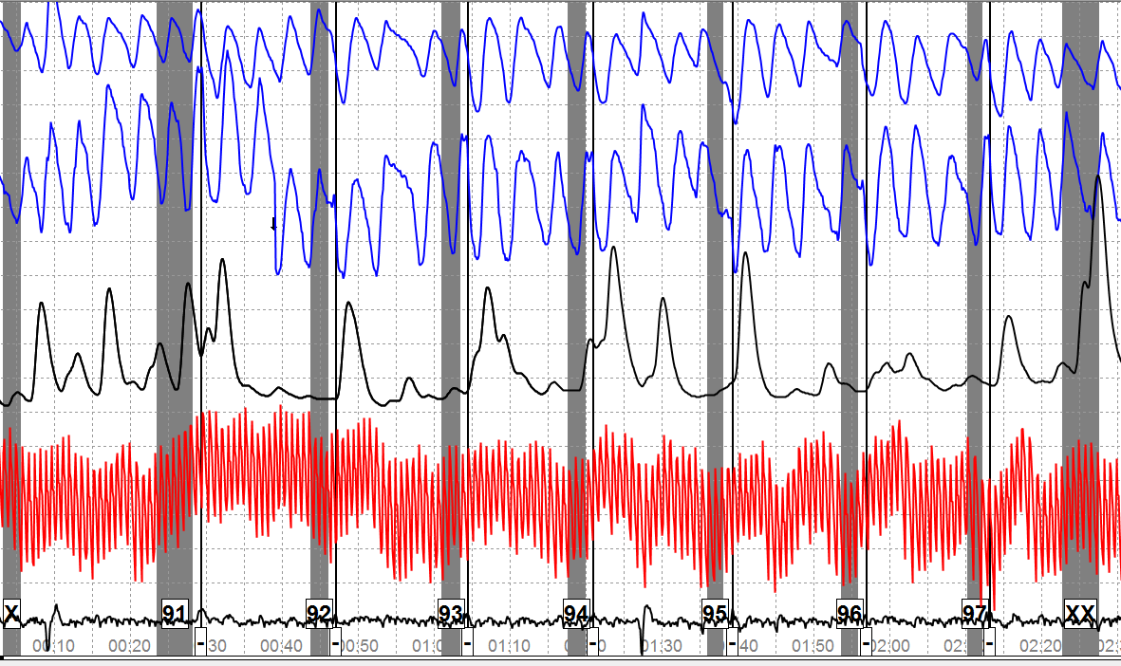
ACQT
Notes:
Note for the Instructor only (D!A5133) (APT – 05-133)
Do not present the below information to the class
This case came from Andy Dollins confirmed NDI cases that we reviewed in the CM Certification material.
5 called this NSR (Dan & Stu among the NDI calls) – 2 called it CM – 2 called it NO
The SCR folks called it NO
Go through the charts then discuss the results.

Slide 3
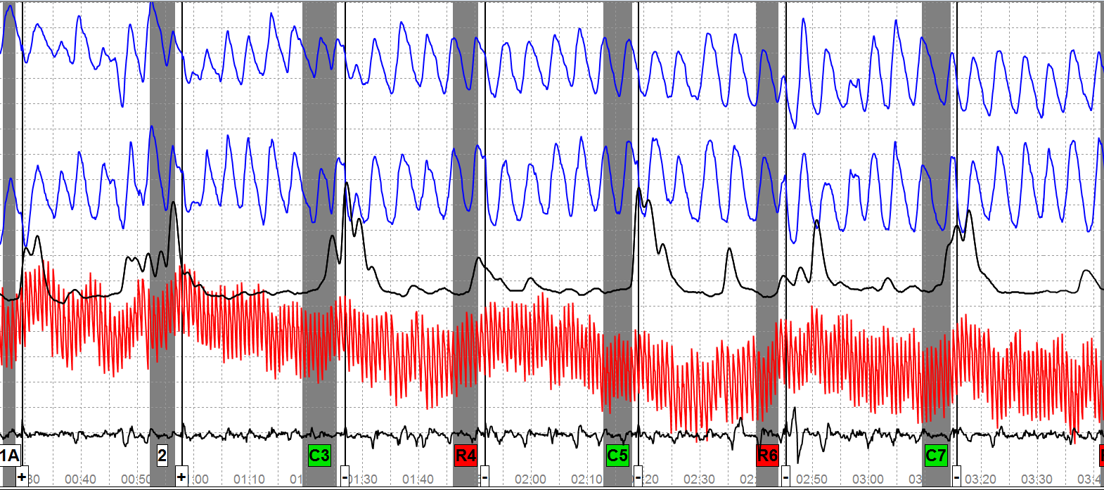
Case 1 – Chart 1(1st half)
Notes:
This is chart 1 – first half of a LEPET exam – Security exam
R4 – Engaged in espionage or sabotage
R6 – Intentionally mishandled any classified information
R8 – Any unauthorized foreign contact
R10 – Involved in any terrorist or subversive activity
PLCQ exam
Type of person who would do anything that would cause me to question your honesty or integrity?
Type of person who would lie to cover up for someone else’s actions?
Type of person who would lie on any official document?
Type of person who would lie to avoid taking responsibility for your own actions?
Type of person who would lie to anyone who trusts you?
5 comparisons & 4 relevants = imbalanced test
Do you see anything that is atypical?
NDI non-CM test – No ground truth

Slide 4
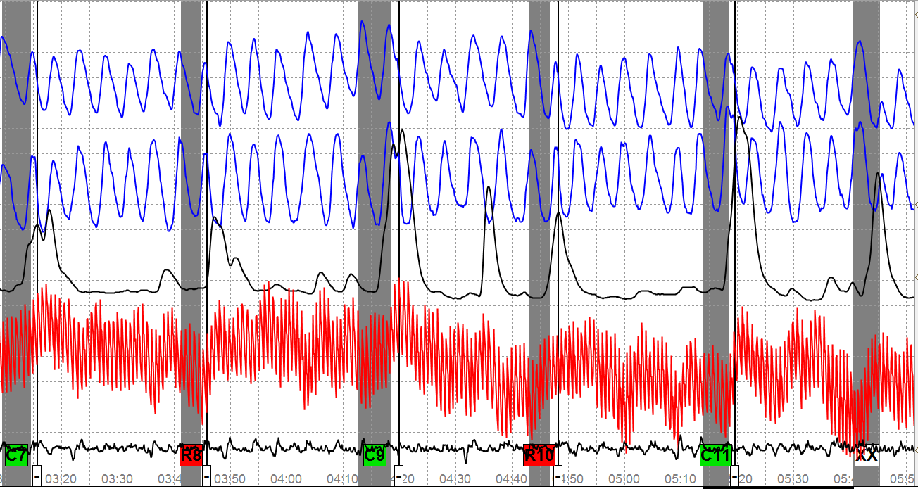
Case 1 – Chart 1 (2nd half)
Notes:
Do you see anything atypical?
Discuss

Slide 5
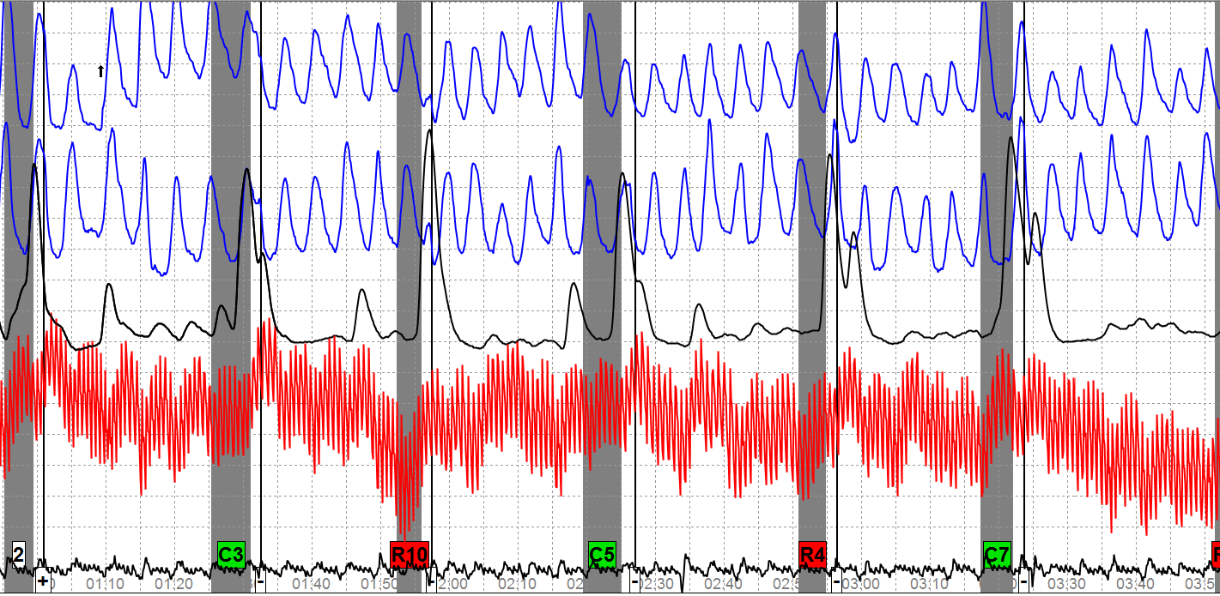
Case 1 – Chart 2 (1st half)
Notes:
Do you see anything that would indicate CM taking place?

Slide 6
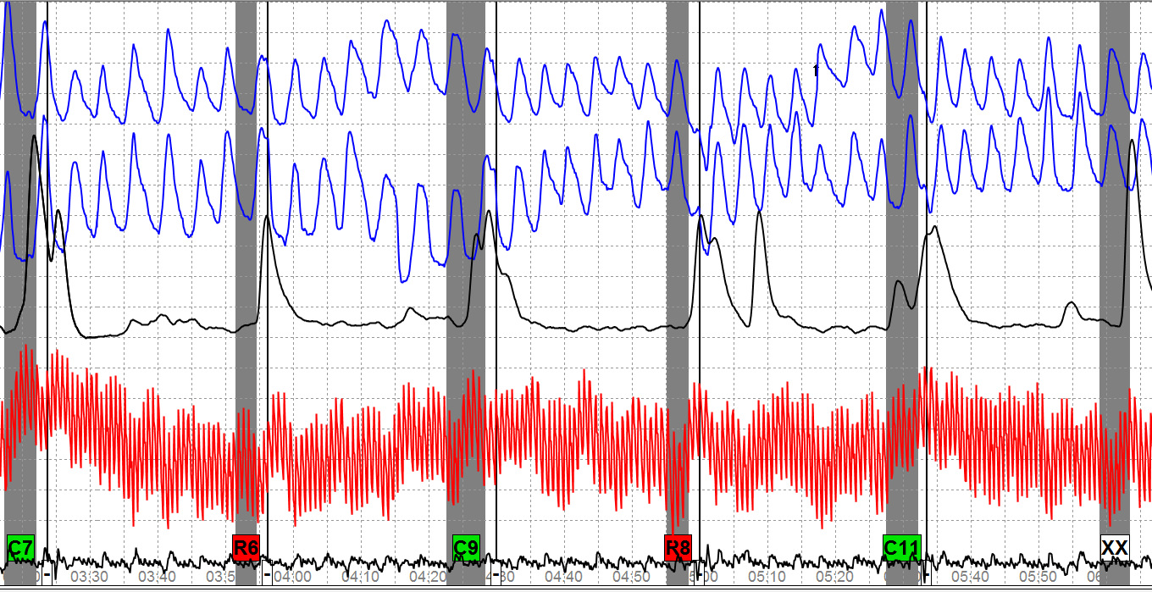
Case 1 – Chart 2 (2nd half)
Notes:
Do you see anything atypical?
Do you see frequency and specificity?
Do you see clusters of behavior?

Slide 7
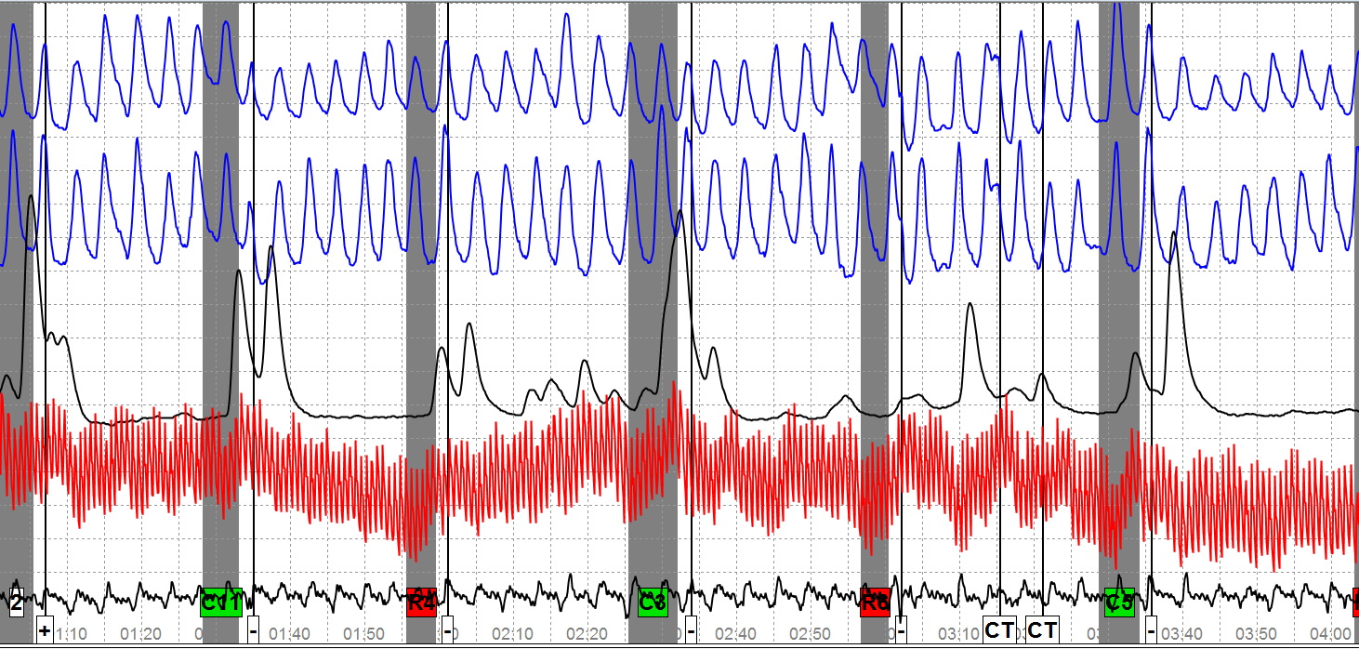
Case 1 – Chart 3 (1st half)
Notes:
Do you see anything atypical?

Slide 8
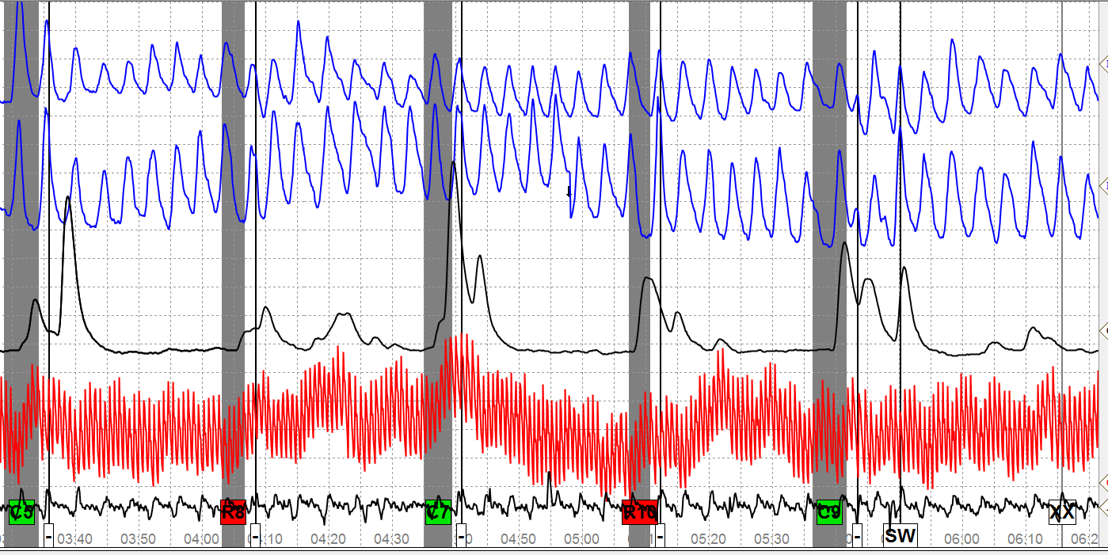
Case 1 – Chart 3 (2nd half)
Notes:
This concludes the third chart
Make a decision – CM or No CM?
This is an NDI case with no suspected CM – Ground truth is not known for sure since this is a field exam.
The problem is that the PN channels are not stable. There is no specificity
The other test data – EDA & CV channels are fairly clean and are timely to the applied stimulus.
This is a reminder that CM identification is not necessarily easy – It also should reveal the importance of being inquisitive. If you suspect CM then probe.
Since examinee’s PN channels were not stable – one of the charts could have been a “silent answer” to see if the PNs cleaned up.

Slide 9
Case 2
Review the test data
Be ready to discuss your decision
Notes:
Note to Instructors – This is an NDI case that was part of Andy Dollins CM Certification exams.
D!A6040 (APT-06-040)
Controlled breathing – about 8 CPM
MV in sensor pad at C3 on chart 1 and C2 on chart 2
5 called this an NDI case (Dan & Stu made an NDI call) – 3 called it CM – 1 called it NO
SCR called this a NO case
___________________________________________________________
Have students review the test data and at the end make a decision as to whether CM or no CM.

Slide 10
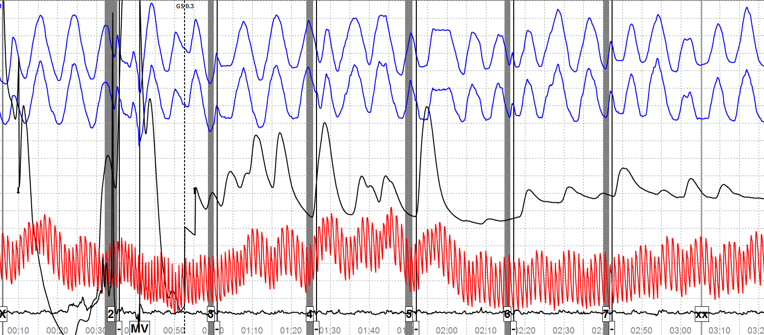
Case 2 - ACQT
Notes:
Do you see anything in the physiology that appears atypical?
If you see something – Is it deliberate?

Slide 11
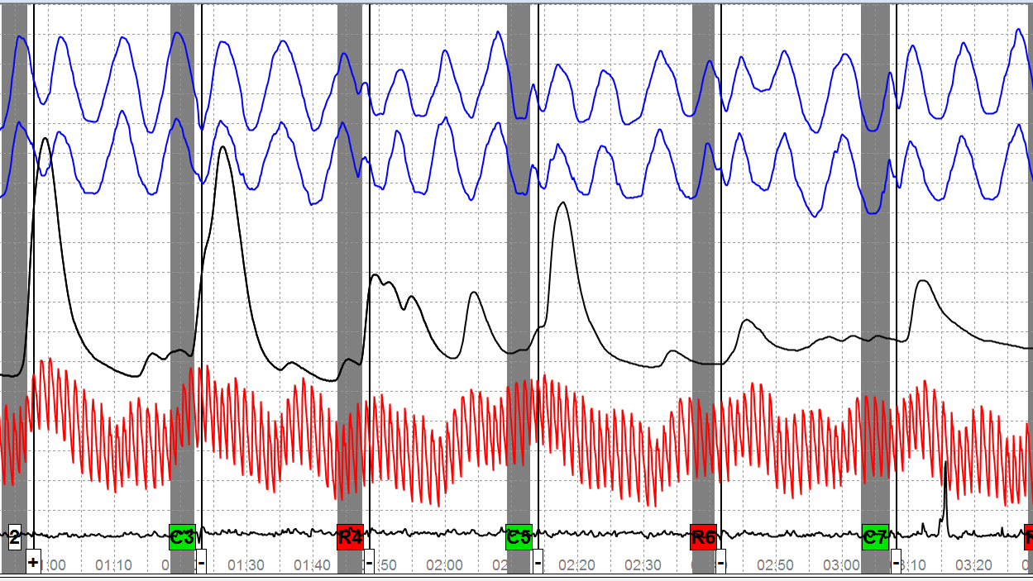
Case 2 – Chart 1 (1st half)

Slide 12
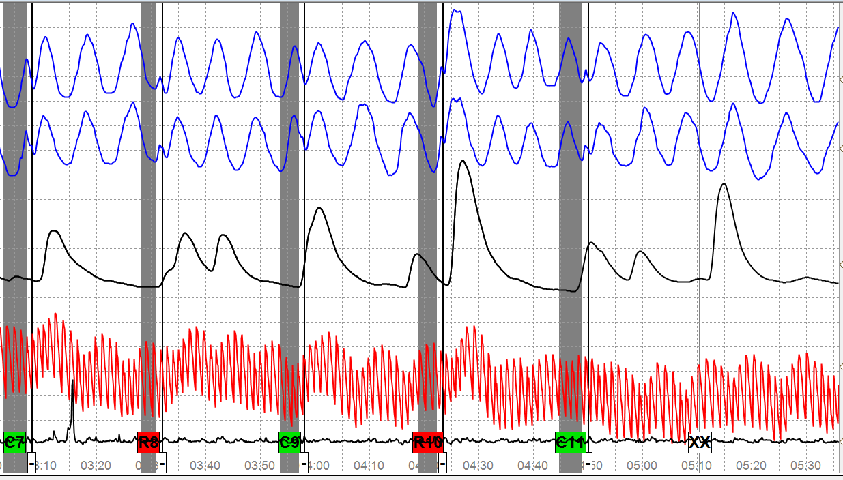
Case 2 – Chart 1 (2nd half)

Slide 13
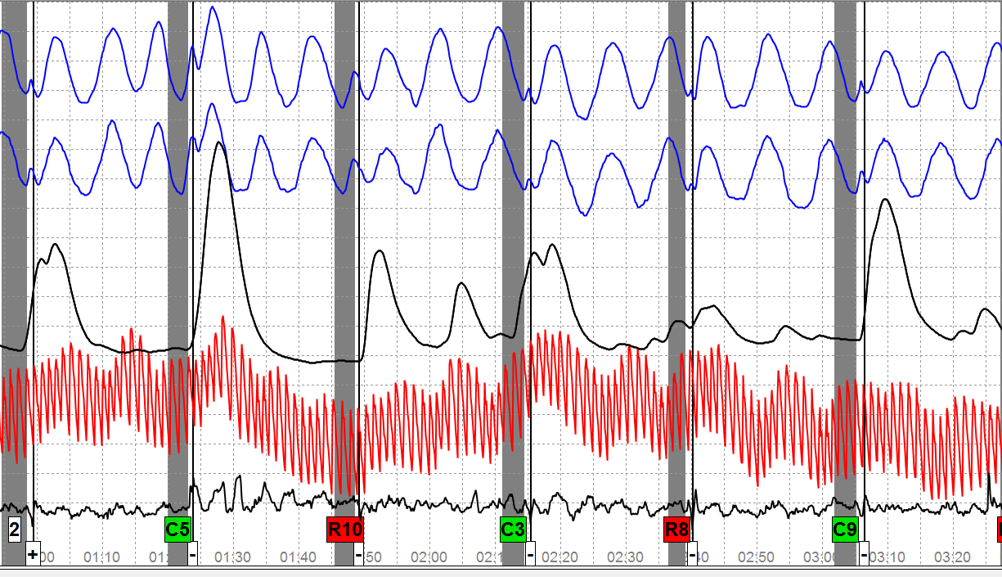
Case 2 – Chart 2 (1st half)

Slide 14
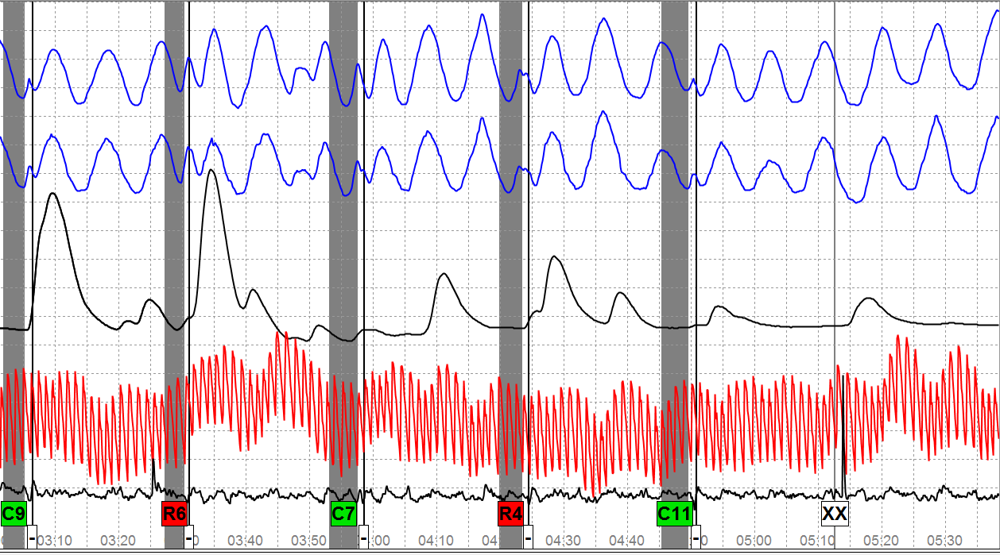
Case 2 – Chart 2 (2nd half)

Slide 15
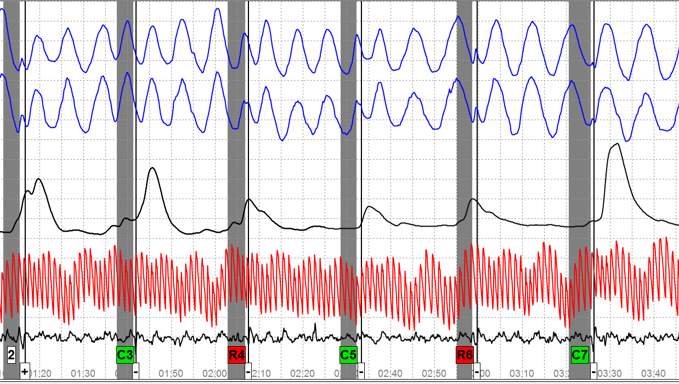
Case 2 – Chart 3 (1st half)

Slide 16
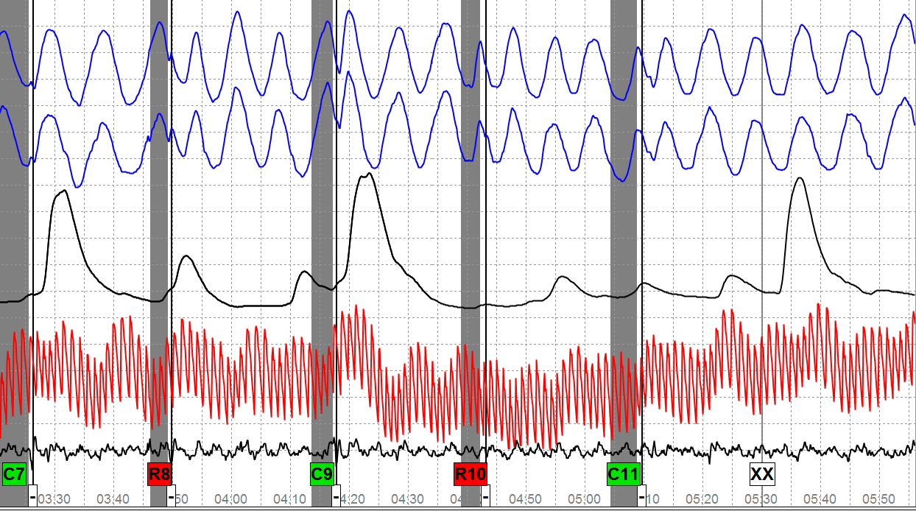
Case 2 – Chart 3 (2nd half)
Notes:
Make a determination – CM or no CM?
NDI case – Security screening – LEPET using PLCQs

Slide 17
Case 3
Selected charts
CM discussion
Notes:
We will not go through all of the charts in this case study
Series 1 – Is LEPET format using DLCQs – it contains suitability questions.
Series 2 is a breakdown test on the drug question.
Series 3 is another breakdown test on the drug question.
Review the selected test data – do you see CM?

Slide 18
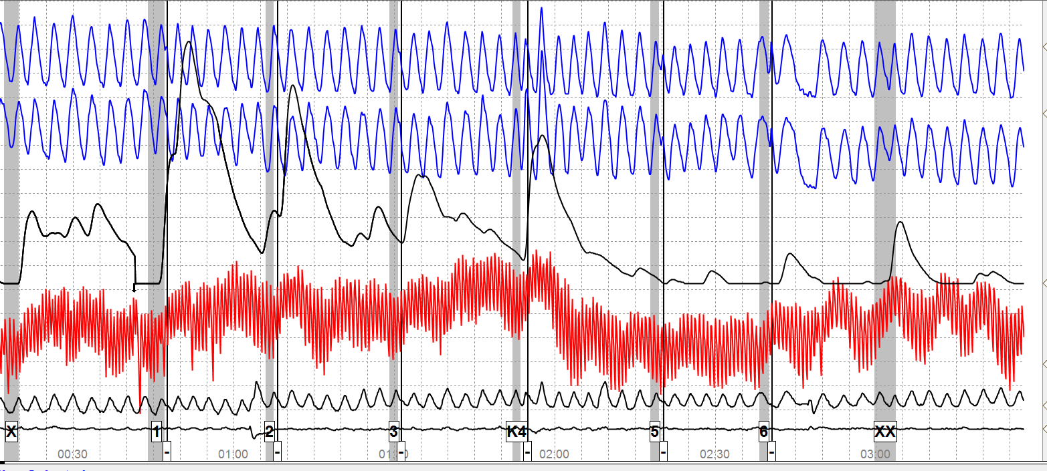
Case 3 - ACQT
Notes:
The PN channels are clean but the baseline is not stable.
There is a peak at the key in the PN, EDA & CV channels.
At the bottom the first black tracing is the seat pad and it is picking up examinee’s breathing.
The second tracing is the foot pad and it is set at 10 SU.
Do you see anything atypical?

Slide 19
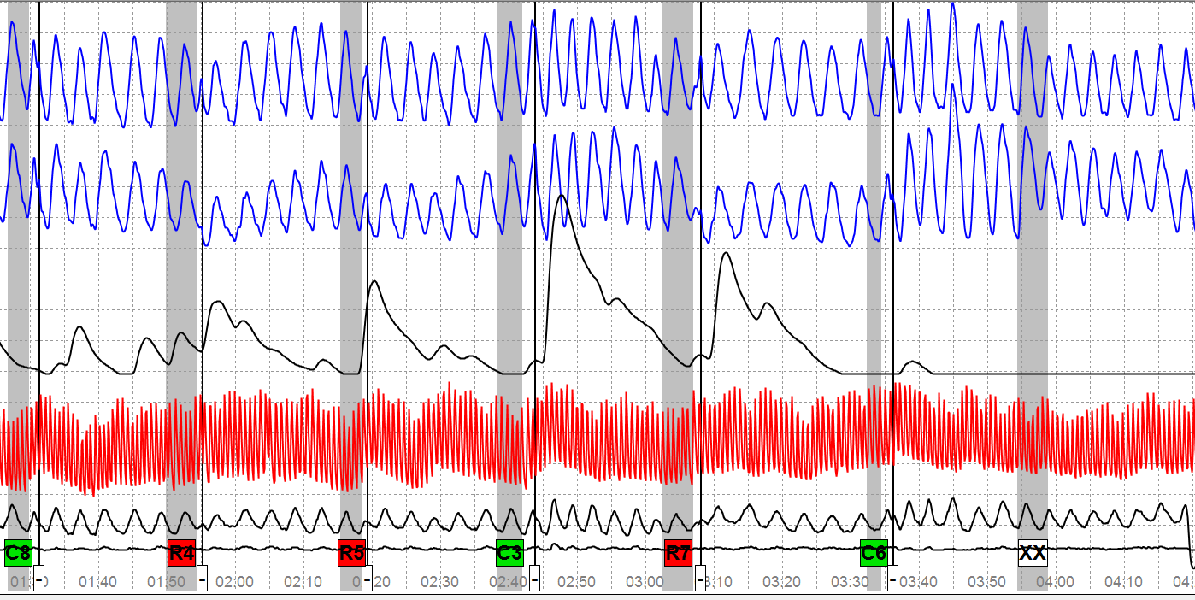
Case 3 – Series 1 – Chart 3
Notes:
Only 3rd chart on 1st series shown. What do you think? Do you see atypical physiology?
Examinee denied performing CM on this first series. Do you think there are other reasons why the atypical physiology shown might appear during a polygraph – especially when DLCQs are being used?

Slide 20
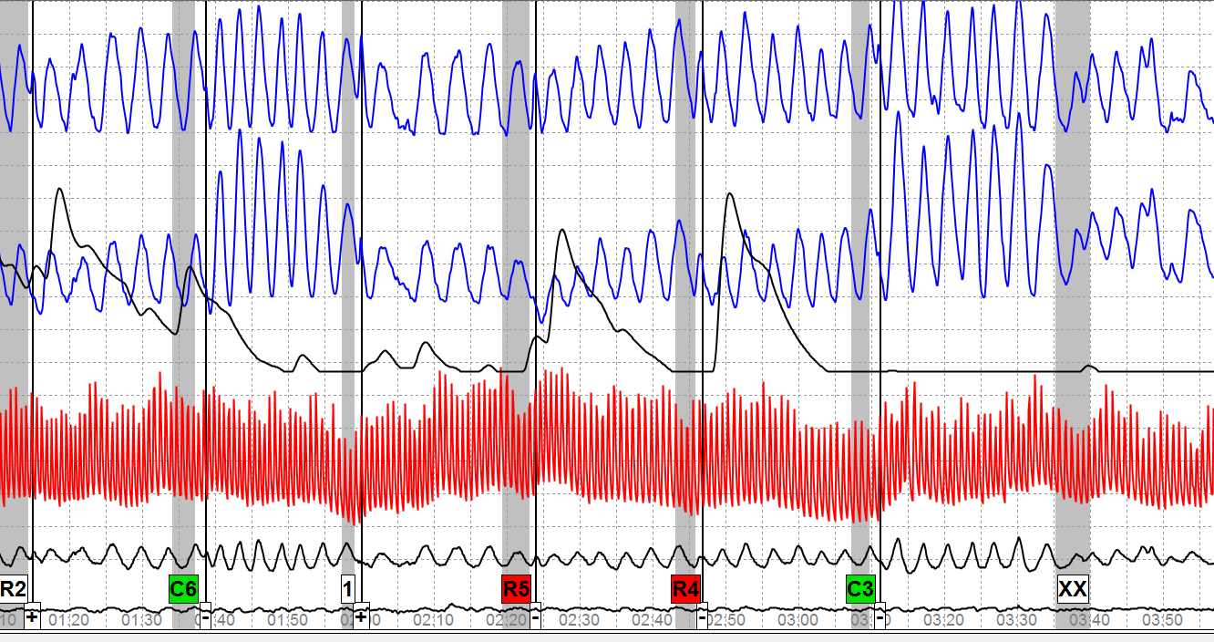
Case 3 – Series 2 – Chart 2
Notes:
This is the first breakdown series on possession of illegal drugs – still using DLCQs.
Do you think the test data looks atypical?
During the pretest the ‘examinee’ asked if it would be helpful to envision or replay the incident for which he was lying about (DLCQ) when asked the questions. The examiner told him that when he heard the question he was to simply hear the question and lie by answering no.
During the post test examinee advised he took deeper breaths to help him through the test. He denied researching CM & denied lying about the relevant issues. [He was told to stop the action]

Slide 21
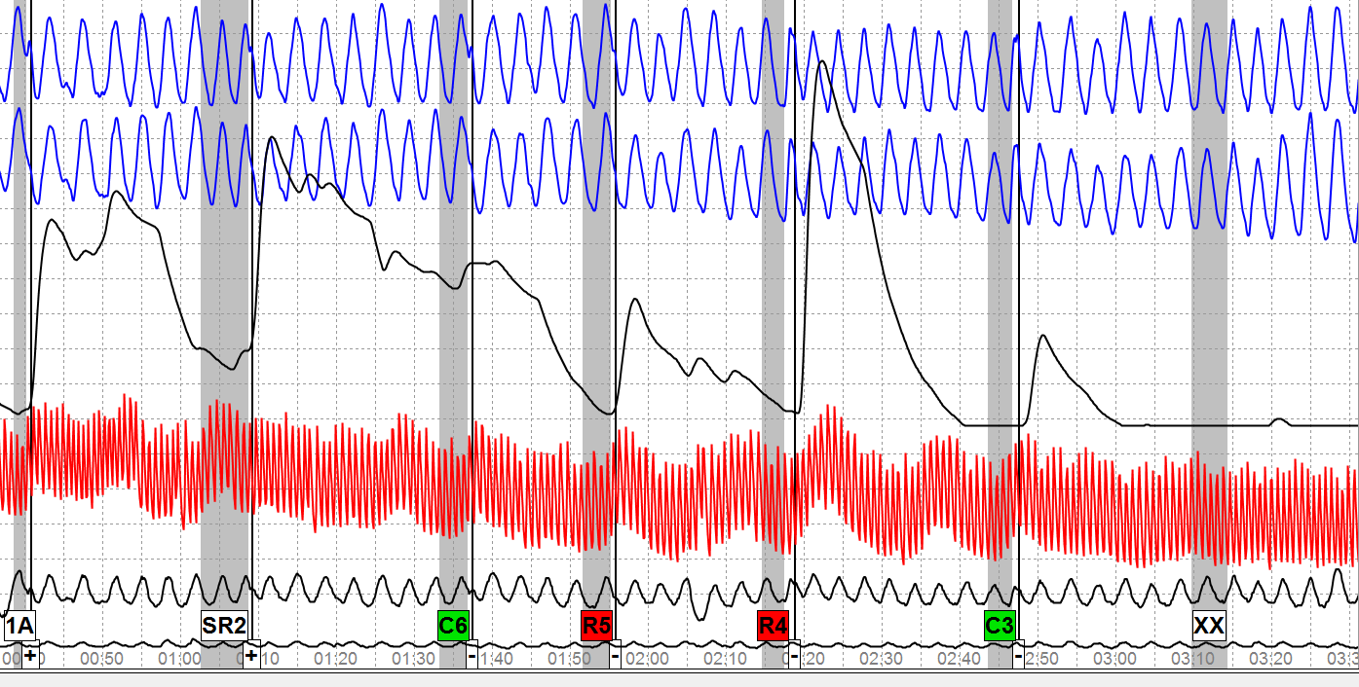
Case 3 – Series 3 – Chart 2
Notes:
Do you see anything atypical?
PN channels look clean – clear responses to the relevant questions.
During the 3rd post test interview the examinee denied attempting to manipulate his physiology because he was concerned that if he did it again the examiner would terminate the process.
He admitted that he smoked marijuana about 350 times, purchased small quantities of marijuana about 20 times, tried cocaine once, hallucinogenic mushrooms 3 times, and ecstasy once.
He deliberately performed CM on series 2 in an effort to hide his drug use.
He is telling us that Series I and Series 3 did not contain CM activity. Do you believe him?

