Slide 1
Case Review 1 LEPET
National Center for Credibility Assessment
Notes:
Tracing colors have been changed and the test data cleaned up to make it easier to evaluate.
The following charts contain test data from a screening examination containing four series.
Review the test data and consider the following:
Is this a good exam that can be evaluated?
Is this a nervous individual with messy physiology?
Is this an examinee intentionally performing CM?
__________________________________________________________
Case file # 175-802-20100213

Slide 2
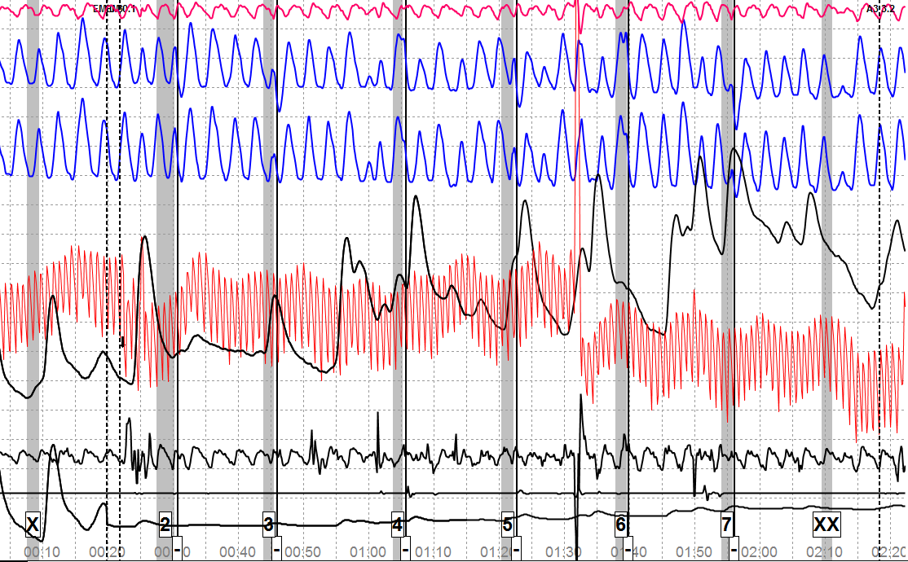
ACQT
Notes:
ACQT
Four MV sensors (3 at the bottom & one at the top)
The top is identified as (AU).
The bottom 3 starting with top to bottom is identified as (A2, A3, EM)
Consider identifying sensors (e.g., FT for foot sensor; SE for seat sensor; AR for arm sensor, etc.)
Do you see anything in the ACQT data that might raise a concern?
Define concern: Not indicating that CM activity is taking place but we do see MV in the A2 sensor and MV in the CV cuff area which takes place about 8 seconds after the key is answered.

Slide 3
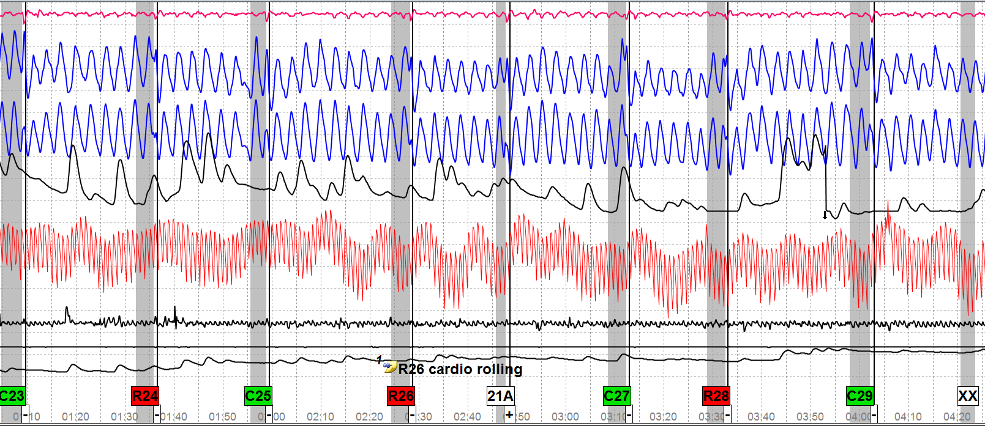
Chart 2-1
Notes:
What are your thoughts on the test data?
Do you see anything that indicates CM activity?

Slide 4
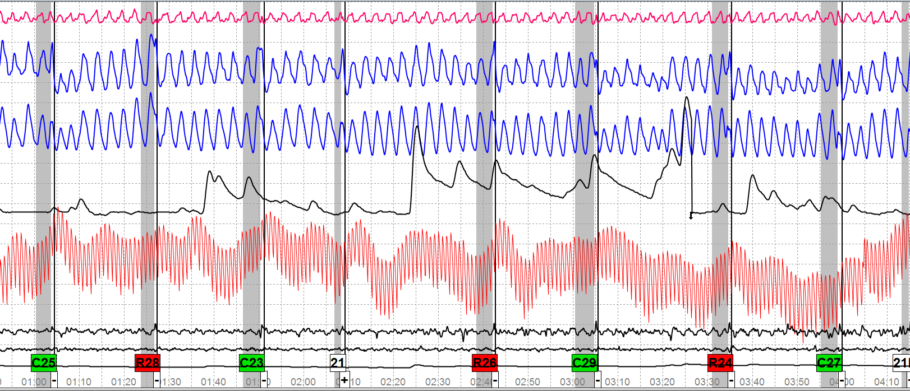
Chart 2-2
Notes:
Do you see anything in the test data to indicate CM activity?
In reality – wouldn’t you numerically evaluate the test data?

Slide 5
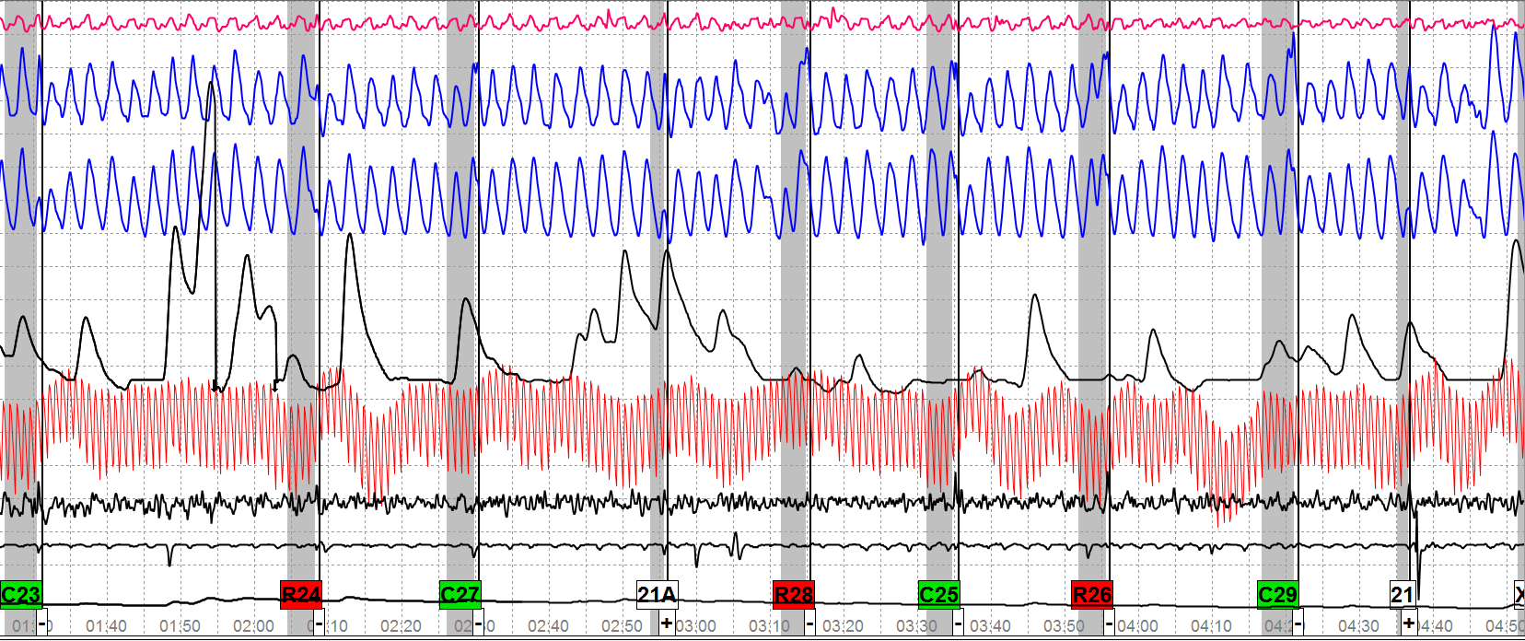
Chart 2-3
Notes:
Do you see any atypical physiology in this test data?
Do you think the MV in the A2 sensor at 21A & 21 is random or a deliberate attack at those questions? Why? Why not?

Slide 6
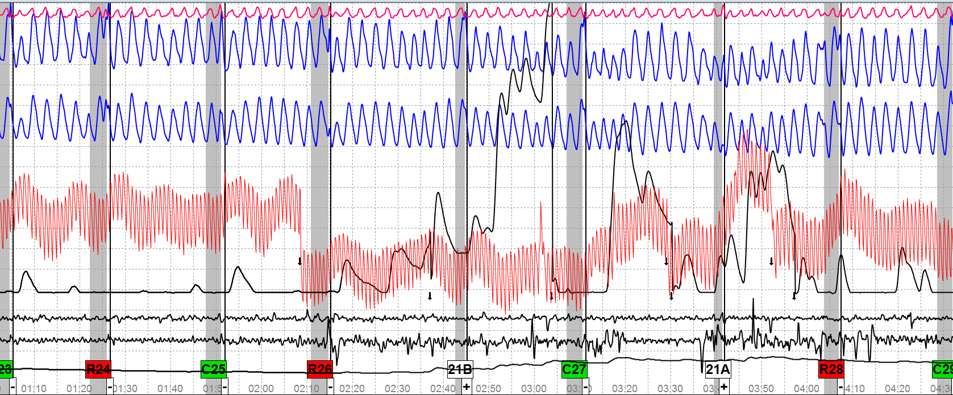
Chart 2-4
Notes:
This is the last chart in the first series
I could not get the last comparison question on the chart but it had a smaller EDA & CV so if you are going to numerically evaluate go against C27.
What are your thoughts? Do you think we have a CM case? Why? Why not?
Reality: If you were in the field and had this data what you do?
R24 is the most salient (-4) with R26 being (+1) and R28 (+5).

Slide 7
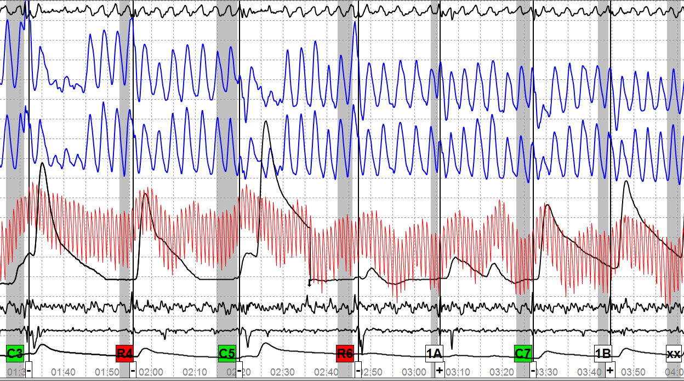
Chart 3-1
Notes:
Breakdown test on serious crime and drugs (clean copy did not have the test questions)
Do you see anything different in this test data that was not present in the first series?
What approach would you take at this time?

Slide 8
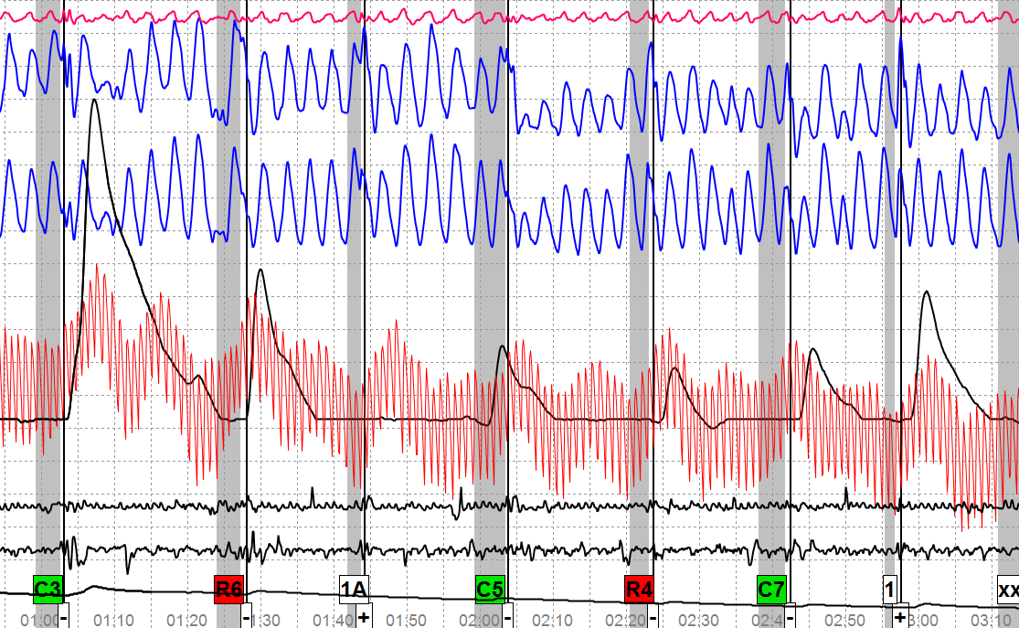
Chart 3-2
Notes:
What is your opinion of this second chart in the second series?
Do you see anything that you might consider atypical?

Slide 9
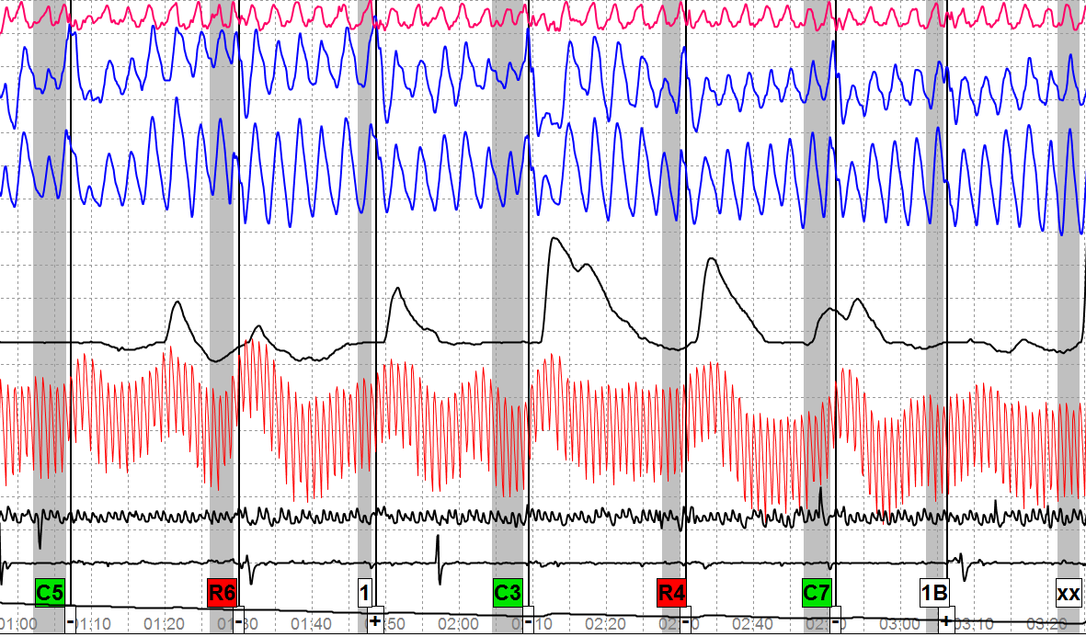
Chart 3-3
Notes:
This completes the second series. Have you drawn an opinion? What is it?
What would you do at this point?

Slide 10
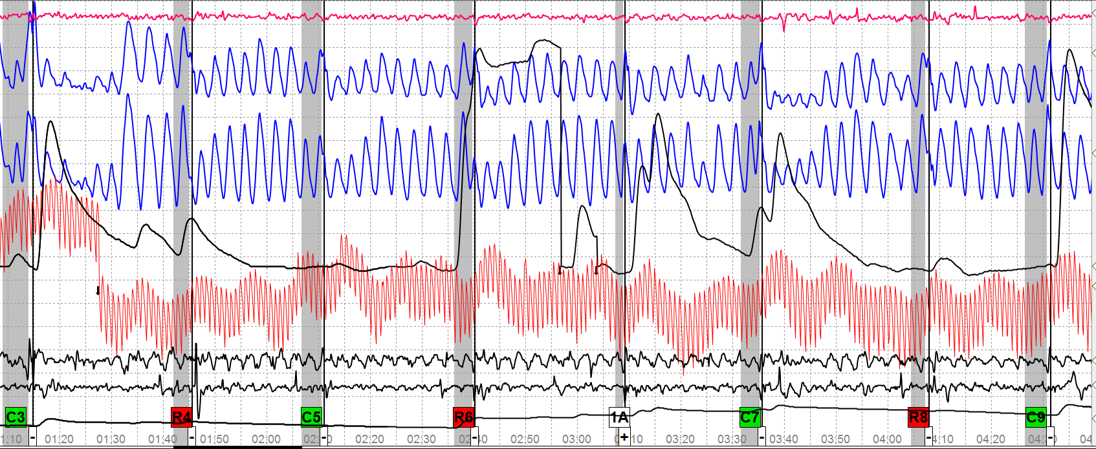
Chart 4-1
Notes:
Series 3 - What are your thoughts on the first chart?

Slide 11
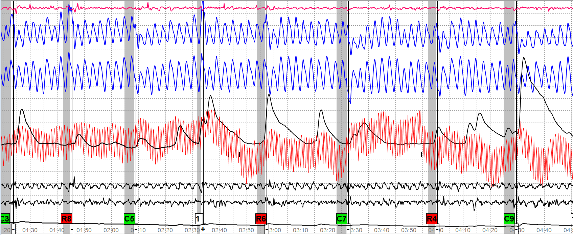
Chart 4-2
Notes:
Do you see anything on this chart that you would consider atypical physiology?

Slide 12
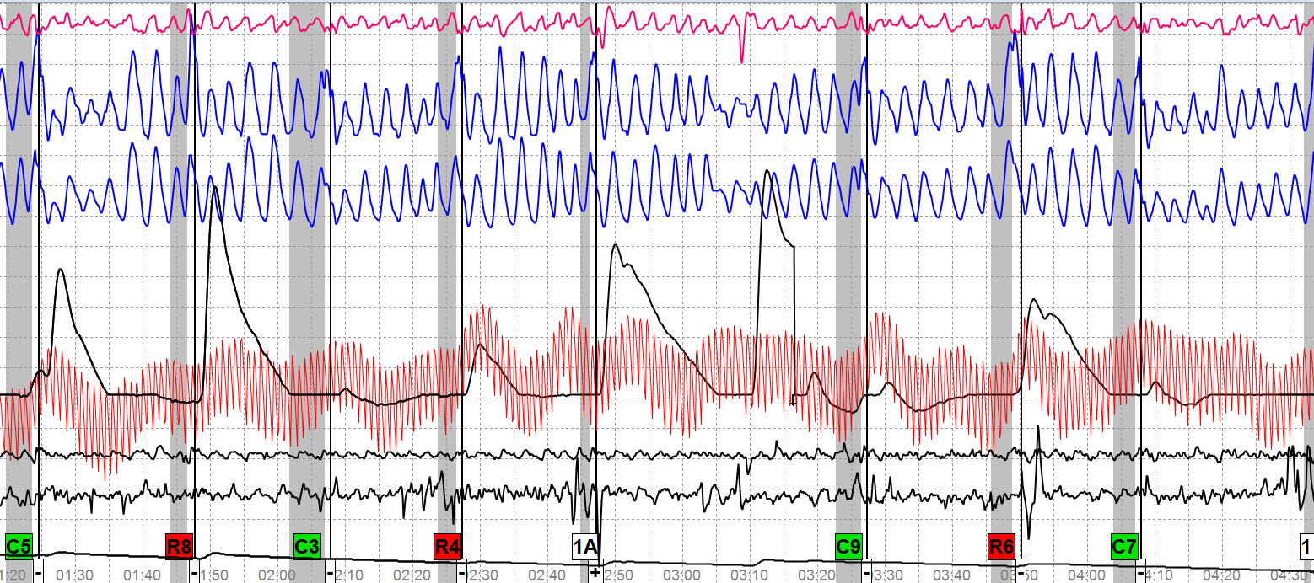
Chart 4-3
Notes:
Do you see anything in the test data that appears atypical?

Slide 13
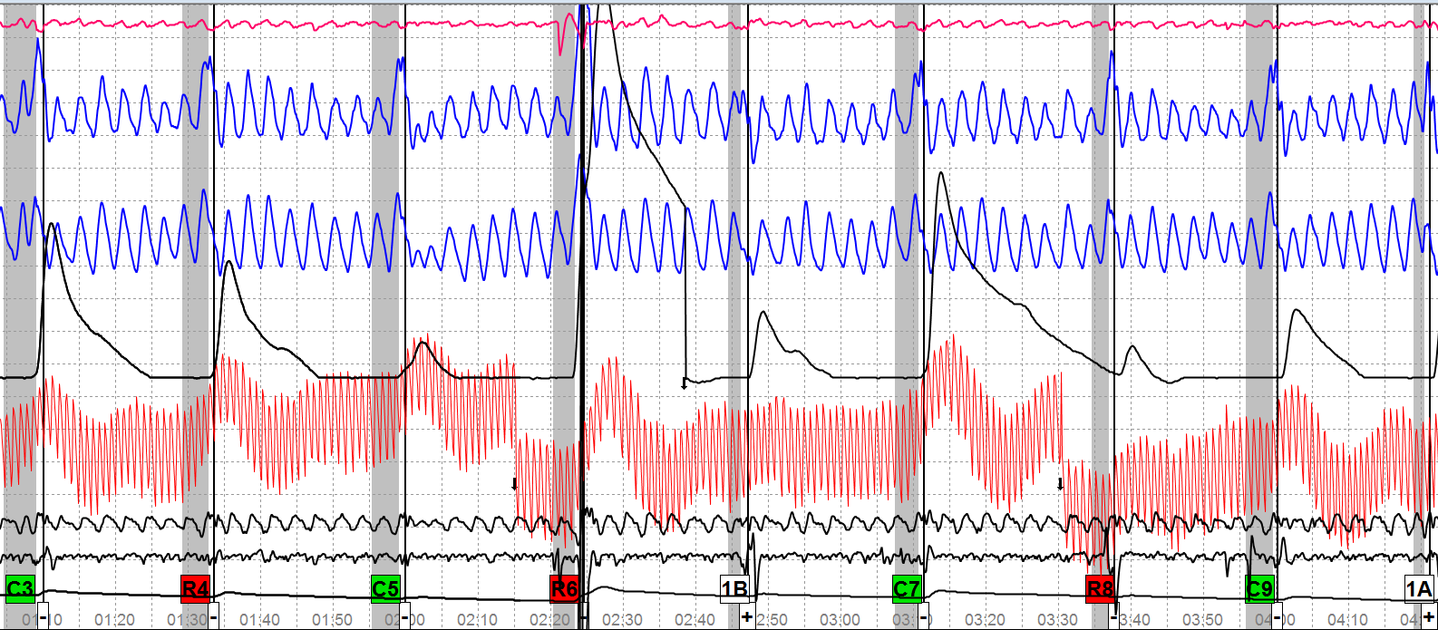
Chart 4-4
Notes:
Now what is your decision?
What would you do next?

Slide 14
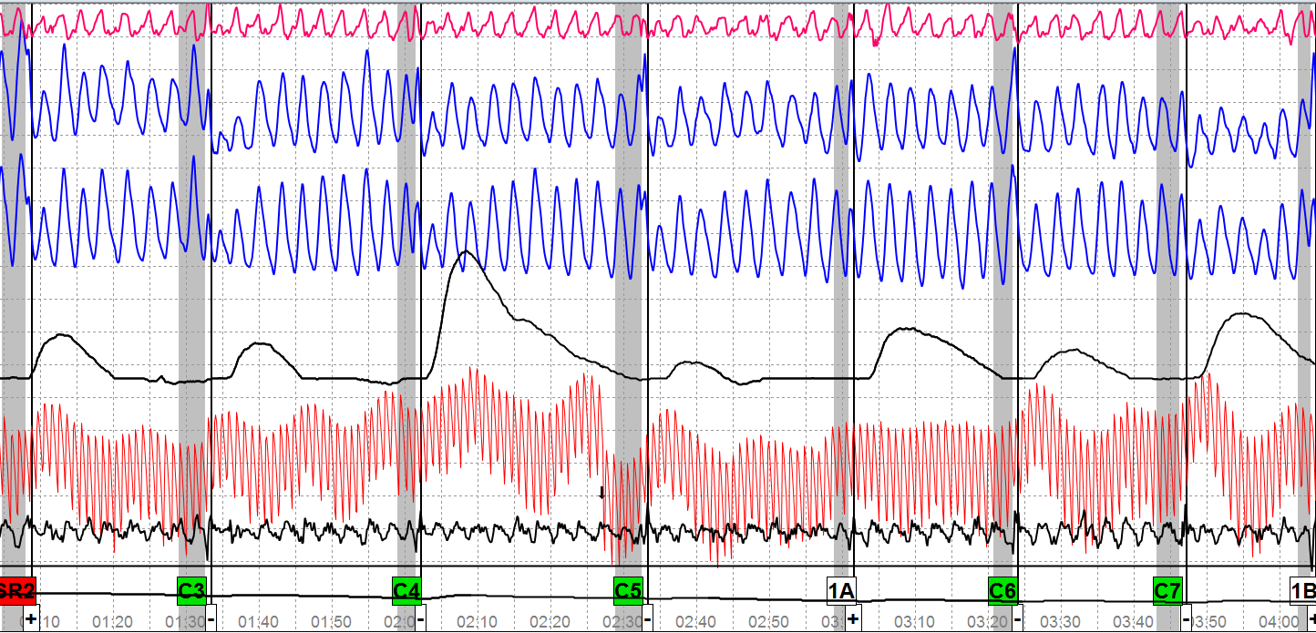
Chart 5-1
Notes:
Asked only comparison questions
Do you see anything that you would consider atypical?
If not – what do you do next?

Slide 15
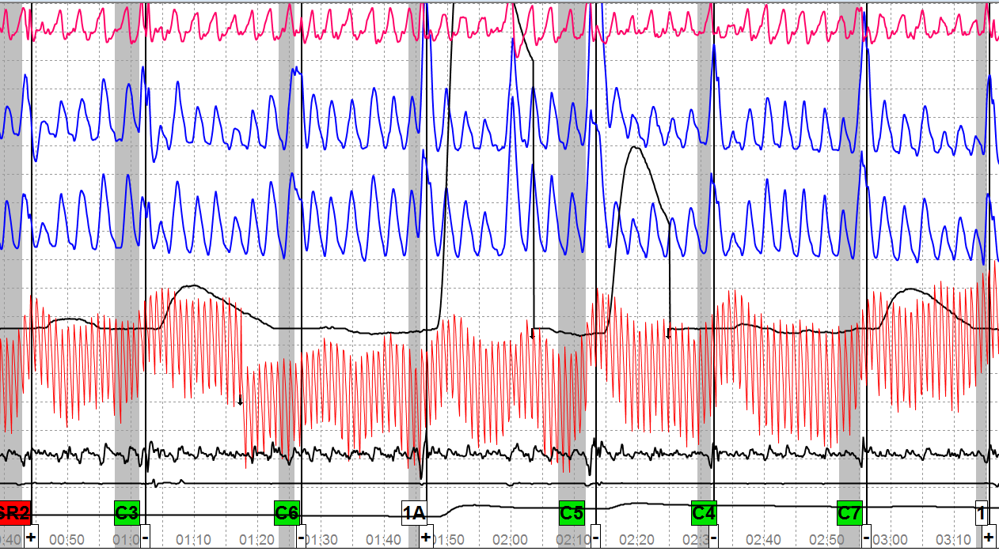
Chart 5-2
Notes:
Now what?
Make a final decision

Slide 16
Case Review 1 The Rest of the Story
Internet - Site with black background & red lettering
Mental CM – Spelled words & sang songs during exam
Tightened muscles in feet, MV hands
Altered breathing
Notes:
175-802-20100213
Examinee made the following post test admissions:
"He took useless information, used it and embarrassed himself"
He went to an internet site, name unknown but remembers it had a black background with red lettering
He made body movements and used psychological means to improve his chance of passing the test.
He spelled words in his head and sang songs during the exam.
He tightened muscles in his feet, moved both hands, and intentionally altered his breathing patterns.
In closing, his statement reads, "I grew up in a healthy household and with caring parents. I have always been taught to take responsibility for my actions, and by making this statement I am doing just that. I'd really appreciate a second chance on becoming an employee of the USSS, because I could do a lot of good things for the government."

