Slide 1
Agenda
Sign in Sheet/Registration
The “signatures”
New Examiner’s Handbook
Current Cases
Demonstrate pREVIEW

Slide 2
Types of Cms
1.
2.
3.
4.

Slide 3
Types of Cms
1. Physical
2. Mental
3. Pharmacological
4. Behavioral

Slide 4
Atypical Tracings
Review of criteria
All examples are from confirmed cases
No silver bullets…yet!
Examinee’s intent may not have been to produce the actual outcome!

Slide 5
The Key
What is the key to CM identification?
A_________ P _________
F _________
S _________
C _________
Notes:
What is the key to CM features?
Frequency – How often does the activity happen.
Specificity – Where is it happening
Clusters – Do you see multiple features during the examination process.
Now what? The next phase of this class is to provide real world examples.

Slide 6
The Key
What is the key to CM identification?
Atypical Physiology
Frequency
Specificity
Clusters
Notes:
What is the key to CM features?
Frequency – How often does the activity happen.
Specificity – Where is it happening
Clusters – Do you see multiple features during the examination process.
Now what? The next phase of this class is to provide real world examples.

Slide 7
Pneumograph
Notes:
Definition:
An apnea is the ultimate manifestation of respiratory suppression and appears almost exclusively at the bottom of the respiratory cycle.
When the apnea occurs at the top or middle of the inhalation they are indicative of deliberate manipulation of respiration.
If apnea appears at the bottom of the exhalation tracing on all comparison questions consider CM activity.
Apneas sometimes have sudden onsets, but instant recoveries should be viewed with caution.
True apneas are frequently observed at the relevant questions, but are elicited far less often for comparison questions.
One way to discern true from false apneas is whether the trailing respiratory recovery is gradual or immediate.

Slide 8
False Apnea
True apnea (blocking) is rare. Occurs more often at RQs than at CQs.
High frequency of blocking at CQs may indicate CM activity.
False apnea (holding) occurs at other than the bottom of the tracing.
May have unnatural recovery.
Notes:
Definition:
An apnea is the ultimate manifestation of respiratory suppression and appears almost exclusively at the bottom of the respiratory cycle.
When the apnea occurs at the top or middle of the inhalation, it may be indicative of deliberate manipulation of respiration.
If apnea appears at the bottom of the exhalation tracing on several comparison questions, consider CM activity.
Apneas sometimes have sudden onsets, but instant recoveries should be viewed with caution.
True apneas are frequently observed at the relevant questions, but are elicited far less often for comparison questions.
One way to discern true from false apneas is whether the trailing respiratory recovery is gradual or immediate.

Slide 9
True Apnea
Rare! Why?
More often seen at RQs than at CQs.
High frequency at CQs may indicate Cms.

Slide 10
False Apnea
Baseline
Baseline

Slide 11
False Apnea

Slide 12
False Apnea

Slide 13
Exaggerated Exhalation Cycle
Similar to false apnea
One cycle of drawn-out exhalation
Often falling below the baseline
May be followed by a single DB
Notes:
Some of the previous slides contained at least one channel of “exaggerated exhalation”.
We will sometimes see in a true response a rate change where after the answer breathing slows for several cycles.
Exaggerated exhalation is considered false apnea because after the answer there is a sharp or drawn out exhalation followed by an immediate return to a deep breath and/or normal breathing.

Slide 14
Exaggerated Exhalation Cycle
Notes:
Left slide: Exaggerated exhalation cycle falling below the baseline. The upper pneumo moves up with a deep breath. Both channels form a new baseline.
Right Slide: This CM is a toe press. Note the lower pneumo channel falling well below the baseline.

Slide 15
Exaggerated Exhalation Cycle
Notes:
Left Slide: Note that the exhalation of the pneumograph channel at the comparison question and the relevant question is similar. Additionally, the exhalation cycle does not fall below the baseline.
If the sensor cushion were not present it would be difficult to make a CM determination based on this specific criterion.
Note the “answer-like distortions.
Right Slide: The exaggerated exhalation falls below the baseline in the upper pneumo channel of both comparison questions with false apnea in the lower pneumo channels. Note the sharp cardio at both comparison questions.

Slide 16
Hyperventilation—Two Types
90% breathe 10 to 23 cycles/minute.
Gauge normal breathing rate by…?
20% faster is an indication.
Significant amplitude increase also indicative of hyperventilation.
Notes:
A global analysis is required to determine why hyperventilation is occurring.
On a DLC exam hyperventilation in the form of increased amplitude may be the result of DLC breathing; however, it could also be the result of CM activity.
If it occurs only at the comparison questions in a PLC format it is CM activity.
If it appears throughout an exam it might be CM activity, but it might also be that examinee is hiding a relevant or comparison question issue.

Slide 17
Hyperventilation
~30 cycles/minute

Slide 18
Hyperventilation
Notes:
This is an example of increased amplitude at the comparison question.
If occurring at all of the comparison questions in a Directed Lie test this could be DLC breathing or CM activity. (Discuss).
If this activity only occurred at the comparison questions during a PLC exam consider CM activity.

Slide 19
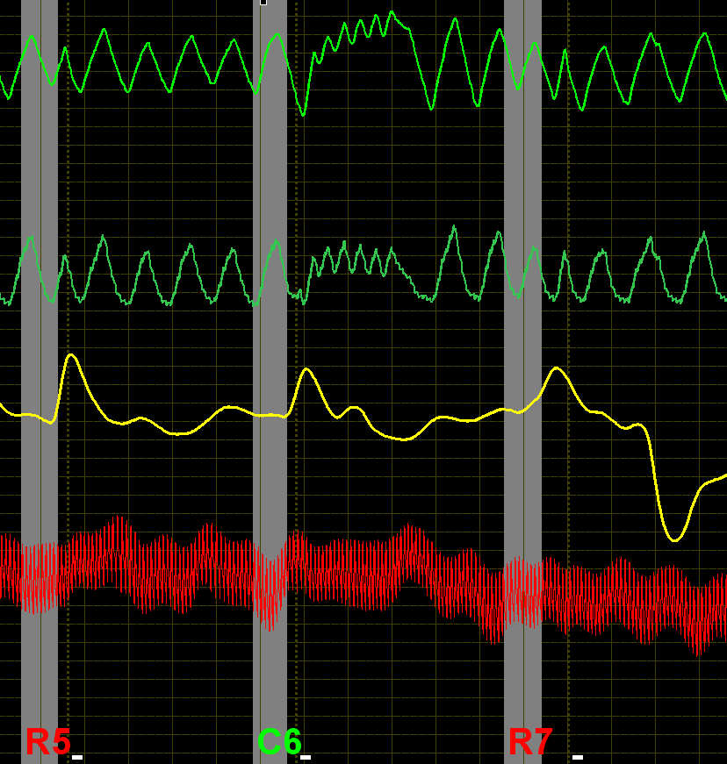
Hyperventilation
Notes:
Left Slide: Hyperventilation in the pneumos. Change of baseline in the pneumos.
Right Slide: Hyperventilation in the pneumo with baseline change. Tachycardia, prolonged response, and late secondary cardio.

Slide 20
Misplaced or Multiple Answer-Like Distortions
Answer distortion normally on exhalation side.
Should be timely and accurately marked!
Look for answer with immediate inhalation depicting a crown or horns.
May also see sharp increase in blood volume.
Notes:
The answer distortion is normally located anywhere on the exhalation stroke from the top of the cycle to the bottom of the cycle.
The answer distortion should line up with the answer mark on the polygraph chart. The answer should be timely with all the other answers throughout the exam.
The depiction of the crown or horns may be an indicator of CM activity. Once again must look globally. If occurring at all or most of the questions (Irrelevant, relevant & comparison) it may be normal activity. If only occurring at the comparison questions or irrelevant questions if identified as comparisons then suspect. Additionally, if the crown appears more than once across the asking it is suspect.
If the pneumo activity is accompanied by a sharp increase in cardio activity particularly with a secondary rise in the cardiograph – suspect.

Slide 21
Misplaced or Multiple Answer-Like Distortions

Slide 22
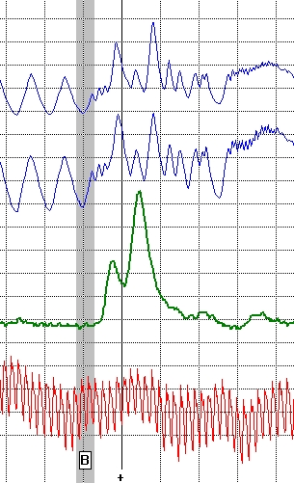
Misplaced or Multiple Answer-Like Distortions

Slide 23
Loss of Parallelism
Diverging or converging
Slight or exaggerated
Usually accompanied by other signatures

Slide 24
Loss of Parallelism

Slide 25
Loss of Parallelism

Slide 26
New Permanent Baseline
Unexplainable shift in baseline up or down
Normally at comparison questions
Can be dramatic or subtle
Notes:
It is important that the pneumograph tubes be properly placed on the examinee. A stable tracing is usually necessary.
In a PLC format will normally occur at the comparison questions. Sometimes the examinee will be confused and it will occur at relevant questions.
Sometimes will occur at Irrelevant questions if they have been pretested as control questions.
The permanent change need not be dramatic. A subtle change can be suspect, particularly if it occurs on more than one comparison question.

Slide 27
New Permanent Baseline
Notes:
Left Slide: Note the upper pneumo rises forming a new permanent baseline. Note the strong cardio response at the R2 question.
Right Slide: The reason for this slide is to show that it is difficult to label something a change of baseline if the pneumos at each question are moving off the baseline.
It is interesting to note that the pneumos at 2C1 suppress and converge. At the same time there is answer-like distortions and some false apnea.
Connect the changes in the pneumo channels with the sharp cardio that is too good to be true.

Slide 28
New Permanent Baseline
Notes:
Left Slide: The pneumos converge at 2C2, but they also form a new permanent baseline.
Right Slide: The upper pneumo at C6 forms a new baseline. Note the crown at the answer.

Slide 29
Bradypnea
Resting respiration seldom below 10 breaths per minute
Rare exceptions
Observations
Notes:
Resting respiration rates seldom drop below 10 cycles per minute.
The rare exceptions are those with medical conditions, and a very small group of athletes.
Suspect respiration rates should be investigated with surreptitious observation of recording.
Slow respiration is not, in itself, a strong indication of CM. However, it should be discouraged due to the influence of respiration on the other physiological data channels.

Slide 30
Bradypnea
Notes:
As can be seen by the slide, the breathing is very slow, but there is still good response in the cardio at the relevant issue.

Slide 31
Review - Pneumos
Can you name the seven criteria?
Notes:
Link to “TDA April 2007.ppt”
Seven criteria are:
False Apnea, Exaggerated Exhalation, Hyperventilation, Misplaced/Multiple Answer-Like Distortions, Loss of Parallelism, New Permanent Baseline, Bradyapnea.

Slide 32
Electrodermal
Notes:
Latency refers to the period between stimulus onset and response onset.
The EDR may be observed rising from 0.5 seconds after stimulus onset up to 5 seconds after the examinee’s answer.
High within subject variability of latency is atypical of genuine phasic EDRs.

Slide 33
Labile EDR
Excessive electro-dermal activity
EDR often in constant motion
Responses frequently seen well after points of answer
Notes:
Latency refers to the period between stimulus onset and response onset.
The EDR may be observed rising from 0.5 seconds after stimulus onset up to 5 seconds after the examinee’s answer.
High within subject variability of latency is atypical of genuine phasic EDRs.

Slide 34
Labile EDR
Notes:
Left Slide: Exaggerated cardio with exaggerated secondary and tertiary blood volume response.
Note the pneumos changing baseline and the false apnea.
Right Slide: Not only a secondary blood volume response, but the pneumo has the crown effect and lifts off the baseline.

Slide 35
Inconsistent EDR Latency
Stimulus onset to Response onset
What is atypical?
Notes:
Latency refers to the period between stimulus onset and response onset.
The EDR may be observed rising from 0.5 seconds after stimulus onset up to 5 seconds after the examinee’s answer.
High within subject variability of latency is atypical of genuine phasic EDRs.

Slide 36
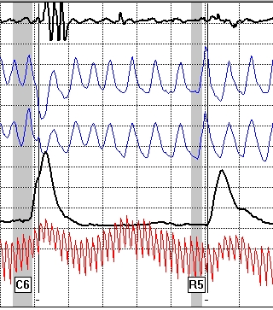
Inconsistent EDR Latency

Slide 37
Exaggerated EDRs
Globally out of proportion
Frequency
Notes:
Exaggerated EDRs are defined as those that globally are well out of proportion with the remaining EDRs, either in terms of amplitude or complexity.
Among truthful examinees, EDRs for comparison questions that have 5 times the amplitude of those adjoining relevant questions occur only about 4% of the time.
More than one of these rare EDRs per exam should be considered suspect.
Similarly, strong EDRs on irrelevant questions are atypical.
While complex responses in themselves are not uncommon, three or more rises are rare.

Slide 38
Exaggerated EDRs
Notes:
If the EDRs are cookie-cutter across the chart consider it suspect.
Note the matching cardio tracings.

Slide 39
Downward Spike of the EDR
EDR does not have parasympathetic innervations
Look for patterns

Slide 40
Downward Spike of the EDR
Notes:
Note the apnea at both comparison questions with strong cardio responses.
Question C10 has a downward spike in the EDA.

Slide 41
Review - EDA
Can you name the four criteria?
Notes:
Lability, Inconsistent Latency, Exaggerated Responses, Downward Spikes

Slide 42
Cardiovascular
Notes:
Rapid rises and prolonged duration of phasic blod volume (slow wave) responses are commonplace on relevant questions for deceptive examinees.
They are far less frequent on comparison questions regardless of examinee veracity.
They virtually never appear on other types of questions.
Dramatic blood volume reactions, except to relevant questions should be considered suspicious, and more so when they co-occur with respiratory and electrodermal manipulations.
They are often triggered by covert muscular contractions.
However, they have been observed during the use of mental CM activity.

Slide 43
Exaggerated Blood Volume Increase
Rapid rise and/or prolonged response duration
Common at RQs for DI examinees
Not common at comparison questions
Virtually non-existent at irrelevant questions
Notes:
Rapid rises and prolonged duration of phasic blod volume (slow wave) responses are commonplace on relevant questions for deceptive examinees.
They are far less frequent on comparison questions regardless of examinee veracity.
They virtually never appear on other types of questions.
Dramatic blood volume reactions, except to relevant questions should be considered suspicious, and more so when they co-occur with respiratory and electrodermal manipulations.
They are often triggered by covert muscular contractions.
However, they have been observed during the use of mental CM activity.

Slide 44
Exaggerated Blood Volume Increase
1. Slope/Angle
Notes:
Left Slide: Diverging pneumos, multiple EDRs, exaggerated blood volume increae.
Right Slide: Change of baseline in the lower pneumo, exaggerated blood volume increase that continues until the next question is asked.

Slide 45
Exaggerated Blood Volume Increase
1. Slope
2. Amplitude
3. Duration

Slide 46
Secondary Blood Volume Response
Sharp rise in cardio followed by a secondary rise
“Compound Cardio”
Notes:
When CM activity is being performed (toe press) the covert muscular contractions can cause a sharp rise in amplitude in the slow wave component of the cardiovascular tracing followed by a secondary rise.
This is suspect at comparison questions, but particularly so when it occurs at more than one comparison question during the same series.

Slide 47
Secondary Blood Volume Response

Slide 48
Secondary Blood Volume Response

Slide 49
Tachycardia or Bradycardia
Tonic pulse rates in excess of 100 BPM, or less than 60 BPM
Notes:
On many occasions, CM activity is accompanied by tachycardia.
Must review the entire exam. Also, any medications or illnesses.
Bradycardia (less than 60 BPM) often seen in long distance runners.
Must also consider medications, illnesses, drugs.
The key is to look for other CM signatures.

Slide 50
Tachycardia

Slide 51
Bradycardia
~24 c/m
~22 b/m

Slide 52
Inconsistent Cardiovascular Response Latency
Consistent with EDR latency
Contrast points of response onset of all CQs with all other question types
Look for inconsistency unique to the CQs
Notes:
As with EDR, latency refers to the period between stimulus onset and response onset.
Globally, an examinee’s response time is fairly consistent at each question asking.
If the rise time changes, particularly from one comparison question to another this is suspect.

Slide 53
Inconsistent Cardiovascular Response Latency
Notes:
Note the rise time difference between C6 and C4.
Possibly the result of mental activity being generated at different times to produce CM.

Slide 54
Review - Cardio
Can you name the five criteria?
Notes:
Exaggerated Responses, Compound Cardios (secondary responses), Tachycardia, Bradycardia, Inconsistent Respiratory Responses.

Slide 55
Other CM Signature Considerations
“Messy” test data containing erratic breathing, erratic EDA tracings, erratic “jumping” cardiograph tracings with a pulse rate over 100 BPM
Notes:
Obviously there are many reasons for messy tracings.
They can be the result of a poor pretest interview.
Messy tracings can be caused by an examinee that is guilty of the issue under investigation.
Messy tracings can be caused by someone who is ill and on certain cold medications.
Messy tracings can also be caused by examinee’s attempting CM activity.
If you have eliminated the possibility of a Poor pretest interview & whether examinee is ill that leaves two issues. Either examinee is guilty or performing CM activity or guilty and performing CM activity.
There is no reason to continue with collecting test data when such activity is taking place. A good post test interview is required.

Slide 56
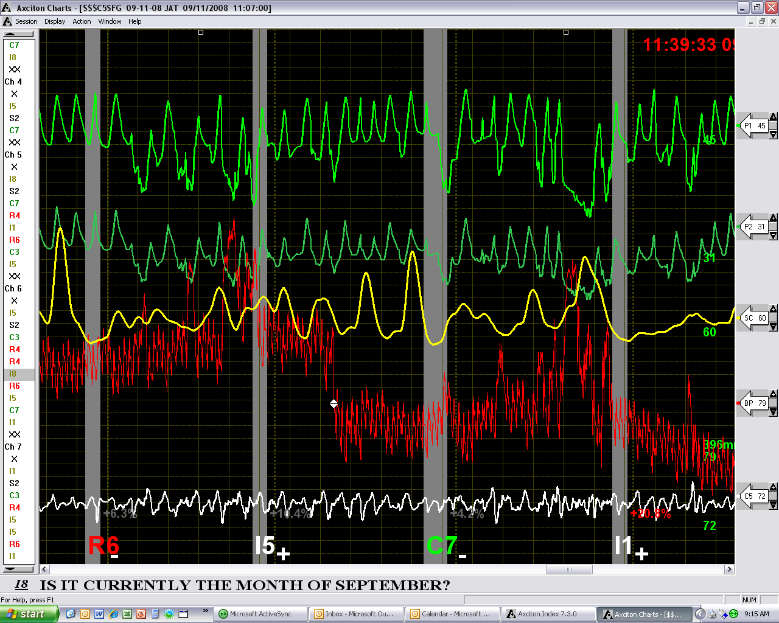
Other CM Signature Considerations
Notes:
Left Slide: The false apnea at 8C is a consideration. Additionally, the response to the number 9 symptomatic questions may indicate a CM issue.
Note how the cardio jumps at 9SY. This is the result of a physical movement or the cardio cuff may be misplaced on the examinee’s arm.
Right Slide: If the pneumos are riding all over the paper at every question and the EDR is large and bouncing stop the test.

Slide 57
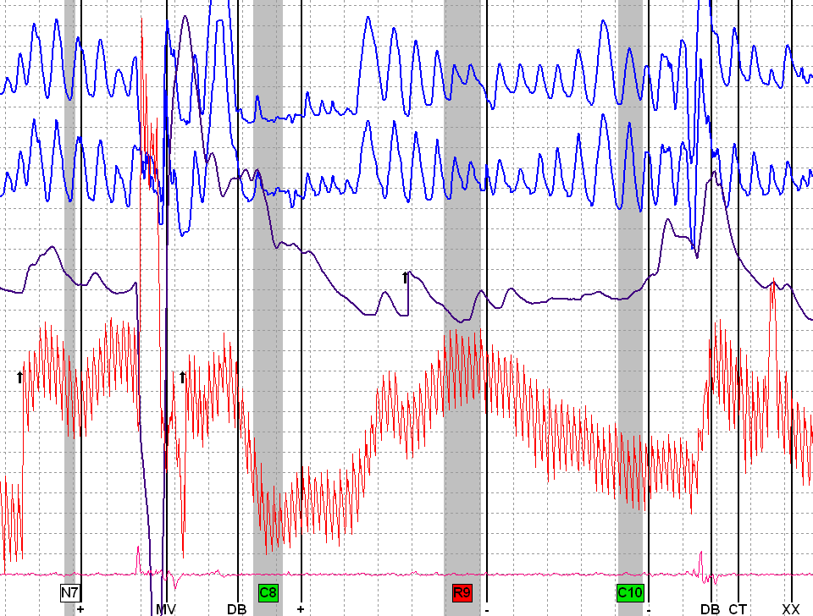
Other CM Signature Considerations
Notes:
Left Slide: The false apnea at 8C is a consideration. Additionally, the response to the number 9 symptomatic questions may indicate a CM issue.
Note how the cardio jumps at 9SY. This is the result of a physical movement or the cardio cuff may be misplaced on the examinee’s arm.
Right Slide: If the pneumos are riding all over the paper at every question and the EDR is large and bouncing stop the test.

Slide 58
Cookie-Cutter Responses
Lack of variability
Can occur in any channel, or combinations of channels
Notes:
These are responses that show little of the variability that normally occurs among genuine phasic responses.
These signatures often occur in the pneumograph channels, but can occur in any or all comparison question channel.

Slide 59
Cookie-Cutter Responses
Notes:
Once again, the key is the same type of response at all of the comparison questions. Note the false apnea.
Note the latency of the cardio responses.

Slide 60
Cookie-Cutter Responses
Notes:
Would you consider the cardios too good to be true?

Slide 61
Dramatic Tonic Change in Rate or Morphology
Significant changes in waveforms
Within or between charts
Notes:
Significant changes in tonic respiration rate, or the shape of the respiration waveforms that occurs within or between charts should be considered suspect.

Slide 62
Dramatic Tonic Change in Rate or Morphology
Notes:
Left Slide: The exaggerated exhalation lasting about 7 seconds in some situations may not be unusual.
Right Slide: However, the mess on the right slide is way out of the norm.

Slide 63
Answer Delays
Late answers to CQs.
Delays may be a fraction of a second or several seconds.

Slide 64
Answer Delays
CQs=1.8 seconds. Non-CQs=1.0 second.

Slide 65
Answer Delays

Slide 66
Conclusion
What is the key to CM identification?
Atypical Physiology
Frequency
Specificity
Clusters
Notes:
What is the key to CM features?
Frequency – How often does the activity happen.
Specificity – Where is it happening (at what question type?), and, what is the signature?
Clusters – Do you see multiple features during the examination process.
Now what? The next phase of this class is to provide real world examples.

