Slide 1
Atypical Tracings
Threat Analysis &
Strategic Support Branch
National Center for
Credibility Assessment
For Official Use Only/Law Enforcement Sensitive

Slide 2
TASS Branch
Background
Defense Authorization Act 1987
Public Law 108-136, DAA 2004
NAS report on polygraph, 2003
Battelle Report
DoD IG Report 05-Intel-18 (Montes)
Notes:
Battelle Report: Pg needs more training on Cms.
IG Report: Refresher training, Foreign Use.

Slide 3
TASS Branch
Mission
Training
Collect, maintain, analyze, disseminate
Conduct pilot research
Standardize counter-CM procedures
Policy issues
CI & HUMINT program issues
QAP sensitive case reviews

Slide 4
TASS Branch Pilot Research
Chapter 5, 2003 NAS Report
CM training & detection
CM signatures
Detection of mental CM
CM – Screening vs. SIP
What are we doing now?
XTRACT Project
Advanced TES/Screening
Managing Conversation

Slide 5
The Key
What is the key to CM identification?
Atypical Physiology
Specificity
Frequency
Clusters
Notes:
What is the key to CM features?
Frequency – How often does the activity happen.
Specificity – Where is it happening?
Clusters – Do you see multiple features during the examination process.

Slide 6
TDA Review
“Typical” Physiology
For Official Use Only/Law Enforcement Sensitive
Notes:
Link to “TDA April 2007.ppt”

Slide 7
Disclaimer
The following information is yet to be scientifically validated. It has, however, seen significant confirmation through hundreds, perhaps thousands, of verified Cm charts.
Not all of the following atypical physiology is deliberately produced. Some are side effects of otherwise unrelated activity.

Slide 8
Pneumograph

Slide 9
False Apnea
True apnea (blocking) is rare and occurs more often at RQs than at CQs.
High frequency of blocking at CQs may indicate CM activity.
False apnea (holding) occurs at other than the bottom of the tracing.
False apnea often has immediate recovery.
Notes:
Definition:
An apnea is the ultimate manifestation of respiratory suppression and appears almost exclusively at the bottom of the respiratory cycle.
When the apnea occurs at the top or middle of the inhalation, it may be indicative of deliberate manipulation of respiration.
If apnea appears at the bottom of the exhalation tracing on several comparison questions, consider CM activity.
Apneas sometimes have sudden onsets, but instant recoveries should be viewed with caution.
True apneas are frequently observed at the relevant questions, but are elicited far less often for comparison questions.
One way to discern true from false apneas is whether the trailing respiratory recovery is gradual or immediate.

Slide 10
True Apnea
True apnea is infrequent.
More often seen at RQs than at CQs.
High frequency at CQs may indicate Cms.

Slide 11
False Apnea
Baseline
Baseline

Slide 12
False Apnea

Slide 13
False Apnea

Slide 14
False Apnea

Slide 15
False Apnea

Slide 16
False Apnea

Slide 17
Exaggerated Exhalation Cycle
Similar to false apnea
One cycle of drawn-out exhalation
Often falling below the baseline
Immediately followed by a single deep breath
Notes:
Some of the previous slides contained at least one channel of “exaggerated exhalation.”
We will sometimes see in a true response a rate change where after the answer breathing slows for several cycles.
Exaggerated exhalation is considered false apnea because after the answer there is a sharp or drawn out exhalation followed by an immediate return to a deep breath and/or normal breathing.

Slide 18
Exaggerated Exhalation Cycle

Slide 19
Exaggerated Exhalation Cycle

Slide 20
Exaggerated Exhalation Cycle

Slide 21
Exaggerated Exhalation Cycle

Slide 22
Hyperventilation
90% breathe 10 to 23 cycles/minute.
Gauge normal breathing from…?
20% faster is an indication.
Significant amplitude increase indicative of hyperventilation.
Notes:
A global analysis is required to determine why hyperventilation is occurring.
On a DLC exam hyperventilation in the form of increased amplitude may be the result of DLC breathing; however, it could also be the result of CM activity.
If it occurs only at the comparison questions in a PLC format it is CM activity.
If it appears throughout an exam it might be CM activity, but it might also be that examinee is hiding a relevant or comparison question issue.

Slide 23
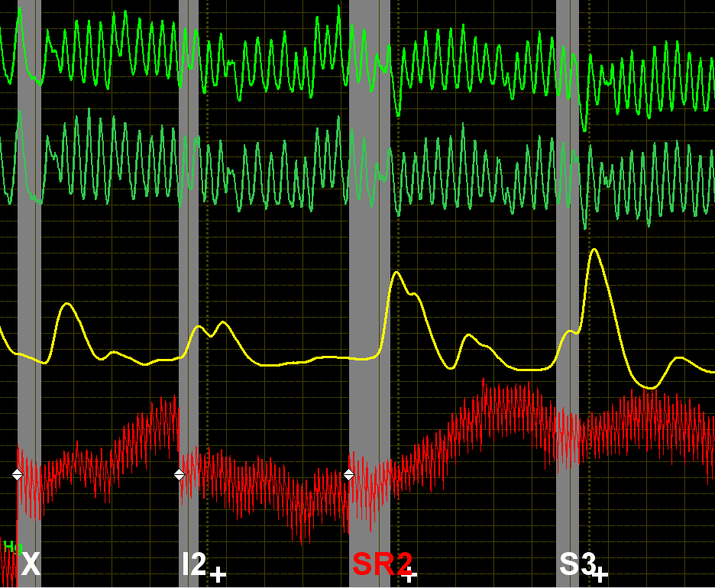
Hyperventilation (Tachypnea)
~36 cycles per minute
Notes:
Tachypnea: (tak-ip-nee-uh)
Unusually rapid respiration.

Slide 24
Hyperventilation
~30 cycles/minute

Slide 25
Hyperventilation
Notes:
This is an example of increased amplitude at the comparison question.
If occurring at all of the comparison questions in a Directed Lie test this could be DLC breathing or CM activity. (Discuss).
If this activity only occurred at the comparison questions during a PLC exam consider CM activity.

Slide 26
Hyperventilation

Slide 27
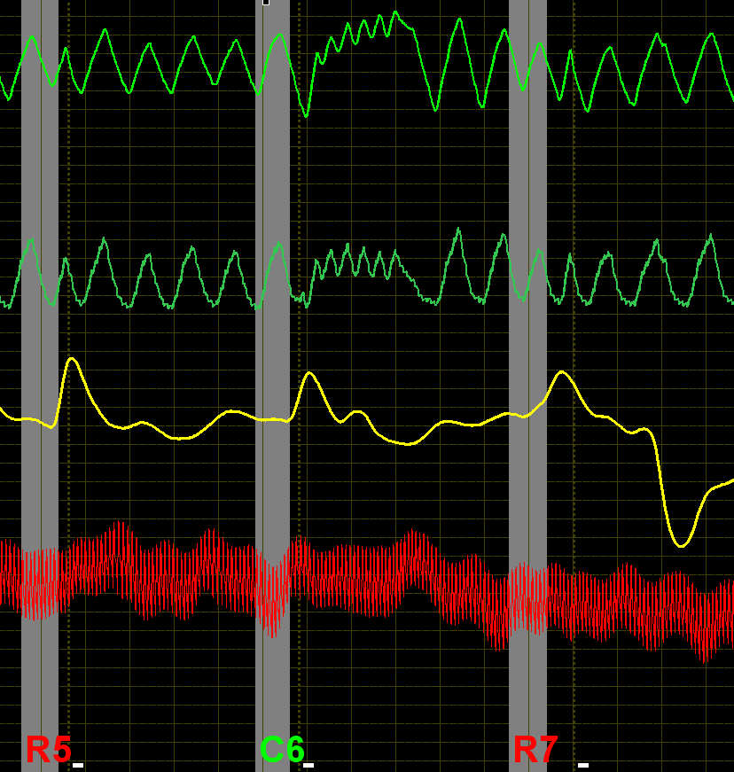
Hyperventilation
Notes:
Left Slide: Hyperventilation in the pneumos. Change of baseline in the pneumos.
Right Slide: Hyperventilation in the pneumo with baseline change. Tachycardia, prolonged response, and late secondary cardio.

Slide 28
Misplaced or Multiple Answer-Like Distortions
On what side of the respiratory cycle do we typically see answers?
How long does it take to say ‘yes’ or ‘no’?
Accurate markings are critical!
Look for answer delays
Look for sharp increases in the cardio
Notes:
The answer distortion is normally located anywhere on the exhalation stroke from the top of the cycle to the bottom of the cycle.
The answer distortion should line up with the answer mark on the polygraph chart. The answer should be timely with all the other answers throughout the exam.
The depiction of the crown or horns may be an indicator of CM activity. Once again must look globally. If occurring at all or most of the questions (Irrelevant, relevant & comparison) it may be normal activity. If only occurring at the comparison questions or irrelevant questions if identified as comparisons then suspect. Additionally, if the crown appears more than once across the asking it is suspect.
If the pneumo activity is accompanied by a sharp increase in cardio activity particularly with a secondary rise in the cardiograph – suspect.

Slide 29
Misplaced or Multiple Answer-Like Distortions

Slide 30
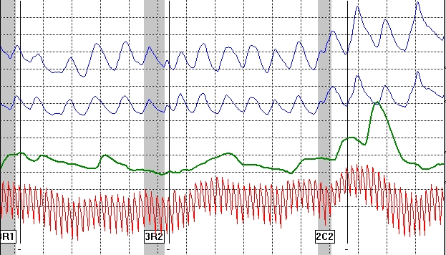
Misplaced or Multiple Answer-Like Distortions
Notes:
Answers rarely come on the inhalation side of the respiratory cycle.

Slide 31
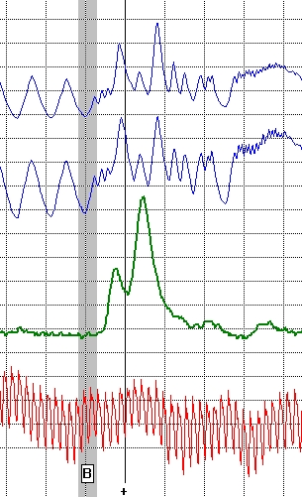
Misplaced or Multiple Answer-Like Distortions

Slide 32
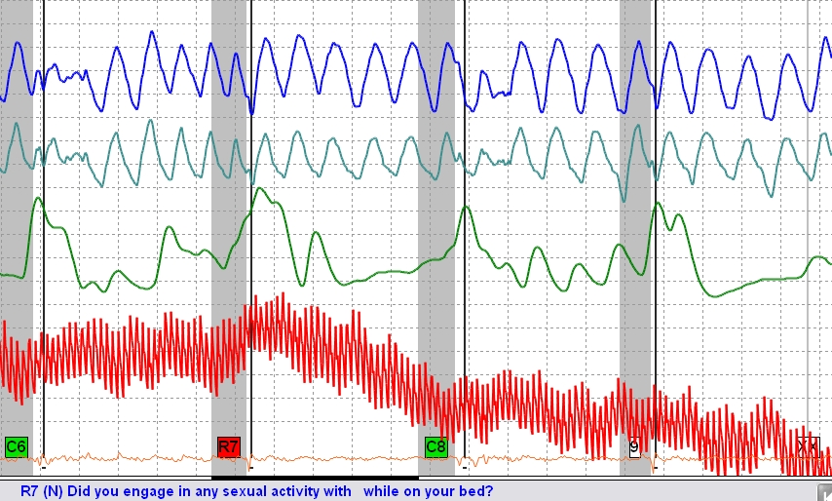
Misplaced or Multiple Answer-Like Distortions

Slide 33
Loss of Parallelism
Diverging or converging
Slight or exaggerated
Usually accompanied by other signatures

Slide 34
Loss of Parallelism

Slide 35
Loss of Parallelism

Slide 36
Loss of Parallelism

Slide 37
Loss of Parallelism

Slide 38
Loss of Parallelism

Slide 39
New Permanent Baseline
The baseline can be up or down
Normally at comparison questions
Can be dramatic or subtle
Notes:
“Permanent” does not necessarily mean from point of occurrence all the way to the XX. It may just be through the particular question, then return to the original baseline.
The change need not be dramatic. A subtle change can be suspect, particularly if it occurs on more than one comparison question.
It is important that the pneumograph tubes be properly placed on the examinee. A baseline change can result if the tubes slip.
In a PLC format, will normally occur at the comparison questions. Sometimes the examinee will be confused and it will occur at relevant questions.
Sometimes will occur at Irrelevant questions if they have been pretested as control questions.

Slide 40
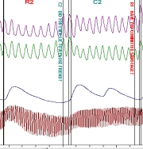
New Permanent Baseline

Slide 41
New Permanent Baseline

Slide 42
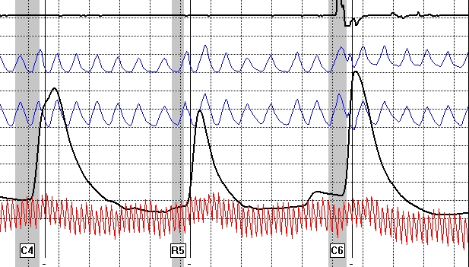
New Permanent Baseline

Slide 43
New Permanent Baseline

Slide 44
Bradypnea
Resting respiration seldom below 10 breaths per minute
Rare exceptions
Observations
Notes:
Resting respiration rates seldom drop below 10 cycles per minute.
The rare exceptions are those with medical conditions, and a very small group of athletes.
Suspect respiration rates should be investigated with surreptitious observation of recording.
Slow respiration is not, in itself, a strong indication of CM. However, it should be discouraged due to the influence of respiration on the other physiological data channels.
Should we give BI to slow breathers? (No!)

Slide 45
Bradypnea
Notes:
As can be seen by the slide, the breathing is very slow, but there is still good response in the cardio at the relevant issue.

Slide 46
Bradypnea
Notes:
Note the difference between this slide and the last slide.
Look how slow the pneumo tracing is at the relevant question.
At the comparison question the breathing picks up and also lifts off the baseline for 25 seconds. The corresponding cardio tracing continues up for almost 20 seconds. This is unusual considering that 2C2 is the last asking. Also, there is a latency issue with the EDA tracing. All suggest the possibility of CM activity.

Slide 47
Review - Pneumos
How many Pneumo criteria?
Seven
What are they?
For Official Use Only/Law Enforcement Sensitive
Notes:
The seven criteria were:
False Apnea, Exaggerated Exhalation, Hyperventilation, Misplaced/Multiple Answer-Like Distortions, Loss of Parallelism, New Permanent Baseline, Bradypnea.

Slide 48
Electrodermal

Slide 49
Labile EDR
Excessive electro-dermal activity
EDR often in constant motion
Responses frequently seen well after points of answer

Slide 50
Labile EDR

Slide 51
Labile EDR

Slide 52
Inconsistent EDR Latency
Stimulus onset to Response onset
What is atypical?
Notes:
Latency refers to the period between stimulus onset and response onset.
The EDR may be observed rising from 0.5 seconds after stimulus onset up to 5 seconds after the examinee’s answer.
High within subject variability of latency is atypical of genuine phasic EDRs.

Slide 53
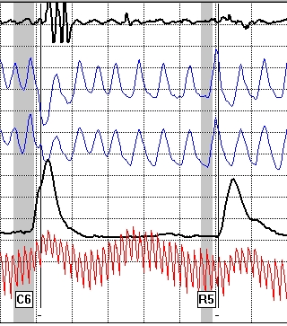
Inconsistent EDR Latency

Slide 54
Exaggerated EDRs
Globally out of proportion
Frequency
Notes:
Exaggerated EDRs are defined as those that globally are well out of proportion with the remaining EDRs, either in terms of amplitude or complexity.
Among truthful examinees, EDRs for comparison questions that have 5 times the amplitude of those adjoining relevant questions occur only about 4% of the time.
More than one of these rare EDRs per exam should be considered suspect.
Similarly, strong EDRs on irrelevant questions are atypical.
While complex responses in themselves are not uncommon, three or more rises are rare.

Slide 55
Exaggerated EDRs
Notes:
C7 is a little smaller than 5 times the rise of R6. However, if the EDR rise continues to be large at other comparison questions it might be suspect.

Slide 56
Exaggerated EDRs
Notes:
Note the rising pneumos.
Not only is the EDR extremely large, the examiner re-centered five times.
Note the sharp rise of the cardio that is too good to be true.

Slide 57
Exaggerated EDRs
Notes:
If the EDRs are cookie-cutter across the chart consider it suspect.
Note the matching cardio tracings.

Slide 58
Downward Spike of the EDR
EDR does not have parasympathetic innervations
Look for patterns

Slide 59
Downward Spike of the EDR
Notes:
Downward spike occurs only at the comparison question.
Corresponding sharp cardio too good to be true.

Slide 60
Downward Spike of the EDR
Notes:
Note the apnea and strong cardio response at C10, as well as a downward spike in the EDA.

Slide 61
Downward Spike of the EDR

Slide 62
Review - EDA
How many EDA criteria?
Four
What are they?
For Official Use Only/Law Enforcement Sensitive
Notes:
The four were:
Lability, Inconsistent Latency, Exaggerated Responses, Downward Spikes

Slide 63
Cardiovascular

Slide 64
Exaggerated Blood Volume Increase
Rapid rise and/or prolonged response duration
Common at RQs for DI examinees
Not common at comparison questions
Virtually non-existent at irrelevant questions
Notes:
Rapid rises and prolonged duration of phasic blood volume (slow wave) responses are commonplace on relevant questions for deceptive examinees.
They are far less frequent on comparison questions regardless of examinee veracity.
They virtually never appear on other types of questions.
Dramatic blood volume reactions, except to relevant questions should be considered suspicious, and more so when they co-occur with respiratory and electrodermal manipulations.
They are often triggered by covert muscular contractions.
However, they have been observed during the use of mental CM activity.

Slide 65
Exaggerated Blood Volume Increase
Three prong test for Exaggerated
1. Slope
2. Amplitude
3. Duration

Slide 66
Exaggerated Blood Volume Increase
Notes:
Also note pneumo activity.

Slide 67
Exaggerated Blood Volume Increase

Slide 68
Exaggerated Blood Volume Increase

Slide 69
Exaggerated Blood Volume Increase

Slide 70
Exaggerated Blood Volume Increase

Slide 71
Exaggerated Blood Volume Increase

Slide 72
Secondary Blood Volume Response
Sharp rise in cardio followed by a secondary rise
“Compound Cardio”
Notes:
When CM activity is being performed (toe press) the covert muscular contractions can cause a sharp rise in amplitude in the slow wave component of the cardiovascular tracing followed by a secondary rise.
This is suspect at comparison questions, but particularly so when it occurs at more than one comparison question during the same series.

Slide 73
Secondary Blood Volume Response

Slide 74
Secondary Blood Volume Response

Slide 75
Secondary Blood Volume Response
Notes:
Secondary cardio can sometimes be very late.

Slide 76
Tachycardia or Bradycardia
Tonic pulse rates in excess of 100 BPM, or less than 60 BPM
Notes:
On many occasions, CM activity is accompanied by tachycardia.
Must review the entire exam. Also, any medications or illnesses.
Bradycardia (less than 60 BPM) often seen in long distance runners.
Must also consider medications, illnesses, drugs.
The key is to look for other CM signatures.

Slide 77
Tachycardia
~120 b/m

Slide 78
Tachycardia
Notes:
Explain the Lafayette caliper function.

Slide 79
Bradycardia
~24 c/m
~22 b/m
Notes:
Extremely rare instance of respiratory rate out pacing the heart rate!
Few people—if any—can slow their heart to a rate such as this. Most likely pharmacologically induced (and not necessarily nefarious).

Slide 80
Inconsistent Cardiovascular Response Latency
Consistent with EDR latency
Contrast points of response onset of all CQs with all other question types
Look for inconsistency unique to the CQs
Notes:
As with EDR, latency refers to the period between stimulus onset and response onset.
Globally, an examinee’s response time is fairly consistent at each question asking.
If the rise time changes, particularly from one comparison question to another this is suspect.

Slide 81
Inconsistent Cardiovascular Response Latency
Notes:
Note the points of response onset in the green questions (mid question onset), then compare with response onsets at the red questions (post question onset).

Slide 82
Inconsistent Cardiovascular Response Latency
Notes:
More of the same.

Slide 83
Inconsistent Cardiovascular Response Latency
Notes:
And even more…

Slide 84
Review - Cardio
How many Cardio criteria?
Five
What are they?
For Official Use Only/Law Enforcement Sensitive
Notes:
The five were:
Exaggerated Responses, Compound Cardios (secondary responses), Tachycardia, Bradycardia, Inconsistent Respiratory Responses.

Slide 85
Other CM Signature Considerations
“Messy” test data containing erratic breathing, erratic EDA tracings, erratic “jumping” cardiograph tracings with a pulse rate over 100 BPM
Notes:
Obviously there are many reasons for messy tracings.
They can be the result of a poor pretest interview.
Messy tracings can be caused by an examinee that is guilty of the issue under investigation.
Messy tracings can be caused by someone who is ill and on certain cold medications.
Messy tracings can also be caused by examinee’s attempting CM activity.
If you have eliminated the possibility of a Poor pretest interview & whether examinee is ill that leaves two issues. Either examinee is guilty or performing CM activity or guilty and performing CM activity.
There is no reason to continue with collecting test data when such activity is taking place. A good post test interview is required.

Slide 86
Other CM Signature Considerations
Notes:
Garbage in…

Slide 87
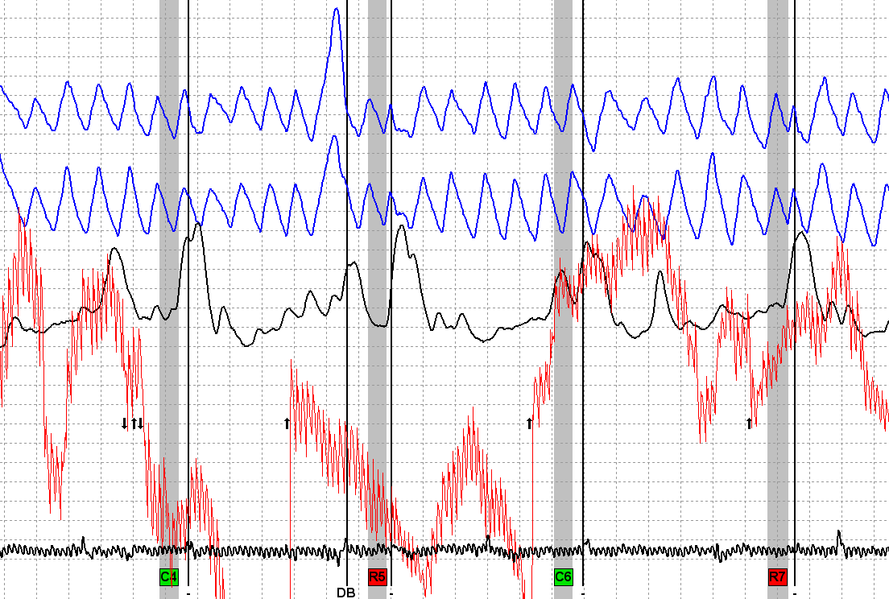
Other CM Signature Considerations

Slide 88
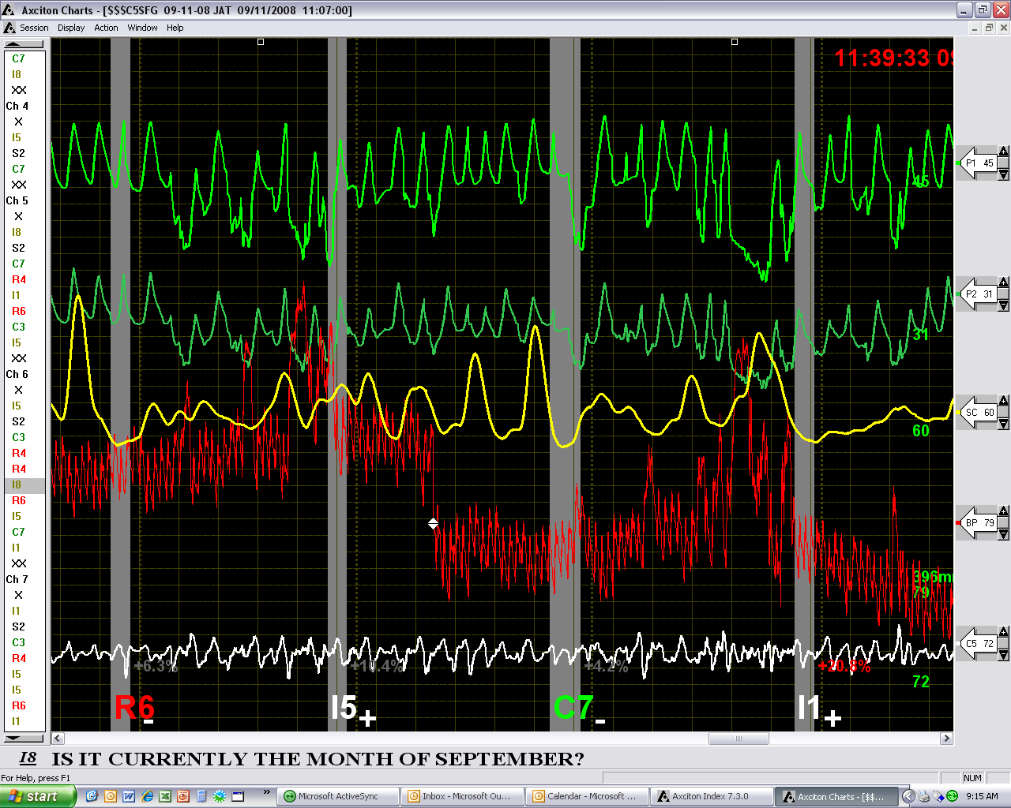
Other CM Signature Considerations

Slide 89
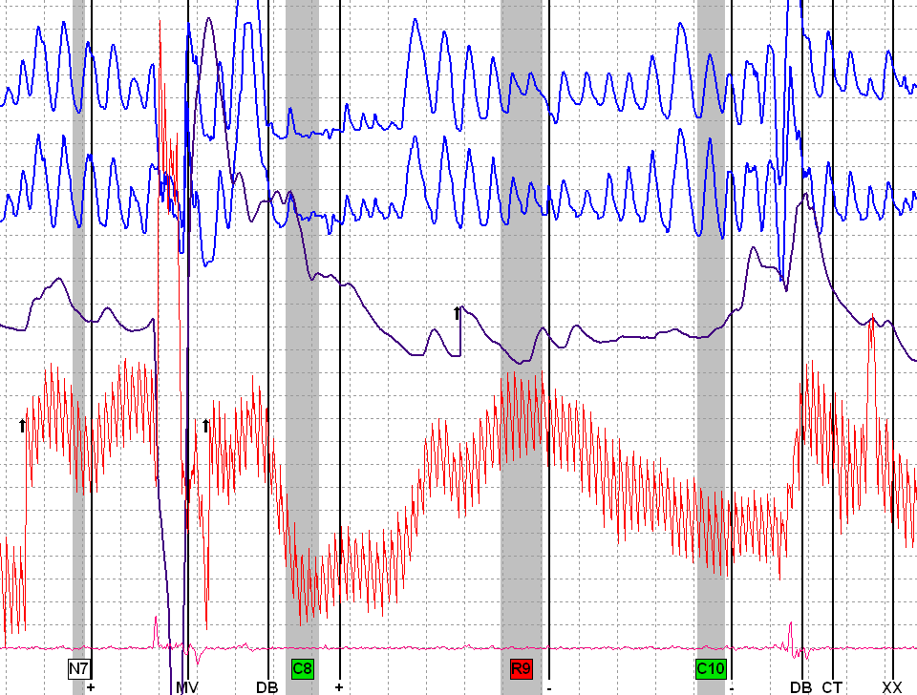
Other CM Signature Considerations

Slide 90
Cookie-Cutter Responses
Lack of variability
Can occur in any channel, or combinations of channels
Notes:
These are responses that show little of the variability that normally occurs among genuine phasic responses.
These signatures often occur in the pneumograph channels, but can occur in any or all comparison question channel.

Slide 91
Cookie-Cutter Responses
Notes:
The pneumos at all of the comparison question askings diverged in the same manner. Note the same cookie-cutter EDA and the sharp cardio.

Slide 92
Cookie-Cutter Responses
Notes:
In a DLC format these cookie-cutter responses may be the result of DLC breathing. This may or may not be the result of deliberate manipulation.
Whatever the reason, the tracings should not be evaluated because of the distorted pneumos.
Is the strong response at the R3 question the result of trying to recover from the DLC breathing or is it the result of deception?

Slide 93
Cookie-Cutter Responses
Notes:
Questions “EN” and “FN” are Identities (IRQs). 8H and 9H are RQs.

Slide 94
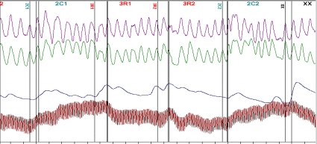
Cookie-Cutter Responses
Notes:
Would you consider the cardios too good to be true?

Slide 95
Cookie-Cutter Responses

Slide 96
Cookie-Cutter Responses
Notes:
Tracing from MSD. Note all activity is only at the norms (IRQs).

Slide 97
Dramatic Tonic Change in Rate or Morphology
Significant changes in waveforms
Within or between charts
Notes:
Significant changes in tonic rate, or the shape of the waveforms, which occurs within or between charts should be considered suspect.

Slide 98
Dramatic Tonic Change in Rate or Morphology
Notes:
Note instantaneous change from 2R2 to 2C1.

Slide 99
Dramatic Tonic Change in Rate or Morphology

Slide 100
Dramatic Tonic Change in Rate or Morphology

Slide 101
Dramatic Tonic Change in Rate or Morphology

Slide 102
Answer Delays
Late answers to CQs.
Delays may be a fraction of a second or several seconds.

Slide 103
Answer Delay
CQs=1.8 seconds. Non-CQs=1.0 second.
Notes:
Delay at Comparison Questions is 1.8 seconds. Delay at other question types is just one second. Coincidence???

Slide 104
Answer Delays
Notes:
1C2.

Slide 105
Answer Delays
Notes:
C3.

Slide 106
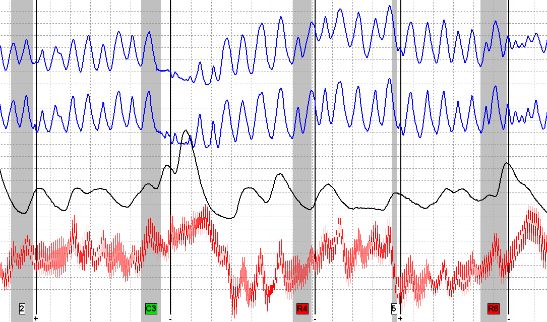
Answer Delays
Notes:
C3.

Slide 107
Any Criteria?
Notes:
Delays may be accompanied by other clues.

Slide 108
Conclusion
What is the key to CM identification?
Atypical Physiology
Specificity
Frequency
Clusters
Notes:
What is the key to CM identification?
Frequency – How often does the activity happen.
Specificity – Where is it happening (at what question type)?
Clusters – Do you see multiple features during the examination process.

