Slide 1
CM Refresher Training
National Center for Credibility Assessment
Notes:
Discuss classification of CM signatures
DoD Instruction C5240.08
When
Why

Slide 2
Countermeasures Today
What’s on the Internet regarding CM?
Notes:
Google “Beat a Polygraph” and see what comes up
Key point: It is no longer unusual for an examinee to do an internet search on polygraph prior to a test
Virtually all sites discuss CM
Most sites recommend:
Controlled breathing
Behavioral CM
Mental CM
Tongue biting
Toe presses
Recommendations based on CM research primarily by Honts

Slide 3
Website Search
** Antipolygraph.org
** Polygraph.com
Wikipedia.org
Wikihow.com
Police-test.net
Howstuffworks.com
Skepdic.com
Lifehacker.com
Beataliedetectortest.com
Expertpolygraphtraining.co
Wired.co.uk
Wisegeek.com
Borderlandbeat.com
Allgov.com
99Reports.com
Squidoo.com
Polygraphplace.com
Truthorlie.com
Notes:
The listed websites are a sampling of what is on the internet regarding how to beat a polygraph.
The first two sites containing the asterisks will be covered in greater detail – most other sites refer back to these two.
Look at Antipolygraph.org first - most professional site.
The sites author is not motivated by money – motivated by ideology, and possibly revenge
Since he failed at least two polygraph examinations

Slide 4
Notes:
George Maschke resides in the Hague and is responsible for the site
Chapter 4 - The Lie Behind the Lie Detector
Detailed instructions on how to use polygraph CM to protect oneself against a false positive
Or in the case of being a guilty liar – How to beat the polygraph test

Slide 5
Antipolygraph.org Breathing CM
Breath normally 15 to 30 BPM
Pick a range that is comfortable for you
Maintain this cycle from the time the PN tubes are place on until taken off
At PLC/DLC/Irrelevant in RI – pick one of five DoDPI (NCCA) diagnostic criteria
Criteria on the next 5 slides
Mirror this criteria for 5-15 seconds
Notes:
These instructions come from the Antipolygraph.org website
Virtually all antipolygraph sites follow this websites lead
Different sites may add an item or two:
e.g., Tack in shoe, antiperspirant on fingers and hands

Slide 6
Antipolygraph.org Breathing CM
Apnea or Blocking: Achieved by simply holding one’s breath for four or five seconds after breathing out (anything much longer may make your polygrapher suspicious)
Notes:
The key to the next 5 slides: (Apnea/Blocking)
Read what antipolygraph.org instruction for each tracing
Do you think examinee physiology will mirror the picture?
Particularly with no bio-feedback
Criteria taken from NCCA handout
Do you think contrived physiology looks contrived?
Look for patterns of behavior

Slide 7
Antipolygraph.org Breathing CM
Change in Rate: Produced by breathing more slowly for 5 to 15 seconds, ending before the asking of the next question.
Notes:
Question: If the examinee has deliberately slowed their breathing for 15 seconds (they will often wait until they hear the next question) and you (the examiner) ask a relevant question – What is going to happen in the PN channels at the relevant question?
The answer:
For every action there is a reaction. (Discuss)
A irrelevant question should be asked.

Slide 8
Antipolygraph.org Breathing CM
Change in Inhalation/Exhalation Ratio: Can be accomplished by exhaling more slowly than inhaling for 5 to 15 seconds, ending before the asking of the next question.
Notes:
Follow the directions given on the antipolygraph.org site
What do you think the PN tracings will actually look like?
Do you think that many will tighten stomach muscles while trying to follow this instruction?

Slide 9
Antipolygraph.org Breathing CM
Suppression/Decrease in Amplitude: Take several shallower breaths for 5 to 15 seconds and then return to one’s baseline pattern before the asking of the next question
Notes:
Remember – other instructions by the website is to control breathing from PN tubes on until PN tubes off.
This instruction says to take several shallower breaths for 5 to 15 seconds then return to baseline.
What is a “shallower breath” and what does it look like on a polygraph instrument?

Slide 10
Antipolygraph.org Breathing CM
Progressively Decreasing in Amplitude: Breath shallower gradually for 5 to 15 seconds before returning to one’s baseline breathing pattern, ending before the asking of the next question
Notes:
This is another instruction that is easily read but may not be easy to replicate,
Look at the picture – now gradually breath shallower
Are you convinced your recorded physiology will mirror the picture?

Slide 11
Antipolygraph.org Cardio/Electrodermal CM
In addition to breathing CM pick 1 of the following:
Mental CM:
(Pick arbitrary number) count backward by 7s
Think exciting thoughts (8-20 seconds)
Tongue biting:
Side of tongue hard enough to cause pain
Suggests not doing AS
Target Key on ACQT
Notes:
Mental CM: All websites discuss mental CM (Excitable image or math problem requiring concentration
Add to controlled breathing – 1 of the breathing criteria plus a mental CM
What do you think will happen to the PN channel?
Tongue biting – Cheek biting or pushing tongue against teeth or the roof of the mouth – Depends on the website
Anal sphincter – Most except polygraph.com suggest not using if the cushion is present
ACQT – Most suggest attacking the ACQT key
Question – If you see CM activity at the key should you identify the activity to the examinee?

Slide 12
Antipolygraph.org CM & the R/I Test
Site suggests attacking a different “relevant” question over several charts in order to avoid a pattern
He also suggests using behavior CM
Dress professionally
Have professional reading material
Mirror the examiner
Compliment the examiner (don’t go overboard)
Be on time – Do not cancel
Notes:
Some sites call the irrelevant questions ‘control’ questions and suggest that they be attacked.
Do you think behavioral CM help the examinee?

Slide 13
Antipolygraph.org Post Test Interview
Be concerned and puzzled – offer some explanation that cannot be considered an admission:
“All I can think of is that I’ve always felt guilty when I’m accused of something.”
“The only thing that comes to mind is that I’m in the middle of reading a Tom Clancy novel which involves espionage/drug dealing.”
“I recently heard that an old childhood friend died of a drug overdose. I haven’t seen him in years. I never imagined he would grow up to become a drug user.”
Notes:
The 3 excuses were pulled from antipolygraph.org
Do you think these excuses are sufficient to warrant a second series?
Are they sufficient to warrant a 3rd series?

Slide 14
Notes:
Polygraph.com is another antipolygraph site that many sites quote attempt to mirror
Motivation - money
Doug Williams spent time as a polygraph examiner in the late 1970s.
That was 30+ years ago
Poly School he attended used poly as an interrogation tool
His web site changes every few years
The breathing CM in his booklet are similar to the breathing criteria in Antipolygraph.org
Read instructions on how to reproduce the pictured criteria, practice the criteria with your polygraph instrument and see what you produce.

Slide 15
Polygraph.com Manual Cost: $19.95
Notes:
His CD with the manual is $49.95
Many sites offering similar services
If you come to his location in Oklahoma he will train you in CM for $1000
For $3500 + First Class airline ticket + 4 star hotel + expenses he will come to your location and train you in CM
Key – If you get caught – do not confess

Slide 16
Polygraph.com Manual Cost: $19.95
Notes:
This warning taken from poly.com manual
The warning is repeated several times throughout the manual
I wonder why?
Have everyone tighten their sphincter VERY slowly to ½ tension. Do you now release slowly or quickly release?

Slide 17
Polygraph.com Suggested Breathing CM
Notes:
These are the 5 breathing criteria identified in the manual for sale on polygraph.com
Compare them against the 5 NCCA criteria
What is the difference?
Apnea is the same – but Williams says to not use it
Figures 1 & 2 are not listed in antipolygraph.org site
Figures 4 & 5 will lead to forms of suppression but the instructions are different from antipolygraph.org
Will look at breathing individually next few slides

Slide 18
Polygraph.com Suggested Breathing CM
(1) Inhale about 1/3 the normal amount of air, hold slightly, and exhale slowly, showing no jagged edges, (2) inhale again, this time inhaling about 2/3s the normal amount of air, exhale slowly, (3) inhale and exhale the normal amount of air, (4) inhale again, this time inhaling just a little more air than normal, and exhale slowly. Now take 2 deep breaths, and resume your normal breathing pattern.
Notes:
Attempting to create a “stair-stepping” increase in amplitude (used to be a scorable criteria) 15 years ago

Slide 19
Polygraph.com Suggested Breathing CM
Figure 2 is manipulated by inhaling more than you exhale each time in a series of 5 small breaths until, with your last breath; you fill your lungs with slightly more than the normal amount of air, just like you are frightened and gasping for breath. You then take 2 deep breaths and resume normal breathing
Notes:
The key here: If the examinee appears to be “gasping for breath” like a fish out of water…probably a CM
Consider what an examinee’s physiology might look like following these directions

Slide 20
Polygraph.com Suggested Breathing CM
Figure 3 is too obvious so don’t use it. It is true that it is the easiest, but it is also the least desirable
Notes:
Real apneas are very rare.
When seen they are usually occur at a relevant question – not a comparison question or an irrelevant question
Williams most likely had a number of his clients get caught by using this CM
And that is the reason he is telling his clients not to use this CM

Slide 21
Polygraph.com Suggested Breathing CM
Figure 4 is manipulated by inhaling a normal amount of air and then take a series of 5 to 7 shallow breaths with your lungs partially full
Notes:
If it looks like a kings crown with multiple diadems it is probably this CM

Slide 22
Polygraph.com Suggested Breathing CM
Figure 5 is a variation of Figure 4 except that you take 5 to 7 shallow breaths with your lungs almost empty
Notes:
Push most of the air out of your lungs and take 5 to 7 shallow breaths - What do you think the tracing will look like?
Attach a non-polygraph trained person to your instrument and have them read the directions for each figure and do it. Look at the results
If the results look normal to you – you are getting beat

Slide 23
Polygraph.com Timing is important
Answer the comparison question (or irrelevant if RI) then react 7 to 9 seconds
Mix PN reactions shown in Figures 1 to 5 using a different PN reaction for each comparison question
2nd series – just manipulate the CV channel
3rd series – use only mental CM
If concerned about getting caught just use mental imagery at every comparison question
Notes:
These instructions have changed repeatedly in williams manual
2nd series where he says to “just” manipulate the CV channel – he is talking about doing the AS (VERY SUBTLE)
He also suggests placing a towel or heavy duty Kotex in your underwear separating the “stinger” from the movement sensor

Slide 24
Polygraph.com Other CM Activity
Attack the key on the ACQT
Use AS and breathing CM together
Mental CM – count backwards from 700 by 3s
Mental CM – frightening mental image
Don’t take drugs
Don’t put a tack in your shoe
Notes:
Additional instructions found in poly.com manual

Slide 25
False Apnea
False apnea occurs at the top or middle of the exhalation cycle
Often immediate recovery
True apnea occurs at the bottom of the exhalation cycle
Unless frequency and specificity observed
Usually at relevant questions not comparisons

Slide 26
False Apnea
Notes:
AS easily identified
False apnea could be the result of the AS
Or, Figure 4 - inhaling a normal amount of air and followed by 5 to 7 shallow breaths with your lungs partially full

Slide 27
False Apnea
Notes:
Upper PN the apnea is at the bottom & the lower PN the apnea is at the top
AS might be responsible for the apnea (cognitive processing)
PLCQ – not it is answered about a second later than the relevant – Why?

Slide 28
True Apnea
R4 - True apnea at the bottom of the “relevant question”
C3 – Permanent change of baseline
C5 – Loss of parallelism
Notes:
Would you question whether the true apnea was a CM if it appeared at 2 or more relevant questions? Comparison questions?

Slide 29
Exaggerated Exhalation Cycle
Similar to false apnea
One cycle of drawn-out exhalation
Often falling below the baseline
Immediately followed by a single deep breath
Occurs during question asking or at the answer

Slide 30
Exaggerated Exhalation Cycle
Notes:
MV in sensor pad –
The exaggerated exhalation falls below the baseline and pulls either one or both PN channels off the baseline
Do you see anything strange about the EDA at the relevant question?
The drop at R8 as the question is being asked is probably a MV.
Did the MV cause the software to pull the EDA up in order to re-establish a baseline?

Slide 31
Exaggerated Exhalation Cycle
Notes:
Top PN exaggerated exhalation
Bottom PN false apnea

Slide 32
Hyperventilation
90% breathe 10 to 23 BPM during polygraph testing.
Gauge normal breathing from surreptitious recording, patterns on non-relevant charts, respiration within charts.
20% faster on relevant charts is an indication of hyperventilation.
Significant increase in respiration amplitude indicative of hyperventilation.
Notes:
Antipolygraph.org informs readers to control breathing in this range from the time the PN tubes are placed on until they are taken off
Dick Arther – 32,000 charts – breathing at 6 to 8 BPM - DI breathing (contrived)
John Reid found the same
Very fast breathing is unusual

Slide 33
Hyperventilation
Notes:
MI called this DLC breathing
Note the late answer
MI suggested that this breathing is the result of the cognitive effort to visualize the directed lie
It was not considered a CM – but the test data was not evaluated either

Slide 34
Hyperventilation
Notes:
This could be poly.com suggesting:
Figure 4 is manipulated by inhaling a normal amount of air and then take a series of 5 to 7 shallow breaths with your lungs partially full

Slide 35
Misplaced or Multiple Answer-like Distortions
Answer distortion normally on exhalation stroke anywhere from top to bottom.
Should be timely.
If the answer is toward the top of the tracing with an immediate inhalation forming a crown – This is atypical.
Answer-like distortions in the PN channels are those distortions that show up anyplace but the answer.
Notes:
Answer-like distortions were occasionally observed by Paul & me in Barland’s mental CM study
We surmised that examinee counting backwards were moving their throat muscles.
If field data we occasionally see answer-like distortions when tongue bites occur.

Slide 36
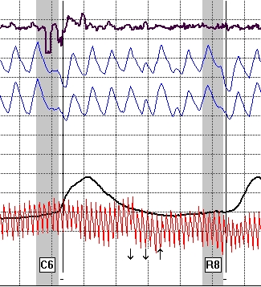
Misplaced or Multiple Answer-like Distortions
Answer-like distortions

Slide 37
Misplaced or Multiple Answer-like distortions

Slide 38
Loss of Parallelism
PN channels diverging or converging
Can be slight or exaggerated
Usually accompanied by other CM signatures
Begins during the question asking or at the answer and can continue for 15 seconds or more

Slide 39
Loss of Parallelism
Note sharp cardio!

Slide 40
Loss of Parallelism

Slide 41
New Permanent Baseline
The baseline can be up or down
Normally at comparison questions
Can be dramatic or subtle

Slide 42
New Permanent Baseline

Slide 43
New Permanent Baseline

Slide 44
Cookie-Cutter Responses
Lack of variability
Can occur in any channel
Notes:
This signature has been specifically identified on antipolygraph.org site.
The suggestion is not to use the same CM at every comparison question

Slide 45
Cookie-Cutter Responses

Slide 46
Cookie-Cutter Responses

Slide 47
Dramatic Tonic Change in Rate or Morphology
Significant changes in waveforms
Within or between charts

Slide 48
Dramatic Tonic Change in Rate or Morphology

Slide 49
Dramatic Tonic Change in Rate or Morphology

Slide 50
Bradypnea
Resting respiration seldom below 10 cycles per minute
Rare exceptions
Observations

Slide 51
Bradypnea

Slide 52
Exaggerated EDRs
Globally out of proportion
5-times the amplitude
Frequency
Seen only 4% of the time

Slide 53
Exaggerated EDRs

Slide 54
Exaggerated EDRs
Notes:
Toe press – picked up in cushion at 1C2

Slide 55
Downward Spike of the EDR
EDR does not have parasympathetic innervations
Look for patterns

Slide 56
Downward spike of the EDR
Notes:
EDA MV can be deliberate
Sometimes it is inadvertent – we have seen people concentrating on performing another CM such as mental math and inadvertently push down on the EDA plates then release pressure

Slide 57
Exaggerated Blood Volume Increases
Rapid rise & prolonged duration common at relevant questions for deceptive examinees
Not common at comparison questions
Virtually non-existent at irrelevant questions
Notes:
Exaggerated blood volume increase is often overlooked
Possibly because too often the cardio cuff is inappropriately placed or does not contain sufficient pressure
If proper operations has taken place – right now 60 degrees for a period of 5 seconds may be indicative of a CM

Slide 58
Exaggerated Blood Volume Increases

Slide 59
Exaggerated Blood Volume Increases

Slide 60
Secondary Blood Volume Response
Sharp rise in cardio followed by a secondary rise
When to question it
Notes:
This response adds to the sharp rise
Unusual – particularly at irrelevant and DLCQs
Should be unusual for a PLCQ

Slide 61
Secondary Blood Volume Response

Slide 62
Secondary Blood Volume Response

Slide 63
Secondary Blood Volume Response

Slide 64
Tachycardia or Bradycardia
Tonic pulse rates in excess of 100 BPM, or less than 60 BPM
Notes:
Most indicative of either a CM or a DI exam is pulse rate in excess of 100 BPM
If in excess of 100 BPM – look for other CM signatures
If the pulse rate is really slow (under 50 BPM) consider drug use (muscle relaxants or barbiturates)

Slide 65
Tachycardia or Bradycardia

Slide 66
Tachycardia or Bradycardia
144 bpm!

Slide 67
Other Global Criteria
Messy erratic test data
Clean charts on first series – Messy on the second
Clean ACQT – Messy during relevant issues
All signs of deception or CM activity

Slide 68
Other Global Criteria
Notes:
This slide
Examinee’s physiology was good until the X

Slide 69
Other Global Criteria
Notes:
This slide
Examinee had good physiology until the first PLCQ was asked

Slide 70
CM Exercise
Teaching Points

Slide 71
CM Exercise - Example 1
U-Phase ZCT regarding cocaine use
Researched “polygraph” on the Internet.
Watched a polygraph exam on YouTube and redirected to a link with stories on how to perform CM – Link identified PLCQs
Read Antipolygraph.org and decided to hold his breath at each PLC
Notes:
Key point – This is typical of confirmed cases
Examinee researches a number of sites
Antipolygraph.org gives the following instruction regarding Apnea or Blocking: Achieved by simply holding one’s breath for four or five seconds after breathing out (anything much longer may make your polygrapher suspicious)
See if examinee followed the instruction

Slide 72
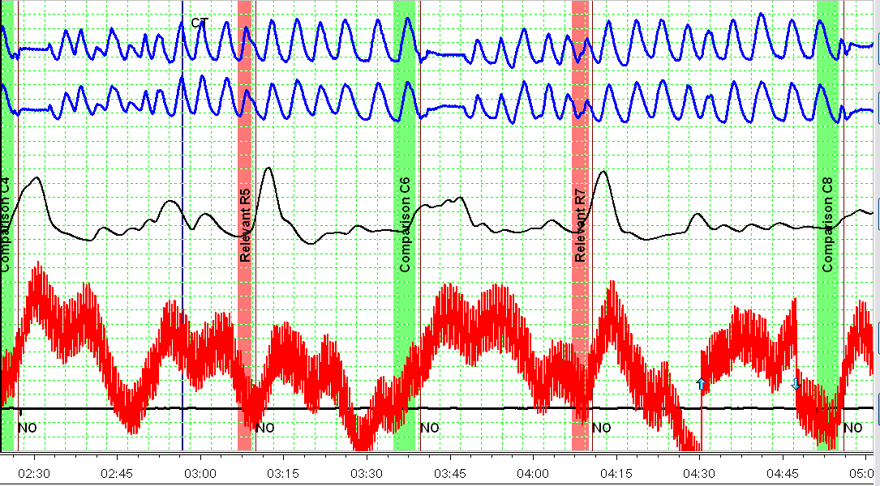
Chart 1
Notes:
Consider:
What is causing the sharp CV rises?
Note: Every comparison question approximately 5 seconds of apnea

Slide 73
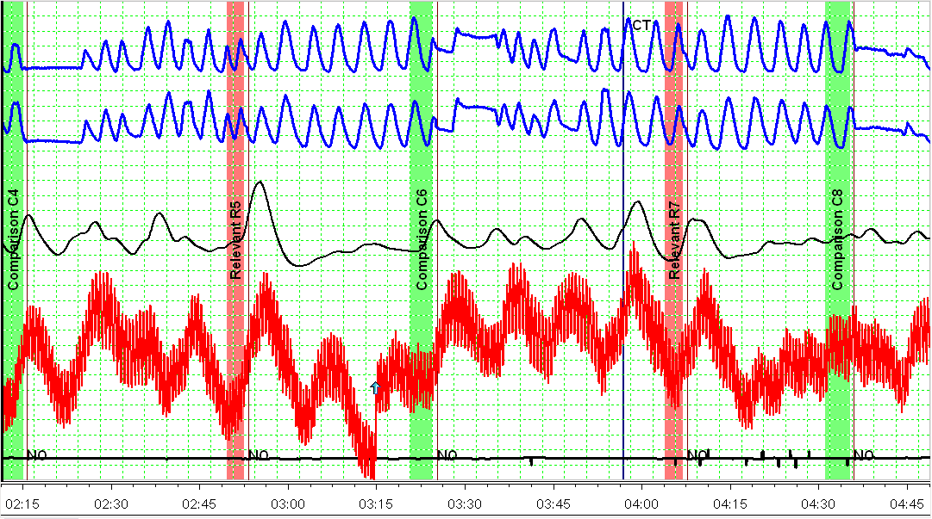
Chart 2

Slide 74
Example 1 - CM Post-test Interview
Post-test confession to CM activity
Examinee performed CM activity because he read that innocent people had to help themselves to “get through the test”
He promised not to perform CM activity
Examiner conducted another exam
Notes:
Typical excuse given for CM activity
A promise is made – should we be more conservative on the next test? Why? Why not?

Slide 75
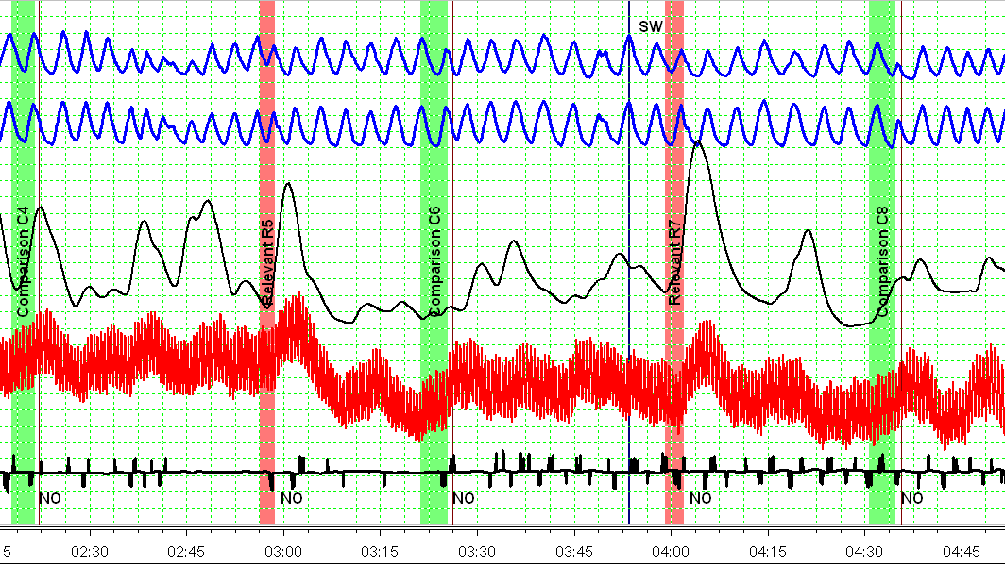
Chart 2-1
Notes:
What is the difference between this series and the last?
Clean CV channel
No more false apnea
Appears to be DI

Slide 76
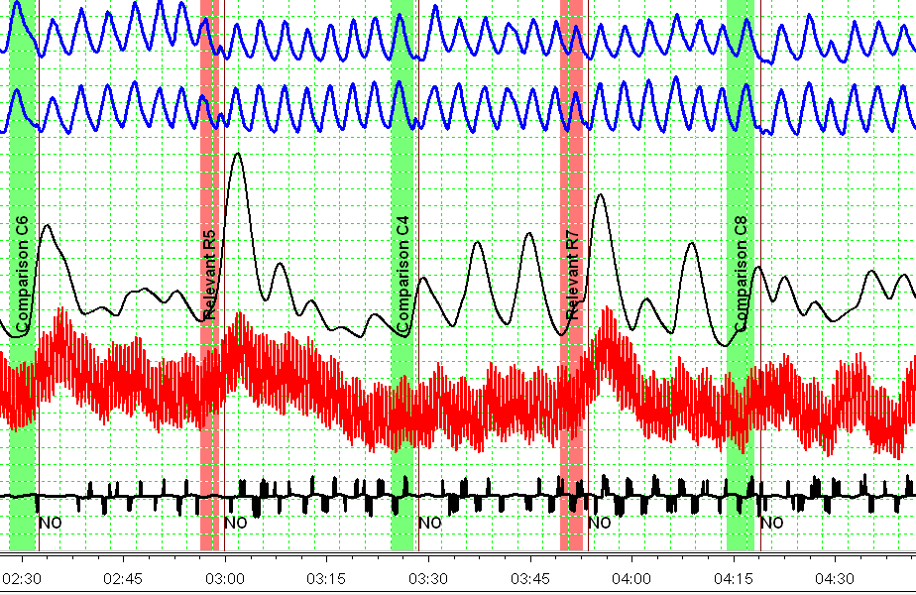
Chart 2-2

Slide 77
Example 1 – Continued Teaching Points
Examinee admitted to using cocaine and admitted to intentional actions to affect the outcome of the polygraph examination.
Teaching points:
Examinee will tell you they only wanted to ‘help themselves’ through the process
Expect them to “throw you a bone”
CM activity often creates messy test data

Slide 78
Example 2
Applicant screening using LEPET PLCQ format
Pretest admissions to prescription drug abuse
Post-test he admitted to:
Tightening his stomach muscles, buttocks
Clenching his teeth
At the “integrity/character” questions
He said he was worried about a “false positive”
He claimed he could not remember the anti-polygraph site that provided the CM information
Notes:
He used the terms ‘false positive’
He is using a variety of CM
Stomach muscles
AS & clenching teeth

Slide 79
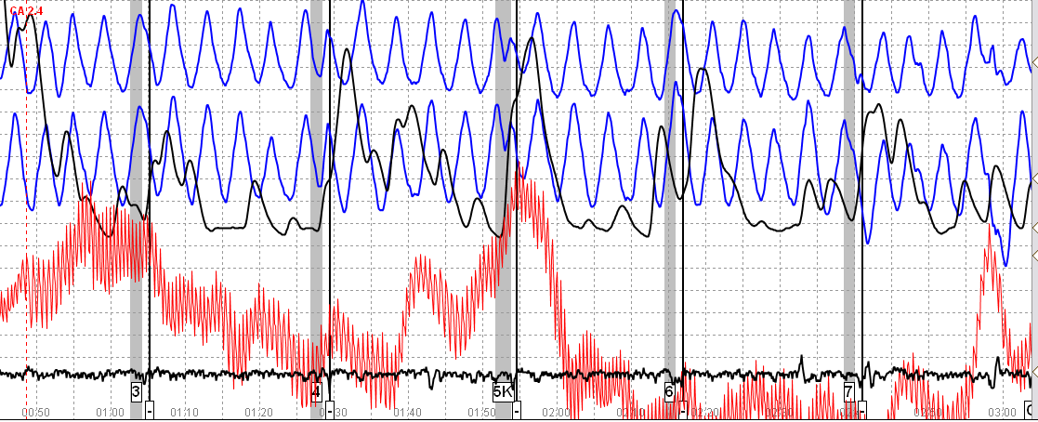
Example 2 - ACQT
Notes:
Why is the CV channel this sharp at the key?
Pulse rate is about 108 BPM
Consider being more conservative once next chart starts

Slide 80
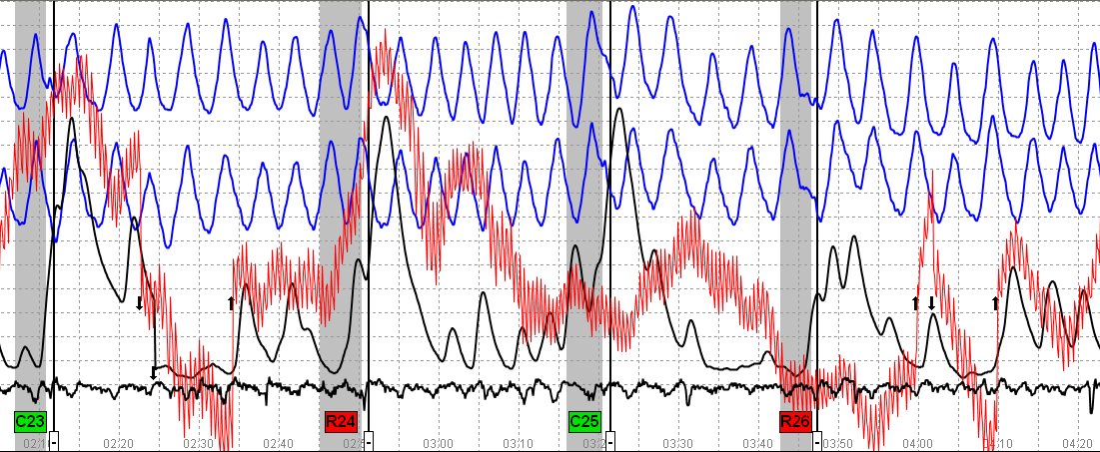
Example 2 – Chart 1 R24 – Serious crimes R26 – Illegal drugs

Slide 81
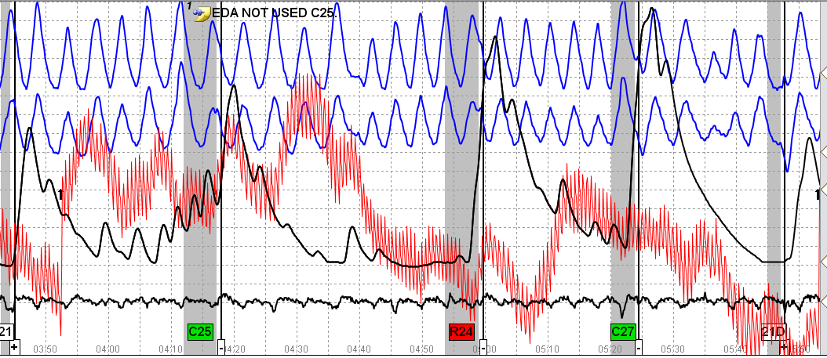
Example 2 – Chart 2 R24 – Serious crime

Slide 82
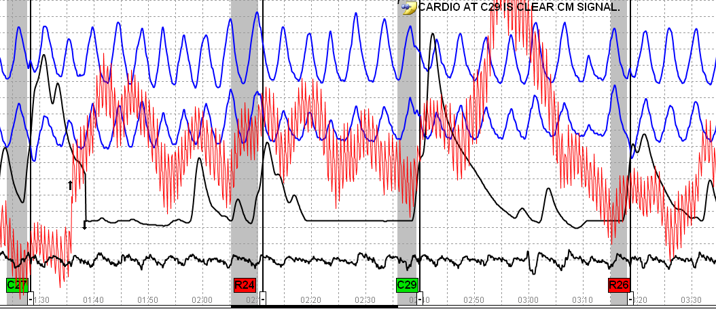
Example 2 Chart 3
Notes:
Double CV at C29

Slide 83
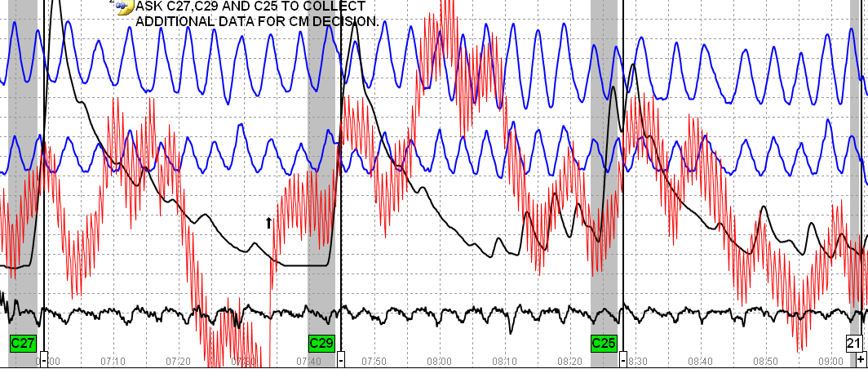
Example 2 Chart 3 - Three PLCQ at the end of the chart
Notes:
This examiner chose to ask 3 PLCQ at the end of the chart to make a final CM determination
Note that the PN channels are fairly stable

Slide 84
Example 2 - Teaching Points
Tightening the stomach muscles and buttocks should have caused significant responses in the seat sensor (Cushion appeared to be working)
Possibility: Padding in his under clothes to mask MV
Clenched teeth can cause dramatic CV changes, but often revealed in PN channels
Consider the possibility that examinee is lying about what CM he is performing
Pretest admission to prescription drug abuse – Global evaluation: Probably hiding serious crime

Slide 85
Example 3
Researched polygraph on the Internet
Concluded from research 4 ways to defeat his polygraph examination
Bite tongue
Bite cheek
Anal sphincter
Tack in shoe
He chose biting cheek – less painful
Did CM because deceptive to the issue
Notes:
Inserting something into a child’s anus…
U-Phase ZCT
C4 – Prior to year 2009, did you ever perform an unnatural sex act?
R5 - Did you insert anything into Angie’s anus?
C6 – Prior to your 21st birthday, did you ever masturbate?
R7 - Did you insert anything into Angie’s anus while in that room?
C8 – Before 2009, did you ever do something sexual for which you are ashamed ?
Isn’t it interesting that someone who would insert objects into a child’s anus would be concerned about a painful CM

Slide 86
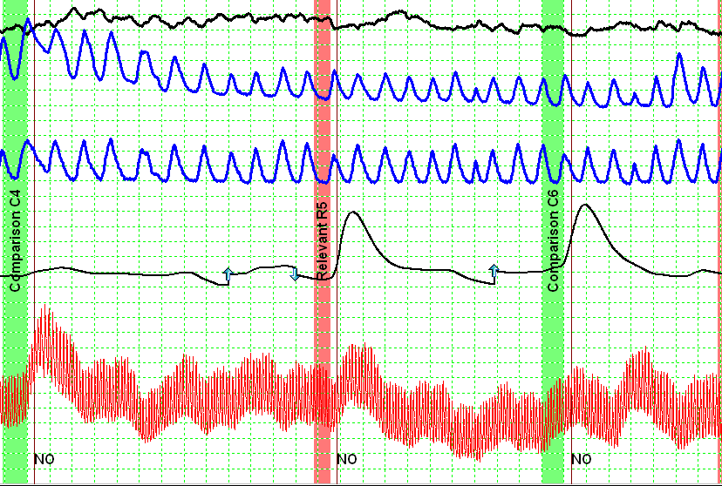
Chart 1 Spot 1

Slide 87
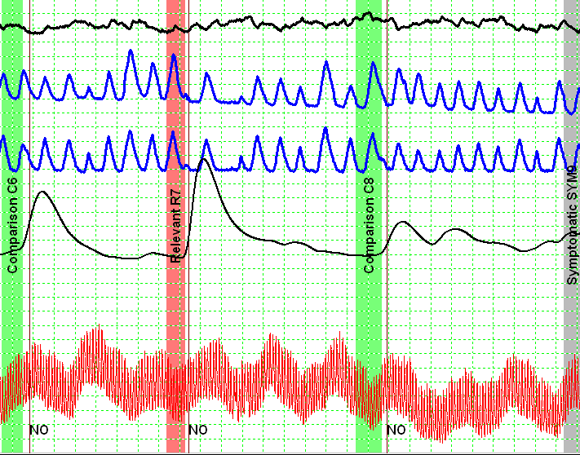
Chart 1 Spot 2

Slide 88
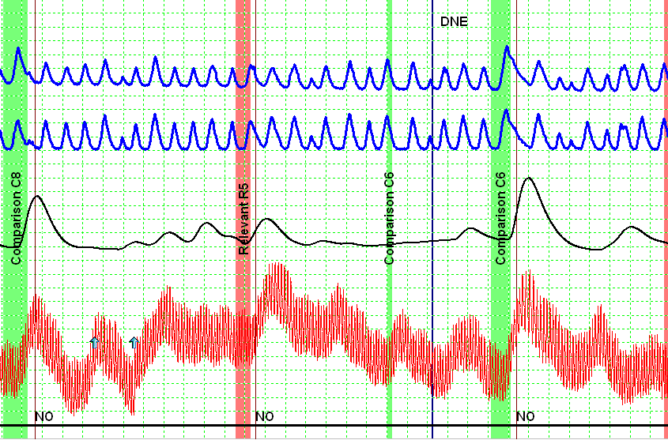
Chart 2 Spot 1

Slide 89
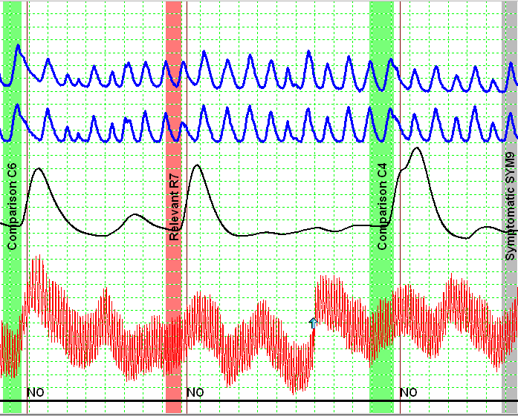
Chart 2 Spot 2

Slide 90
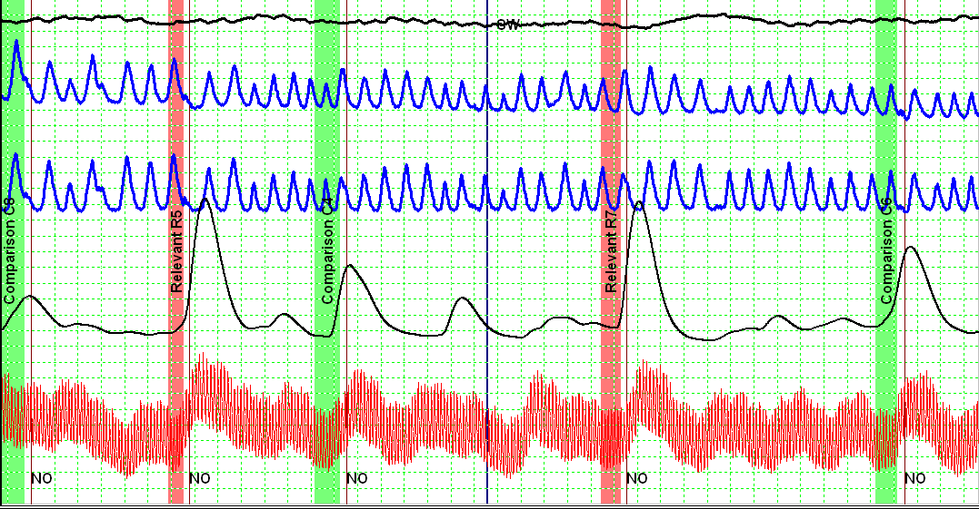
Chart 3 Both Spots

Slide 91
Example 3 - Teaching Points
Did you see anything to indicate CM activity?
Not much
Occasional dragging of exhalation in PN channel
Occasional sharp rise in CV channel – The sharp rise consistent on those occasions with the dragging exhalation
Examinee still responding to the relevant questions, but the examinee wins if the results are NO

Slide 92
Example 4
Examinee is a contractor
He admitted to altering his physiology to influence the outcome of the test
He admitted to the following CM activity:
Excessive swallowing
Deliberately blinking his eyes
Crossing his eyes and rolling them up
TES followed by two MGQT’s using PLCQ

Slide 93
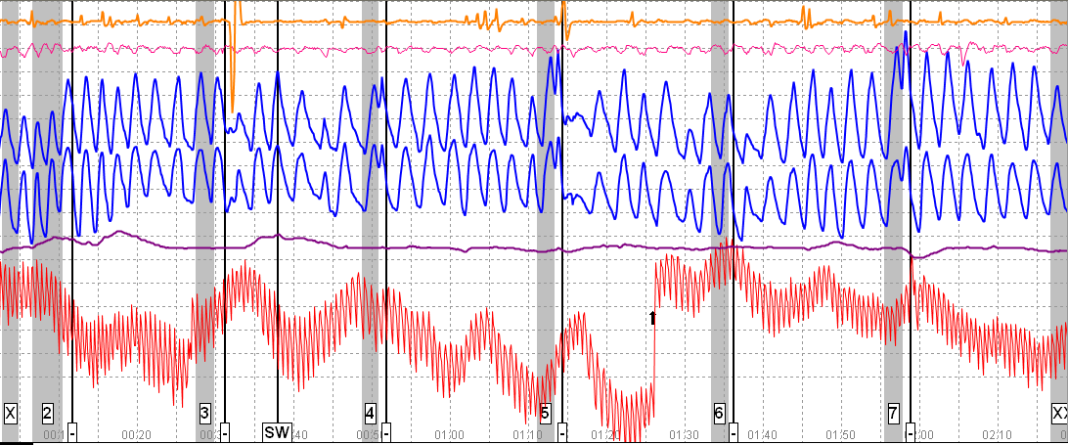
ACQT – What information can you glean from this chart?
Notes:
Examinee attacked the key

Slide 94
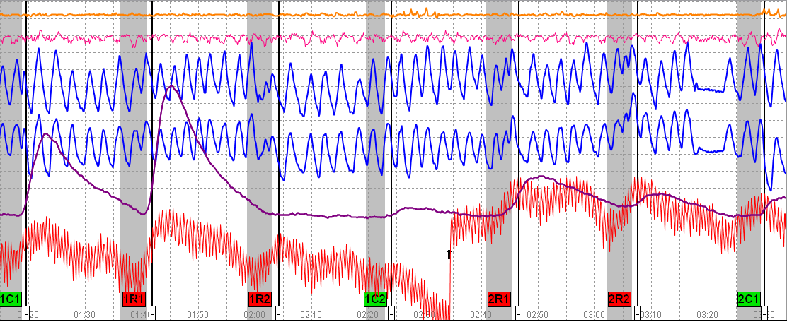
TES – 1st two askings

Slide 95
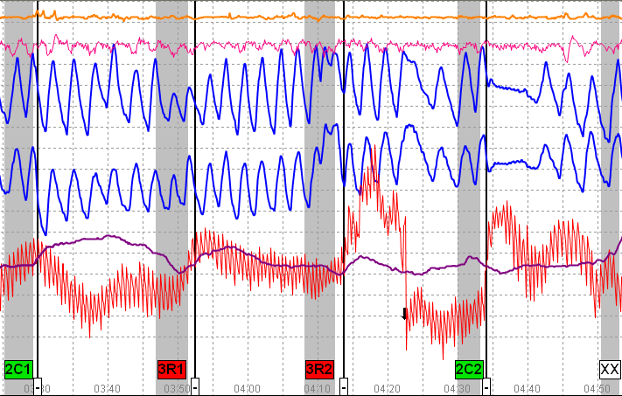
TES – Last asking

Slide 96
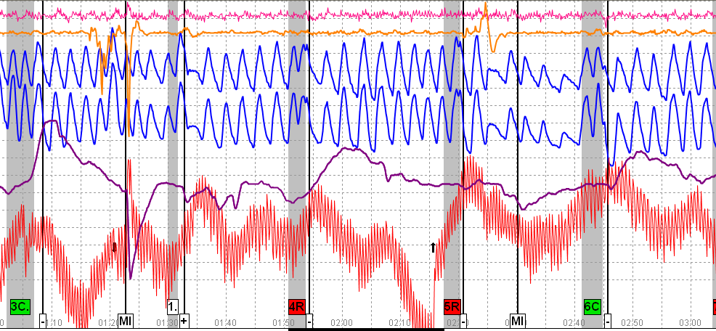
MGQT (Series 2) – Chart 1 - [ 4R – Sabotage ; 5R – Spying ; 7R – Terrorism ]

Slide 97
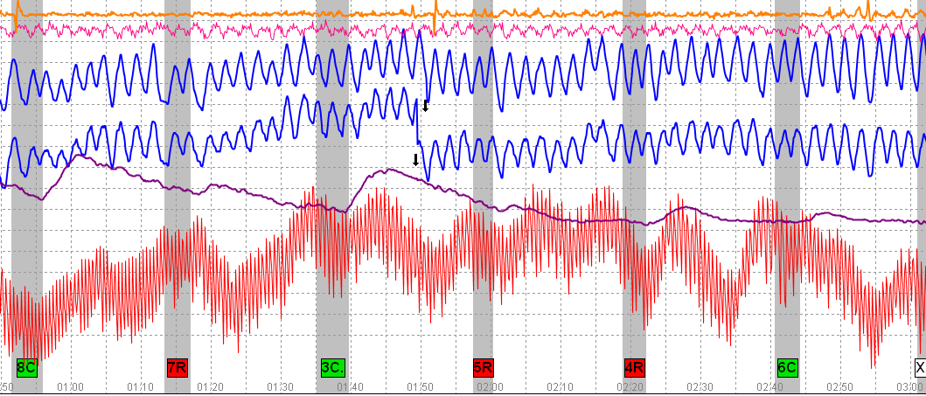
MGQT (Series 2) – Chart 3

Slide 98
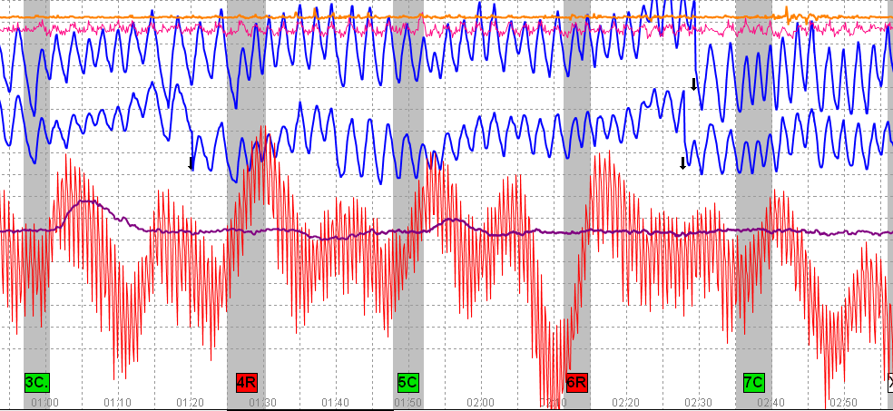
MGQT (Series 3) – [ 4R – Sabotage USG Info Sys; 6R – Damage USG Defense Systems

Slide 99
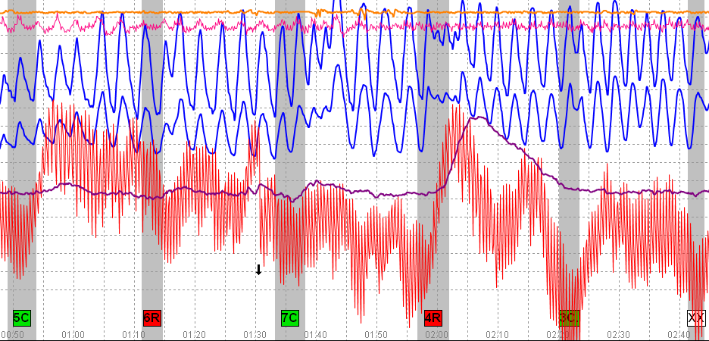
MGQT (Series 3) – Chart 2

Slide 100
Example 4 - Teaching Points
Sloppy and erratic test data should tell us something
Stop running charts
Stop giving BI/MI instructions
Examinee is either DI, or performing CM, or both DI and performing CM
3 Series with 9 charts conducted before the examiner decided to talk to the examinee
Kudos to examiner for stop trying to “get examinee through the test”

Slide 101
Countermeasures Exercise
Do you see CM?
Yes/No
Notes:
The purpose of viewing these samples is to provide an opportunity to see test data.
Some of the test data is messy – Some may contain CM – Some may not – look at the data and make your decision

Slide 102
Example 1
LEPET (Suitability) Exam
Notes:
Why is the test data (particularly the PN Channels) messy?
Are the Pneumograph tubes attached correctly?
Upper across the chest
Lower across the diaphragm
Are the Pneumograph tubes too tight?
Are the Pneumograph tubes rolling?
Is there a loose or broken wire along the EDA shielded cable?
If finger plates are being used – are they loose causing a break in contact between the plate and the fingers?
EDA sensitivity is 0.8 on 1st chart; 1.7 on 2nd; & 2.5 on 3rd

Slide 103
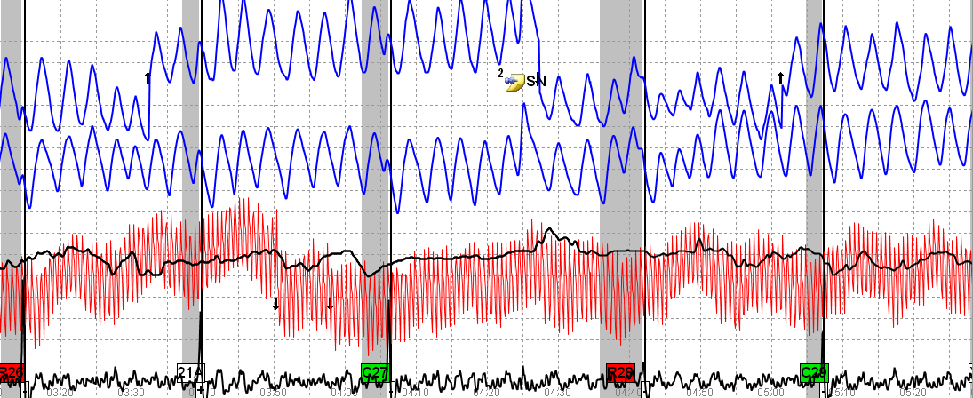
Example 1
Notes:
Example 1
PN channels are not stable.
R28 – PN channels atypical – rise off the baseline forming a new baseline
EDA channel chatter with random responses
CV channel – Pulse rate 96 BPM with strong responses at the relevant questions.
At this point – no decision can be made regarding CM activity.

Slide 104
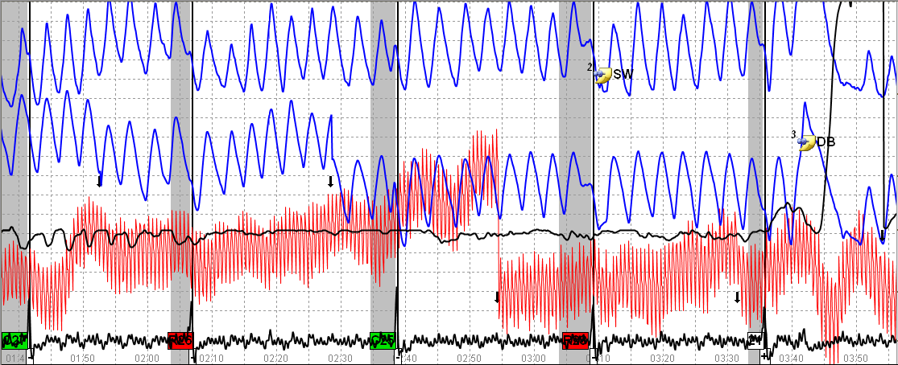
Example 1
Notes:
PN channels are not stable
C27 – Upper PN rising off the baseline. Lower PN re-centered by examiner. It appears that it would have been a diverging PN.
C27 - EDA channel at C27 almost looks like a broken wire. Possibly movements.
C27 - CV channel secondary blood volume increase too good to be true
C25 – PN channels baseline drop + CV channel secondary blood volume increase
IRQ – DB and apnea

Slide 105
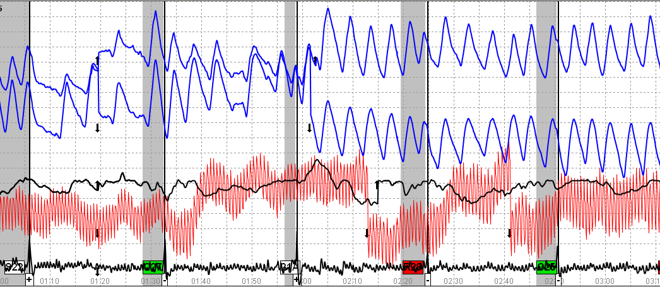
Example 1
Notes:
IRQ – PN channels - False apnea + baseline changes
C27 – Appears to be trying to recover from manipulated irrelevant question.
21A – Examiner moved both PN in opposite directions
R28 – Strong CV responses
Lower PN channel began wandering down from 21A through C25

Slide 106
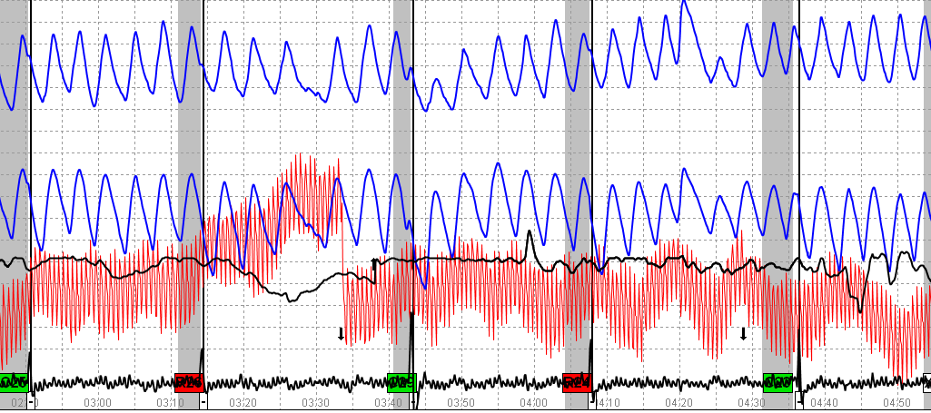
Example 1
Notes:
C29 – PN channels changing baseline + MV in sensor pad at the answer
C23 – Lower PN channel dropped off baseline + EDA drop – both indicate MV
R26 – Strong CV responses
It is clear that examinee is manipulating test data.

Slide 107
Exercise 1 What is your Decision?
The rest of the story:
Examinee admitted mental CM
Dissociating himself to avoid thinking about the questions
To avoid admitting to using Crystal Meth over 10,000 times
Notes:
R26 is the drug question

Slide 108
Example 2
LEPET (Suitability) Exam

Slide 109
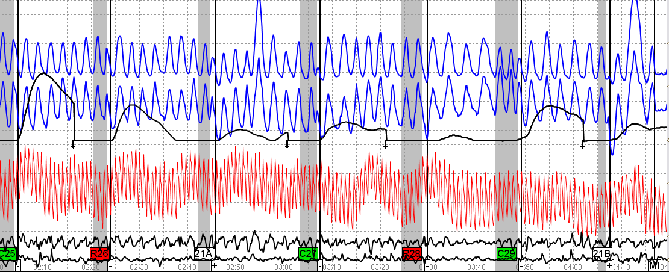
Example 2
Notes:
PN channels are not stable
C25 – PN channel drops off the baseline then rises.
21A – PN channel is clearly atypical – both channels drop a full baseline suggesting movement.
C27 – Lower PN channel about 12 seconds after the answer rises with a corresponding rise in the CV channel
C29 – 3 breaths in a 5 second question window
R28 – Significant change in rate at the PN channels
21B – PN channels drop and DBs

Slide 110
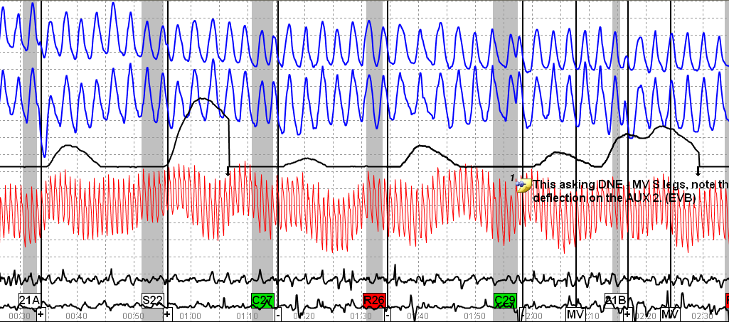
Example 2
Notes:
21A – Converging PN channels + lower PN channel exaggerated exhalation.
C29 – MV in sensor cushion + crown in PN channels
R26 – PN channels rate change

Slide 111
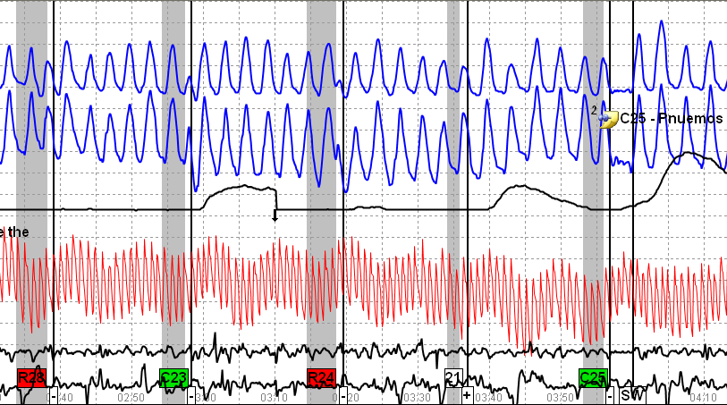
Example 2
Notes:
C23 – Lower PN channel – Exaggerated exhalation pulling lower PN off the baseline
21 – Lower PN channel rising off the baseline
C25 – Note shows a SW, but I see several seconds of apnea.

Slide 112
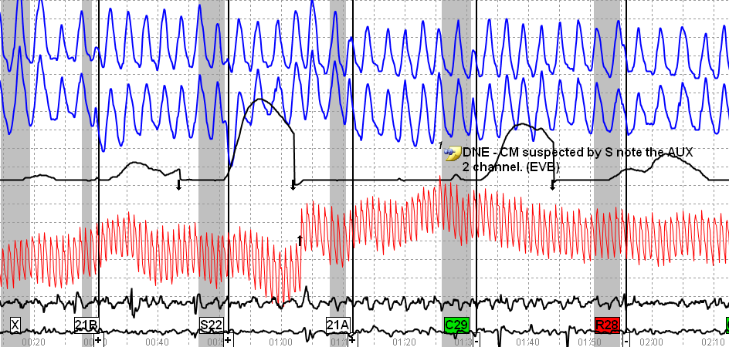
Example 2
Notes:
21B – PN channels drop in baseline
21A – Same
C29 – Examiner noted MV in sensor cushion.

Slide 113
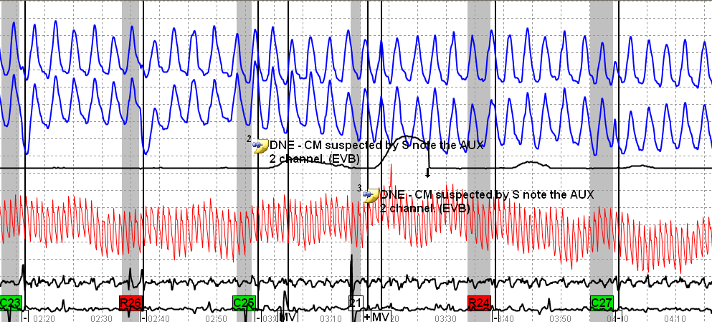
Example 2
Notes:
PN channels are not stable
C23 & C25 MV in sensor cushion
21 – MV in sensor cushion

Slide 114
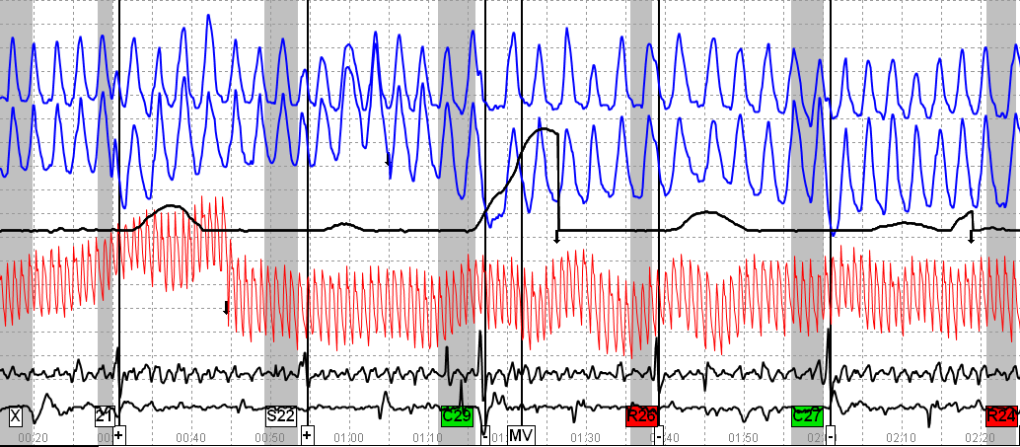
Example 2
Notes:
21 – Lower PN channel exaggerated exhalation pulling off baseline
C29 – False apnea + MV in sensor cushion
C27 – Lower PN channel drops off the baseline

Slide 115
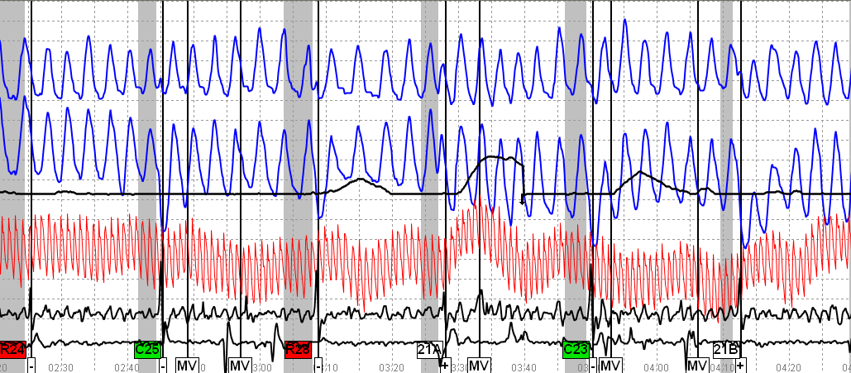
Example 2
Notes:
C25 – MV in sensor cushion + Lower PN channel dropped off baseline
21A – MV in sensor cushion + PN channels dropped off baseline
21B – Lower PN channel – exaggerated exhalation plus both PN channels drop off the baseline.

Slide 116
Example 2 What is your Decision?
Identified IRQ as “setup questions”
Turned them into lie questions – thought hard at each – thinking of specific lies
Sang Christmas songs in head at the IRQ
Thinking so hard at IRQ he realized one foot off CM pad
Hiding steroid use
Numerically, NDI
Notes:
Examinee was also manipulating the comparison questions

Slide 117
Example 3
LEPET (Suitability) Exam
Evaluate R24 spot only

Slide 118
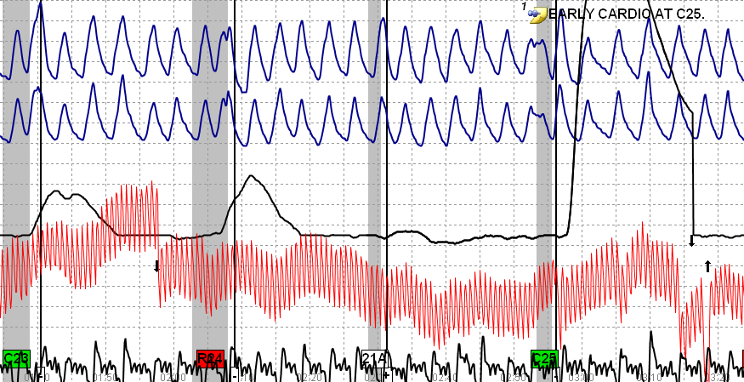
Example 3
Notes:
C23 & C25 – Apnea begins just before the question is asked. Examinee is anticipating the questions (suggesting he knows what question (relevant or comparison) is coming.
Early apnea causes an early rise in the CV channel
Secondary blood volume increase at both PN channels

Slide 119
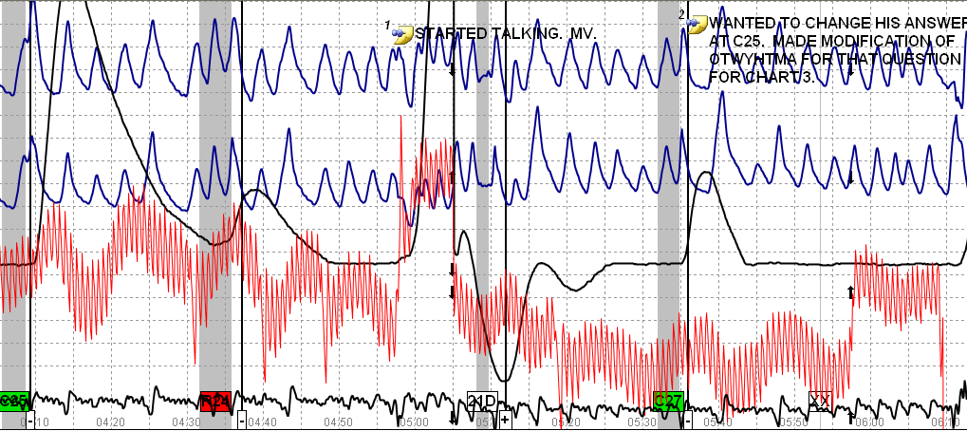
Example 3
Notes:
This chart is a mess between moving and talking
C25 – PN channels – examinee took a breath & answering while breathing in
C27 – Apnea after the answer
R24 - PVCs only at the relevant question

Slide 120
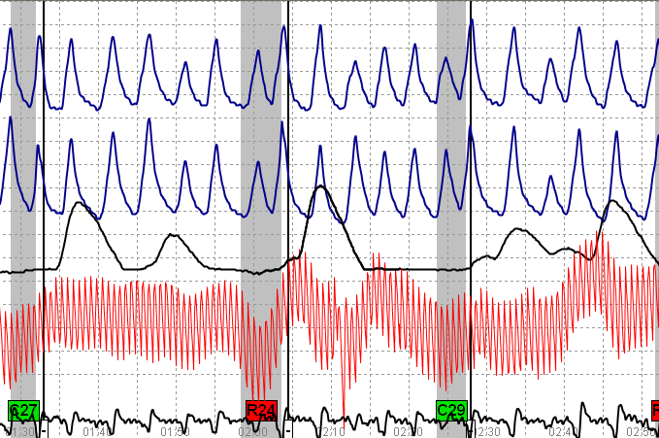
Example 3
Notes:
Clean chart with a secondary rise in blood volume at C29.
R24 – Once again we have a PVC only at the relevant question

Slide 121
Example 3 What is your Decision?
Examinee tightening legs specifically at C25 and C27
Read information about CM & discussed polygraph CM in a criminal justice class
Hiding serious crime issue

Slide 122
Example 4
LEPET (Suitability) Exam

Slide 123
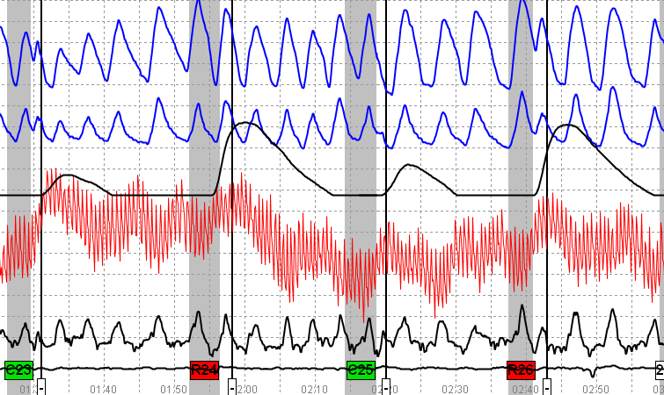
Example 4
Notes:
Controlled breathing
C23 – sharp CV tracing
Strong relevant responses in both EDA & CV channels
Not much in the way of CM signatures at this point

Slide 124
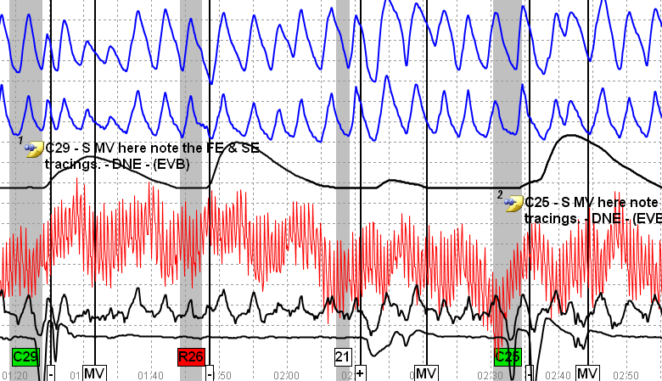
Example 4
Notes:
C29 & C25 – MV in sensor cushions + both PN channels have atypical breathing after the answer + C25 CV channel too good to be true with its sharp rise.

Slide 125
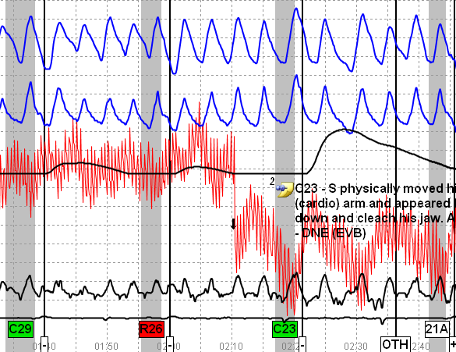
Example 4
Notes:
Examiner observed examinee move arm and clench jaw at C23
Now we have frequency and specificity

Slide 126
Example 4 What is your Decision?
Mental thoughts (happy place); Anal sphincter; Running tongue across teeth; Controlled breathing.
Admitted to defeating two polygraph exams – one with a local Sheriff’s office & the second with a Federal agency. He was scheduled to start work for the Federal agency in a week.
Admitted to hiding extensive drug involvement
Notes:
Beat a DEA exam. Scheduled to go to work for them.
This was a CBP exam – they passed to DEA regarding subject’s drug use and defeat of their exam using CM.

Slide 127
Example 5
LEPET (Suitability)

Slide 128
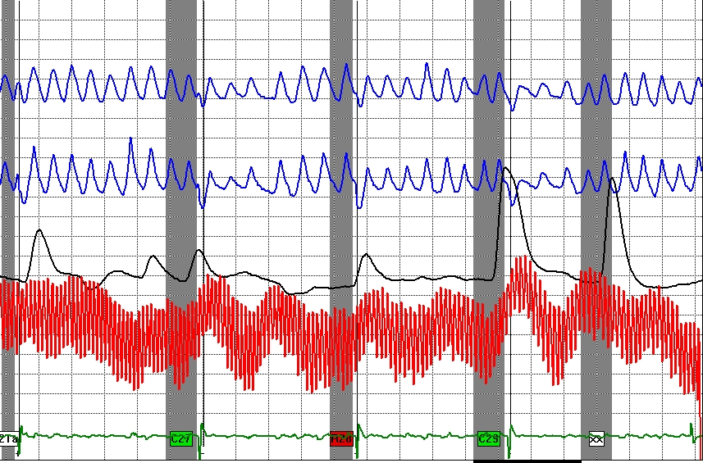
Example 5
Notes:
Example 5
C27 & C29 – Note the rate change and I/E change that goes on for 15 seconds + the CV channels for both comparison questions have very sharp reactions.

Slide 129
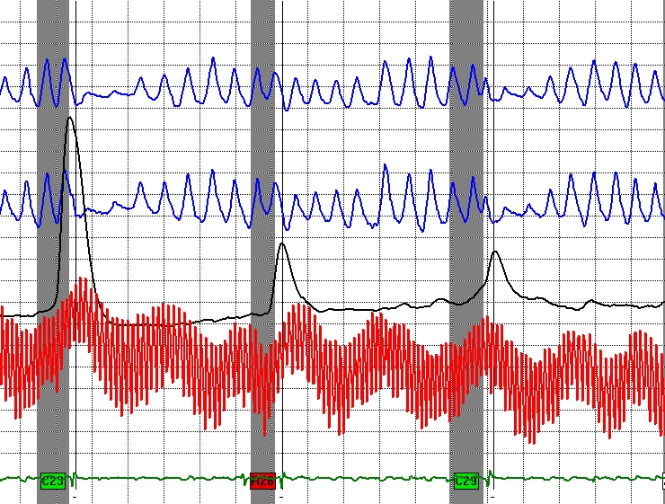
Example 5
Notes:
Example 5
C23 & C29 – Cookie cutter responses in both PN channels – frequency and specificity + strong EDA at C23 & large CV channel responses

Slide 130
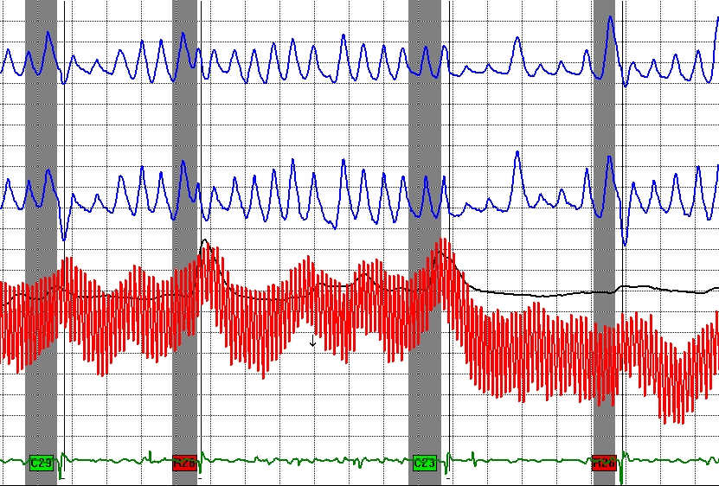
Example 5
Notes:
Example 5
C29 & C23 – Cookie cutter (lacking variability) responses in PN channels + sharp CV at C23.

Slide 131
Example 5 What is your Decision?
Examinee performing mental math and controlling his breathing
Learned about the activity on the Internet
Hiding drug activity

Slide 132
Example 6
TES

Slide 133
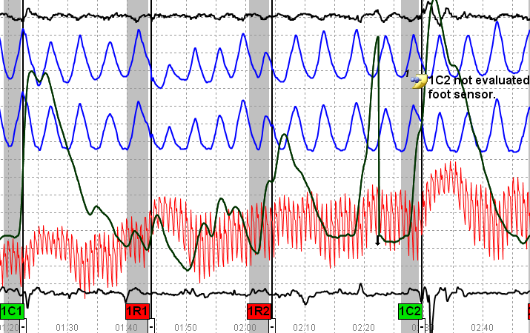
TESA 1st Asking
Notes:
2-sensors are being used (one for the seat and one for the feet)
1C1 – slight movement in both pads after the answer
1C2 – larger responses in both pads + sharp CV rise which is unusual for a DLCQ

Slide 134
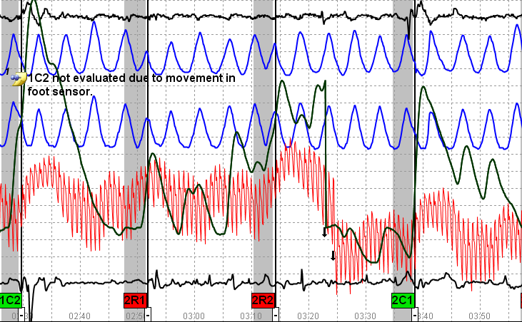
TESA 2nd Asking
Notes:
1C2 – discussed last chart
2C1 – MV both pads
Large EDA responses and CV responses both DLCQ

Slide 135
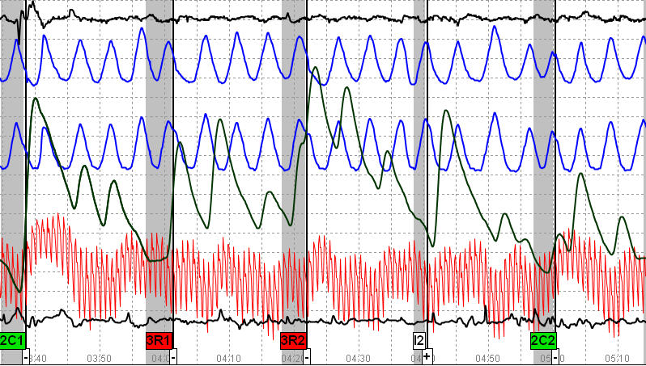
TESA 3rd Asking
Notes:
2C1 – already discussed
Labile EDA

Slide 136
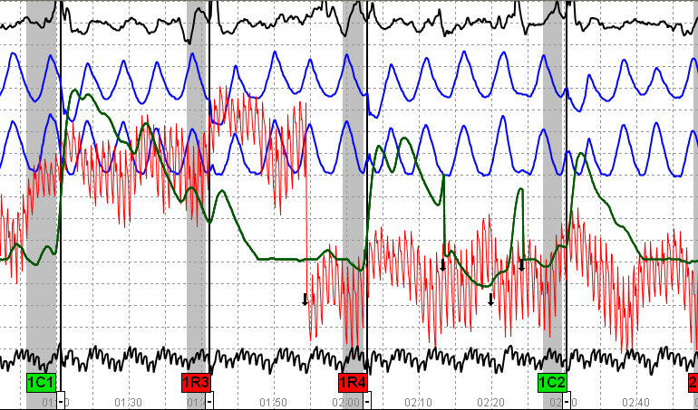
TESB 1st Asking
Notes:
TESB – 1st asking
Sensor pad movement at all of the questions
1C1 – very strong CV channel starting early
1C2 – Sharp CV
Messy CV channel with strong responses at the relevant questions particularly R3.

Slide 137
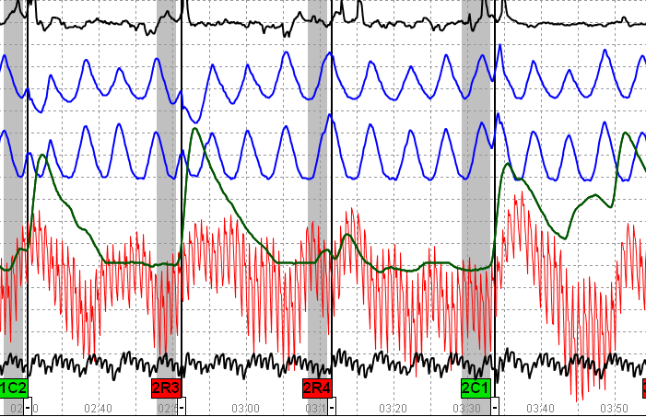
TESB 2nd Asking
Notes:
TESB – 2nd asking
DLCQ – MV in sensor pad
1C2 – Temporary rise off baseline in upper PN channel
2C1 – Very sharp CV rising almost 5 chart divisions

Slide 138
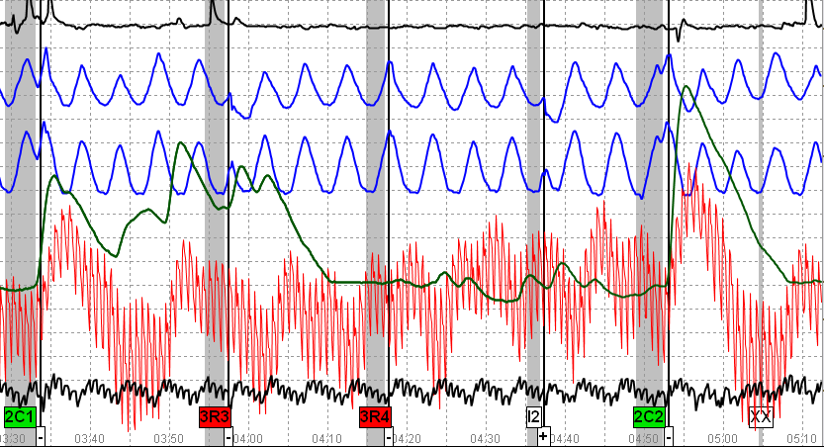
TESB 3rd Asking
Notes:
DLCQ – the CV channels are cookie-cutter (lack variability)
MV in sensor pad for both DLCQ

Slide 139
Example 6 What is your Decision?
Researched polygraph on Internet prior to his last polygraph 5 years ago
Received an email from a friend telling him not to take DB but to breath normally
Clinched buttocks and curled toes at the DLCQ
Admitted to accidently taking classified (TS) document home & telling his wife about information he read in a classified database

Slide 140
Exercise Importance of proper tracings

Slide 141
TES Exam Background
Examinee’s First Polygraph
Assignment to Another Agency
Counterintelligence Scope Only

Slide 142
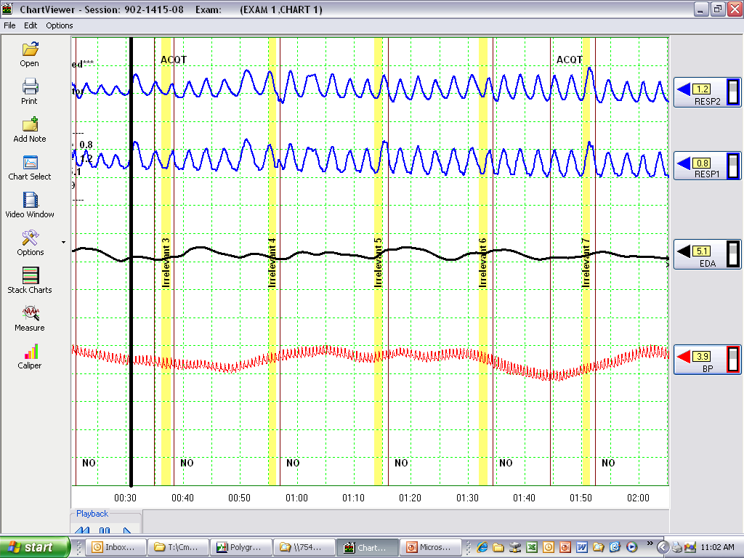
ACQT – Do you think the tracings are adequate?

Slide 143
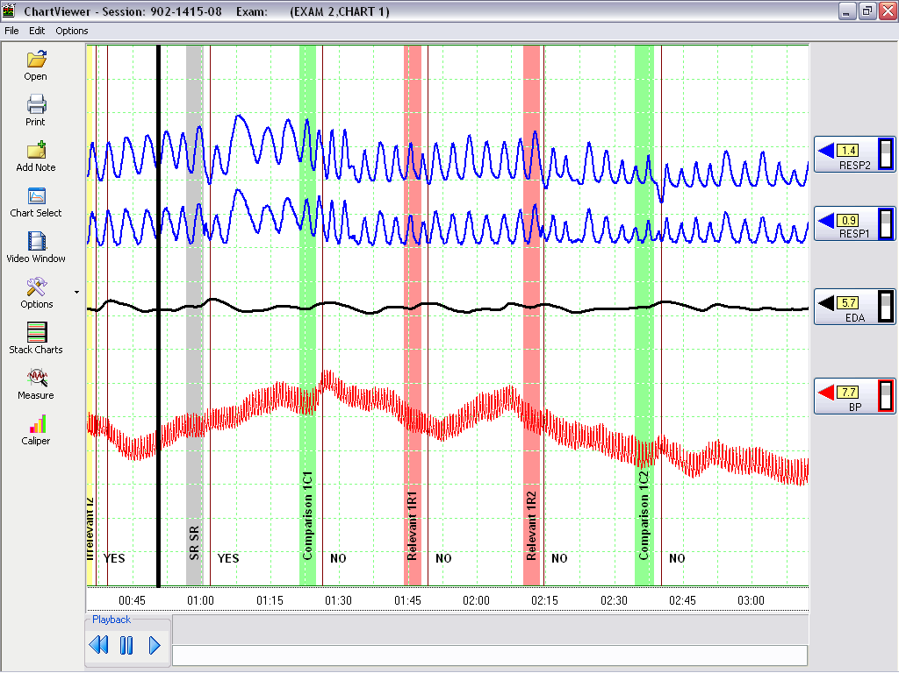
Chart 1 (1st asking) – Can you evaluate the test data?

Slide 144
Chart 1 (2nd asking) – Continue with the evaluation?

Slide 145
Chart 1 (3rd asking) – What is your decision? Do you see CM?

Slide 146
OPERATIONS
Let’s look at the same exam with different sensitivity settings

Slide 147
ACQT

Slide 148
Chart 1 (1st asking)

Slide 149
Chart 1 (2nd asking)

Slide 150
Chart 1 (3rd asking) - Has your decision changed?

Slide 151
Operations
Let’s look at the same charts again with the sensor pad turned on

Slide 152
ACQT

Slide 153
Chart 1 (1st asking) – Where are the movements?

Slide 154
Chart 1 (2nd asking)

Slide 155
Chart 1 (3rd asking)

Slide 156
Exercise What did you see?
One clean movement at each comparison question
EDA is labile
After ACQT – breathing becomes erratic

Slide 157
Exercise Post-test Interview
Examinee claimed the following:
Claimed to flex his right leg (toe) at all DLCQ
He flexed right leg because CV cuff placed on left calf
Learned the activity by watching TV (“The Profit” and “Doctor Phil Show”.
Discussed CM with AIT students at Goodfellow AFB, TX
A SSgt claimed to use technique to pass his poly
Denied on-line research
Said he was just trying to help himself

Slide 158
Exercise Questions to consider
Do you believe his story?
He has been selected to fill an NSA billet
Do you think he attempted to hide relevant responses?

Slide 159
SERIES II
After Admissions
Same Relevant Questions
35 minutes later

Slide 160
Do you see any problems with this test data?

Slide 161
Are you comfortable with this data? Why? Why not?

Slide 162
Are you comfortable with the test data now?

Slide 163
Exercise Post-mortem
The last exam was called No Opinion
Do you think that was the right decision?
What approach would you have taken?
Examinee was scheduled for further testing
If you were required to test this individual again, what approach would you take?

Slide 164
Countermeasures Exercise
Why anti-polygraph folks have had to change tactics
Notes:
Countermeasures Exercise
When the NCCA developed the sensor cushion all of the polygraph program managers were given an opportunity to see if they could defeat the sensor.
The next set of slides are their attempts.
The key here is that these are all senior examiners attempting to be defeat the sensor so the physiology is very subtle + there is no anxiety.

Slide 165
Best Guess #1 DVW
Notes:
Best Guess #1 – Do you see a CM?

Slide 166
Answer #1
Notes:
In this case the movement was caused by the anal sphincter.

Slide 167
Best Guess #2 DVW
Notes:
Best Guess #2 – What do you see?

Slide 168
Answer #2
Notes:
Answer #2 – AS at C10

Slide 169
Best Guess #3 DVW
Notes:
Best Guess #3 – What do you see?

Slide 170
Answer #3
Notes:
Answer #3 – Anal Sphincter

Slide 171
Best Guess #4 DVW
Notes:
Best Guess #4 – What do you see?

Slide 172
Answer #4
Notes:
Answer #4 – Toe Press

Slide 173
Best Guess #5 DVW
Notes:
Best Guess #5 – What do you see?

Slide 174
Answer #5
Notes:
Answer #5 – Toe press

Slide 175
Best Guess #6
Notes:
Best Guess #6 – What do you see?

Slide 176
Answer #6
Notes:
Answer #6 - AS

Slide 177
Best Guess #7 DVW
Notes:
Best Guess #7 – Best guess?

Slide 178
Answer #7
Notes:
Answer #7 – Examiner tried to be sneaky – AS at the relevant question
CM at the relevant questions are not uncommon – some folks just do not study well before taking a test

Slide 179
Best Guess #9 DVW
Notes:
Best Guess #9 – Nothing to see

Slide 180
Are you paranoid?! No CM
Notes:
Answer #9 – No CM activity in the sensor.

Slide 181
Best Guess #10 DVW
Notes:
Best Guess #10 – Take a guess.

Slide 182
Answer #10
Notes:
Answer #10 – C3 pretty obvious
Examinee doing AS – slowly increasing as Doug Williams suggests and slowly decreasing pressure. Being very subtle

Slide 183
Best Guess #11
Notes:
Best Guess #11 – Number 5
Attacking the ACQT key

Slide 184
Answer #11
Notes:
AS at the key

Slide 185
Best Guess #12
Notes:
Best Guess #12 – What do you see?

Slide 186
Answer #12
Notes:
Answer #12
Note the distortion in the sensor does not match up with the answer at 3C & 6C, but does match up with the answer marks at the relevants.
3C & 6C are toe presses & 1A is an anal sphincter.

