Slide 1
Physiological Features A Review of Polygraph Test Data
National Center for Credibility Assessment
Notes:
Physiological Features
We discussed the reason for getting back to basics.
Now we want to review physiological features observed in each polygraph channel and discuss whether these features are typical or atypical, or in some cases both typical and atypical.
This is a very important block of instruction for several reasons:
1st – you will realize there is a fine line between typical and atypical features
2nd – you will realize the importance of good polygraph operations and good interpersonal skills
3rd – you will realize that CM detection is an art form that requires good interpersonal skills, good polygraph operations, and the ability to identify behaviors consistent with CM.

Slide 2
Physiological Features First Consider:
Must get back to basics
Must have good interpersonal skills
Must have a properly functioning polygraph instrument
Must have all components properly placed
Must have good operational skills
Must be able to globally evaluate test data
Notes:
Get back to basics – Discussed in 1st slideshow – need clean test data
Good interpersonal skills - PPP – lack critical thinking – not inquisitive – challenge inconsistencies in a non-confrontational manner
Properly functioning instruments (includes all components) – Leaking CV channel, a broken EDA, or a limp PN tube?
Properly placed components – PN tubes: Stretched to backbone – around beltline; EDA plates so tight fingertips turn blue; CV cuff loose, on the elbow, against the underarm, pressure too low or too high.
Good operations – Record 20 seconds X & XX; Question spacing does not fit examinee’s physiology (e.g., 10 to 12 seconds between questions); Proper sensitivity in all components; Not using standardized chart markings; Not allowing to return to homeostasis
Global evaluation – What does the whole picture tell you? Do you see physiological criteria that is beyond what should be seen in a polygraph examination?
Most NCCA trained examiners conduct a global evaluation to identify artifacts – CM features
After the numeric decision there should be a global evaluation of the test data – Why? Looking for consistent, significant responses at relevant issues – looking for patterns of behavior consistent with CM

Slide 3
Physiological Features What is Atypical?
All features discussed are not necessarily atypical – Why?
When do physiological features become atypical?
Do you think examinees are aware that some CM produce features that are atypical?
Should the examiner reveal CM features to examinee? Why? Why not?
Notes:
Not necessarily atypical – Why? There is 4 physiological aspects to every chart containing test data:
(1) When sitting at rest the examinee should display normal physiology when they do not suspect that a test has begun. (This is their norm).
(2) When a stimulus is applied (test question) there is a physiological response or reaction to that applied stimulus.
(3) At some point depending on the physiology of the examinee there is a return to homeostasis (recovery).
(4) Everything else is some form of artifact or distortion (SN, C, CT, SW, DB, answer distortion)
Whether norm, reaction, recovery or artifact – all leave a signature.
When does the signatures become atypical?
When they look dramatically different than the typical physiology.
When a pattern develops (e.g., only SN at the comparison questions)
When globally the physiology no longer looks normal for the individual being tested.
Unaware of the physiology – Not aware that the cognitive process of performing a mental CM may affect PN, EDA, & CV channels in a way that appears atypical.

Slide 4
Physiological Features
Do you think polygraph examiners can leave their own personal signature on every exam that they run?
Is it possible that a polygraph examiner might assist in creating atypical physiology produced by an examinee?
Notes:
Over time a QC can often identify the examiner that ran an exam during a blind review.
Consistently late with their stim marks.
Certain colors in their component tracings
Lack proper sensitivity settings
Routinely produce crappy charts
Lack proper question spacing
Repeatedly re-center tracings
Repeatedly provide BI on charts at certain locations
Repeatedly identify artifacts at relevant questions but not at comparison questions
Can an examiner cause examinee to produce atypical physiology?
Constant BI
Telling examinee not to SW, CT, DB, SN during the test
Getting angry at the examinee (raising voice)
PPP
Improperly placed components – Improper pressure in CV cuff

Slide 5
Physiological Features Block Objective
Determine if it is possible to differentiate between typical and atypical physiology
Classify different physiological features as typical or atypical
Identify when physiological features are likely to be atypical
Notes:
This block is the cornerstone for the Comprehensive CM course
We in TASS have confirmed that most polygraph examiners are not adept at identifying CM.
We have no way of identifying whether CM performers ‘beat’ the test.
We do know that some examiners are very good at identifying CM and obtaining CM confessions – this usually relates to good interpersonal skills.
As we begin to show pictures of test data we will discuss whether CM are taking place or whether it is typical physiology
During this discussion (which will be classified SECRET) we will identify and classify features that are atypical and consistent with CM.

Slide 6
Physiological Features Pneumograph Channel
What are the NCCA TDA evaluation criteria for the PN channels?
What might cause changes in the PN channel tracings?
How do you know when TDA criteria are atypical?
What effect will BI have on tracings?
Notes:
TDA PN criteria: (1) Apnea; (2) Decrease in amplitude; (3) Progressive decrease in amplitude; (4) Decrease in rate; (5) Change in I/E ratio; (6) Temporary rise from baseline.
What might cause changes in the PN channel tracings? (1) PN tubes are too tight or too loose; (2) Anti-roll bar is loose; (3) PN tubes are improperly positioned; (4) PN tubes have a leak or the rubber band/spring is broken; (5) Artifacts (DB, SW, SN, SZ, M, T); (6) Answer distortion; (7) Response to an applied stimulus; (8) Recovery/return to homeostasis.
Is it possible that many of the above can cause the PN channel to appear to be atypical?
When are these criteria atypical? (1) When they have a dramatic change that is inconsistent with what is normally seen during a polygraph examination; (2) When there is frequency and specificity present
Frequency & Specificity do not necessarily mean dramatic.
What effect will BI have on tracings? (1) Innocent will breath at one half the normal rate; (2) Many will focus completely on breathing; (3) Many will control their breathing to appease the examiner.

Slide 7
Physiological Features Pneumograph Channel
Notes:
What do you see in the PN channels?
Do you think the physical MV in the seat sensor caused the physiological changes in the PN channels?
Do you think examinee is aware that his or her breathing has changed?
Do you think we should point out the seat MV and the breathing changes to the examinee? Why? Why not?

Slide 8
Physiological Features Pneumograph Channel
Notes:
Do you see anything atypical about this tracing?
Seat sensor MV
Discuss the other tracings

Slide 9
Physiological Features Pneumograph Channel
Notes:
What do you see typical physiology on this chart?
Do you see atypical physiology?
If atypical physiology is seen – how do you know it is atypical?
If typical physiology is seen – how do you know it is typical?

Slide 10
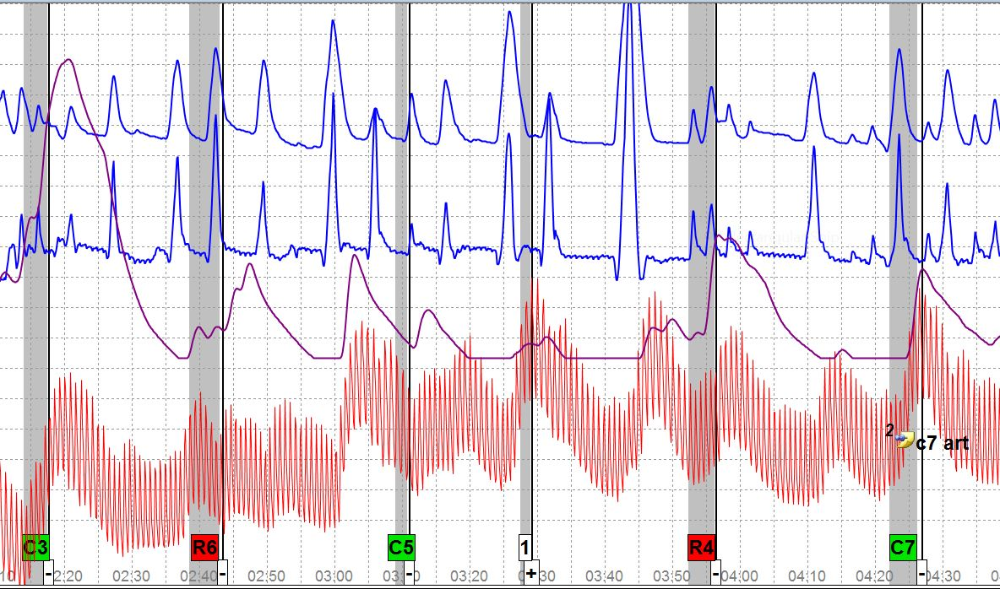
Physiological Features Pneumograph Channel
Notes:
Would you consider this typical or atypical breathing? Why? Why not
Is this bradypnea or apnea?
What do you think would cause such breathing? (DI/SR/CM/PPP/medical issues/old age)?
Is the breathing affecting any of the other channels?
______________________________________________________________
Confession:
Deliberately attempted to manipulate his physiology to control the outcome of the test – hiding petty crimes + knowledge that his brother is stealing cable and electricity.
He deliberately took DBs, focused on a spot on the wall, sang short songs, named different streets, repeated the names of buffet items in a Chinese buffet line.
He advised that he was so scared about the crimes that he did not listen to the examiner’s instructions. [File # 1945-13]
Will repeatedly see that examinee’s perform multiple CMs. Note the sharp CV amplitude increases at the comparison questions

Slide 11
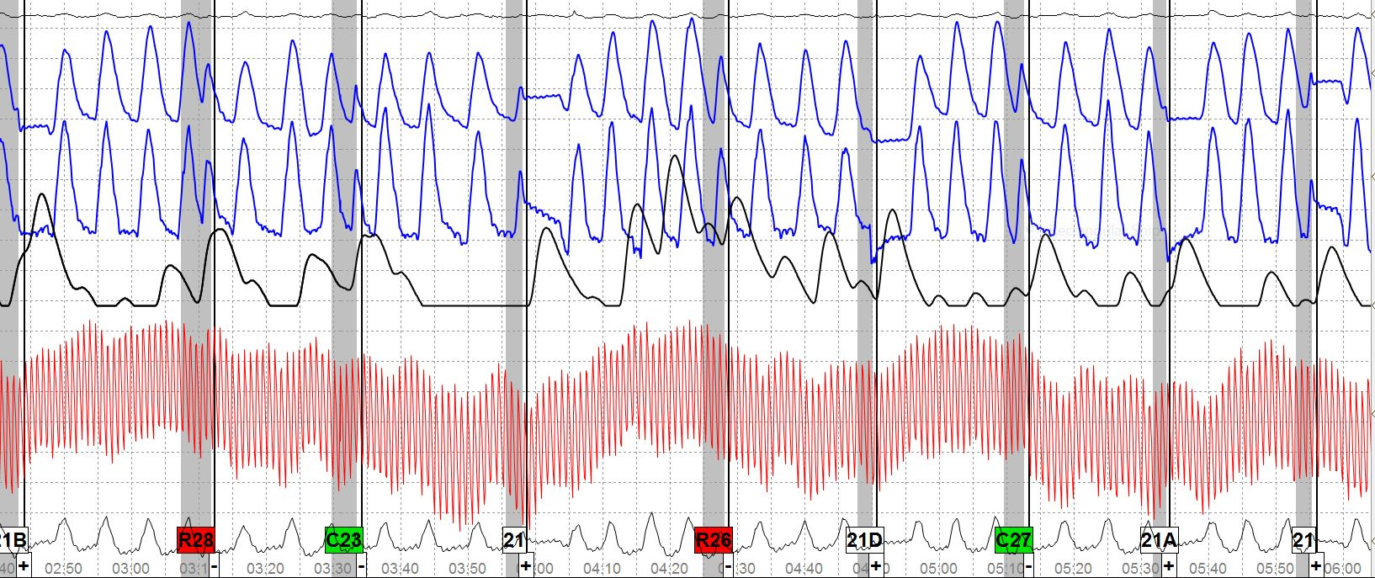
Physiological Features Pneumograph Channel
Notes:
Is the PN channel tracings on this chart different from that of the last chart? How so?
Do you think the physiology in the PN channels is typical or atypical?
Are the other channels typical or atypical? How so?
_________________________________________________________
File: 13-3146
Examinee admitted to attacking the Irrelevant questions
Examinee called the Irrelevant questions the “simple questions like what day is today?, are you sitting down?”
Examinee denied being deceptive on the test claiming he was just trying to stay calm through the process.
Do you think examinee is being truthful?

Slide 12
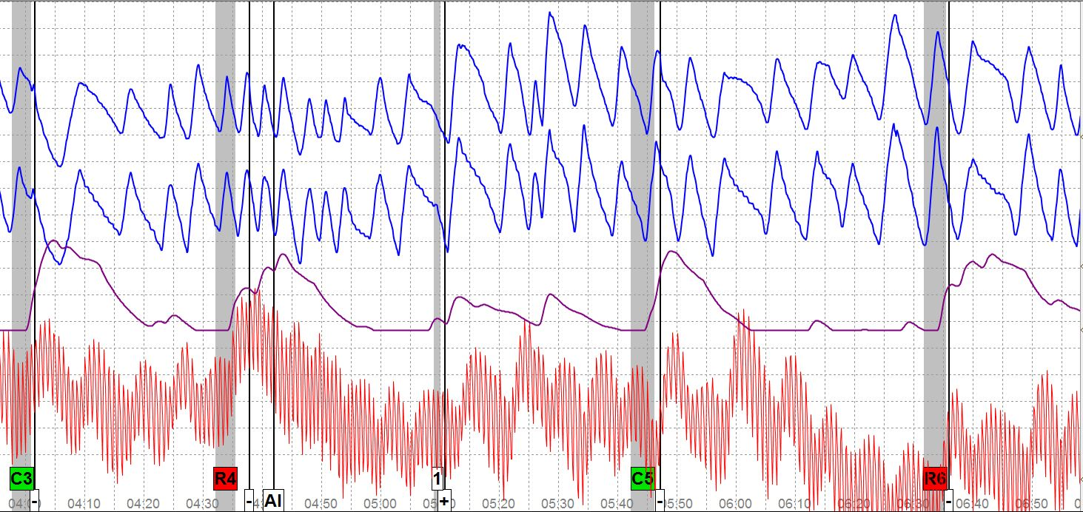
Physiological Features Pneumograph Channel
Notes:
Is this rhythmic breathing typical or atypical? Why? Why not?
Do you think there is a cause and effect relationship where in one place there is very slow breathing and the next very fast breathing?
Do you think the erratic breathing is affecting the other channels? Explain.
Do you think this breathing is deliberate? Do you think it is someone that is deceptive?
Do you see anything atypical about the PN channels?
________________________________________________________________
File # 1430-13
Deliberately manipulated physiology in an attempt to pass the test so he would not have to talk about prior drug use (currently on Active Duty). Hiding cocaine use 50 to 60 times while on active duty. Marijuana use approximately 40 times. Provided drugs to friends. Also used Adderall to stay awake
Went to Antipolygraph.org and downloaded book at work.
Bit his tongue & took DBs at the character questions. Do you see anything that indicates a TB? Note the strong responses at both the PLCQ & RQs.

Slide 13
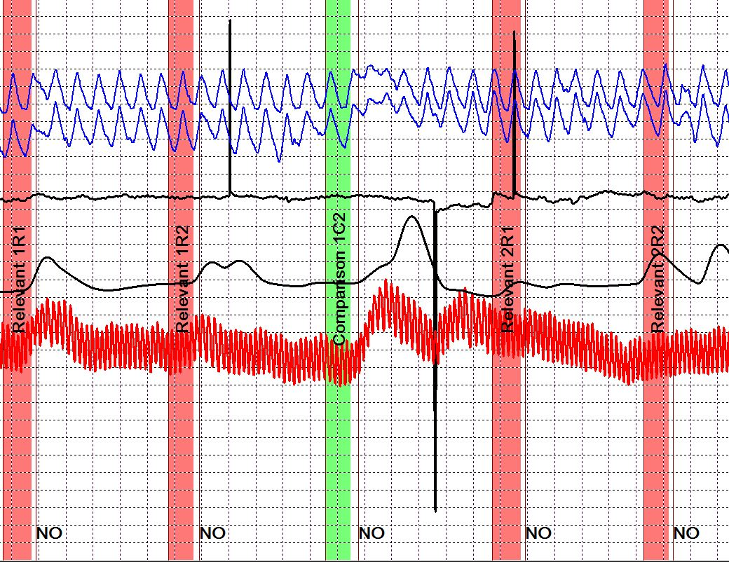
Physiological Features Pneumograph Channel
Notes:
Is the PN channel atypical? In what way? Do you think it is deliberate? Do you think the PN channels need more sensitivity?
Do you think the CV channel is atypical? How? Do you think the changes in the CV channel are caused by the breathing? By the MV in the sensor pad? By both breathing & MV?
File: 0432-13
Attempting to hide drug use - (It must be noted that this was a CI Screening exam – no questions involving drug use were asked) Examinee under mistaken belief that his CSP would include relevant questions addressing drug use.
DLCQs were “Did you ever violate a traffic law?” “Did you ever say anything you later regretted?”
He admitted to holding his breath at the DLCQs
Clear MV in sensor pad that is indiscriminate
May indicate that other CMs taking place

Slide 14
Physiological Features Pneumograph Channel
Notes:
What do you see in this slide? Is it typical or atypical physiology?
Do you think the physiology after the answer is caused by an artifact such as a SW? Do you think it was deliberate?
How would you describe the physiology in the PN channels?
Do you see anything in the other channels that you might question?
__________________________________________________________
The examinee attempted a toe press during this exam.
Note the MV sensor after the answer at C3.

Slide 15
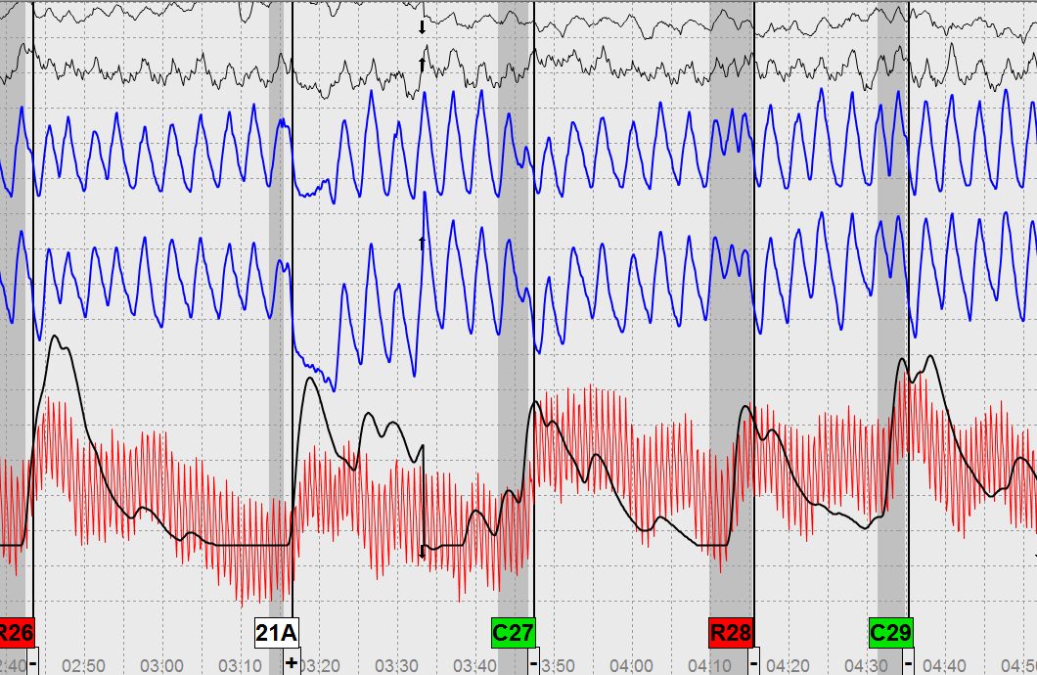
Physiological Features Pneumograph Channel
Notes:
Do you think that the PN channel response at 21A is the result of a SW?
Do you think that the PN channel response at R28 is atypical?
What about the rest of the questions?
________________________________________________________
Examinee claimed he was controlling his breathing & movements. He said he would stiffen up at the NO questions and relax at the YES questions.
He claimed he learned about polygraph and CM in a psychology class at school.
He was attempting to hide use of marijuana and illegal use of pain pills with alcohol. He also admitted to purchasing marijuana.
He advised he passed a pre-employment polygraph w/a local PD.

Slide 16
Physiological Features Pneumograph Channel
What are the average BPM?
What is hyperventilation?
How would you define Hyperpnea?
Can you define Tachypnea?
Can tachypnea be abnormal? Explain.
Is Bradypnea typical or atypical breathing?
Notes:
BPM: Average resting state breathing is 12 to 20 BPM? Healthy individuals with no medical issues.
Hyperventilation: Abnormal increase in pulmonary ventilation of the alveoli (which can occur through increased rate or depth of breathing, or both) where there is a small rise in metabolic carbon dioxide relative to this increase in ventilation.
Hyperpnea: Abnormal increase in depth and rate that is more rapid and deeper than at rest breathing.
Tachypnea: Very rapid breathing which is more than 20 BPM. Tachypnea could be the result of a medical issue, lying or CM.
Bradypnea: Abnormally slow breathing. Usually the result of a medical issue. Medically under 12 BPM.
For polygraph purposes if the breathing is 6-8 BPM probably DI, performing CM, or both DI & performing CM.

Slide 17
Physiological Features Pneumograph Channel
~30 cycles/minute
Notes:
Do you think this is typical or atypical breathing?
Explain.

Slide 18
Physiological Features Pneumograph Channel
Notes:
Do you think the picture depicts typical or atypical breathing? Explain.
This is an example of Hyperpnea or possibly Hyperventilation.
It is possible that an improper instruction was given to the examinee on how to answer the DLCQs.
Discuss the slide and why it could be an improper instruction.
Discuss why it could be a CM.

Slide 19
Physiological Features Pneumograph Channel
Notes:
What do you see in this slide?
What do you think caused the response at R4?
What caused the response at C5?
This could be polygraph.com suggesting:
When you hear the “control” question begin manipulating your breathing by inhaling a normal amount of air and then take a series of 5 to 7 shallow breaths with your lungs partially full of air.

Slide 20
Physiological Features Pneumograph Channel
Notes:
Do you think the breathing in this slide is slow?
Breathing in this slide is probably 10-12 BPM – Bradypnea is rare so when it occurs in a polygraph exam must question why?
In the slide we see that examinee is responding to the relevant question in this DI test.

Slide 21
Physiological Features Pneumograph Channel
Notes:
Breathing at the relevant question is about 6 BPM. What does that suggest to you?
Breathing increased at the DLCQ. Why?
Is it possible that the increase rate in breathing is due to recovery from the very slow breathing at the relevant question?
Do you think the change in breathing rate at the comparison question could be attributed to other causes?
What do you see in the other channels?

Slide 22
Physiological Features Pneumograph Channel
Notes:
Do you see anything that appears atypical?
Anything in the PN channnels?
What do you think is going on?
Examinee doing multiple anal sphincter squeezes. The act of the anal sphincter may be causing examinee’s breathing to modulate with the sphincter movement.
Note that the sensor pad movements match with the answer-like distortions.

Slide 23
Physiological Features Pneumograph Channel
Notes:
The picture is an Irrelevant question. Is there anything that arouses suspicion?
Provide an explanation for the other channels.

Slide 24
Physiological Features Pneumograph Channel
Notes:
Is the response at 2C1 typical or atypical for a DLCQ? Why? Why not?
Discuss responses in other channels.
Should an irrelevant question have been asked after 2C1? Why? Why not?
Do you think examinee was capable of responding in the CV channel at 3R1?
Do you think that the first part of the EDA at 3R1 may be a continuation of response from 2C1?

Slide 25
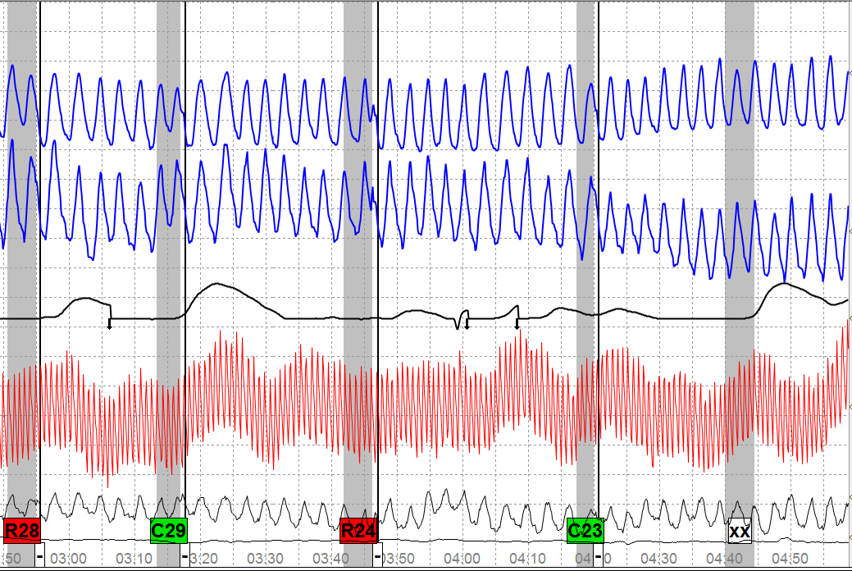
Physiological Features
Pneumograph Channel
Notes:
How would you describe the physiology in the tracings?
Would you evaluate the test data?
Identify information in other channels and questions.
____________________________________________________
File: 4084-13 - Examinee admitted to AS & flexing leg muscles at the credibility questions.
He claimed to have learned the CM in his Psychology class.
Hiding drug use

Slide 26
Physiological Features Pneumograph Channel
Notes:
There is obvious MV in the MV sensor. Has the physical MV caused atypical responses in the other channels? Explain.

Slide 27
Physiological Features Pneumograph Channel
Notes:
Do you think this is typical or atypical physiology?
Discuss the various channels.
A mental CM was performed. Examinee picked a number above 600 and counted backwards by 3s at the comparison questions.

Slide 28
Physiological Features Pneumograph Channel
Notes:
If the sensor pad movement was not present would this exam be good to go? Why? Why not?
________________________________________________________
Examinee performed an anal sphincter

Slide 29
Physiological Features Pneumograph Channel
Notes:
This should be a no-brainer.
Have students pick out the atypical physiology in each channel.

Slide 30
Physiological Features Pneumograph Channel
Notes:
Initiate a discussion regarding the test data.
Also comment on the poor operations – asking a question when hyperpnea is taking place.

Slide 31
Physiological Features Pneumograph Channel
Notes:
Do you think the test data is atypical? Why? Why not?
Discuss each channel.
Mental CM – Picked a number above 700 and counted backwards by 7s.

Slide 32
Physiological Features Electrodermal Response
What are the NCCA TDA evaluation criteria for the EDR channel?
What might cause changes in the EDR channel tracings?
How do you know when criteria and/or changes in EDR channel tracings are atypical?
Notes:
TDA evaluation criteria:
(1) Primary feature: Amplitude;
(2) Secondary features: Complexity and Duration.
What causes changes in the EDR channel tracing?
Sweat gland activity is the simple answer.
The difficult answer is that many things can cause changes in the EDR channel tracing.
Nervous tension – brought on by lying
Nervous tension – brought on by a PPP
Nervous tension – brought on by CM activity
How do you know when these criteria and/or changes in EDR channel tracings are atypical?
When they do not appear typical

Slide 33
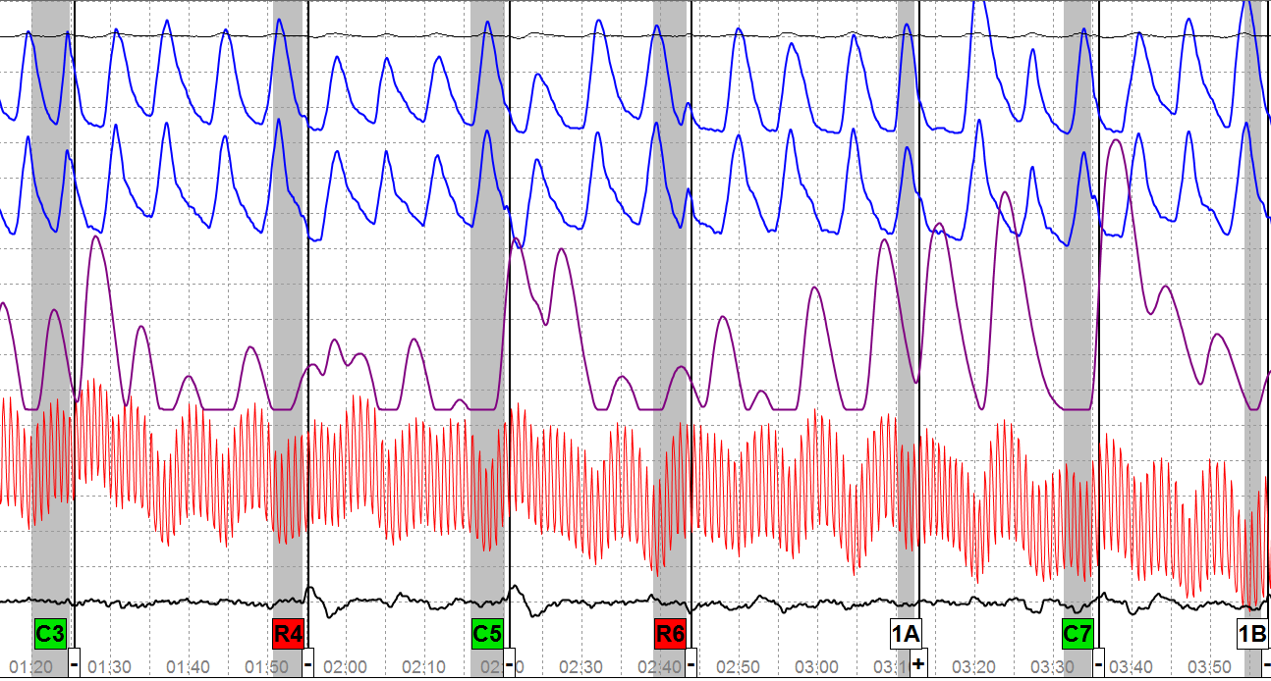
Physiological Features
Electrodermal Response
Notes:
Do you think the EDA responses look typical or atypical?
If I told you that this was the 2nd breakdown series and the 10th chart run – Would you consider the EDA to be typical or atypical?
Why do you think the EDA responsiveness appears nervous?
Do you see anything in the test data to indicate CM is taking place?
___________________________________________________________
Examinee admitted to stealing money from his employer’s cash register everyday for a two year period.
Examinee advised he was controlling his breathing every time he became anxious in an effort to lower his heart rate and regain composure.
Do you think the fact that he is deceptive to serious crimes caused the nervous EDA or the CM? Both?

Slide 34
Physiological Features Electrodermal Response
Notes:
If you ran 3 charts and this was the only chart where there was a huge EDA response – would you numerically evaluate it? Why? Why not?
If every comparison question had a huge response as depicted in the slide, but nothing at any of the relevant questions – would you think that to be atypical? Why? Why not?
What do you see in this test data that appears atypical? Anything?

Slide 35
Physiological Features Electrodermal Response
Notes:
Years ago we used to have a criminal issue R/I with hidden controls and we were told that if we saw “goal posts” it was NDI.
This is a TES format and we clearly have goal posts. In fact, 2C1 and 2C2 look just like the two DLCQs in the slide.
Would you consider this to be an NSR test? Why? Why not?
Do you think the test data is atypical? Why? Why not?
___________________________________________________________________
Examinee was pressing his toe at the DLCs the sensor pad only picked it up once

Slide 36
Physiological Features Electrodermal Response
Notes:
Movement in the EDA channel is rarely seen with wet pads. However, if the metal finger plates are used and are loose on the fingers that can be a break between the plate and finger causing a drop in the EDR tracing.
When would you consider such movements in the EDR tracing as being produced by some form of CM?
If CMs are being performed what do you think causes the drop in the EDR tracing?

Slide 37
Physiological Features Electrodermal Response
Notes:
This is another example of an EDR dropping
What do you see on this chart that may be atypical?

Slide 38
Physiological Features Electrodermal Response
Notes:
Do you see anything in the slide that may appear atypical?
Do you think there is adequate sensitivity in the PN channels and the CV channel?

Slide 39
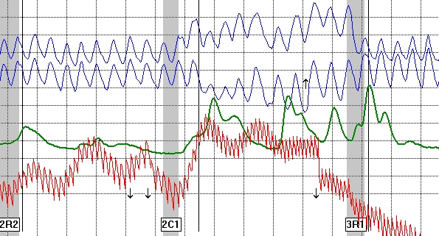
Physiological Features
Electrodermal Response
Notes:
Do you think that the EDA in this chart looks similar to the EDA in the previous chart?
Does it look like a typical EDA response?
What is different about it?
Identify everything on the chart that appears atypical?
Do you think the examiner erred by asking 3R1 rather than an irrelevant question? Explain.

Slide 40
Physiological Features Cardiograph Channel
What are the NCCA TDA evaluation criteria for the CV channel?
What might cause changes in the CV channel tracings?
How do you know when these criteria or changes are atypical?
Notes:
What are the diagnostic features for the CV channel?
Primary feature:
Amplitude increase (called baseline arousal-phasic response)
Secondary features:
Response duration
Decrease in rate
The secondary features cannot outweigh the primary feature
What might cause changes in the CV channel tracings?
Breathing – it affects the other channels
Reaction (fear of detection of deception)
Relief (returning to homeostasis)
SW, CT
Mental gymnastics
Physical MV
How do you know when it is atypical? When it doesn’t look typical.

Slide 41
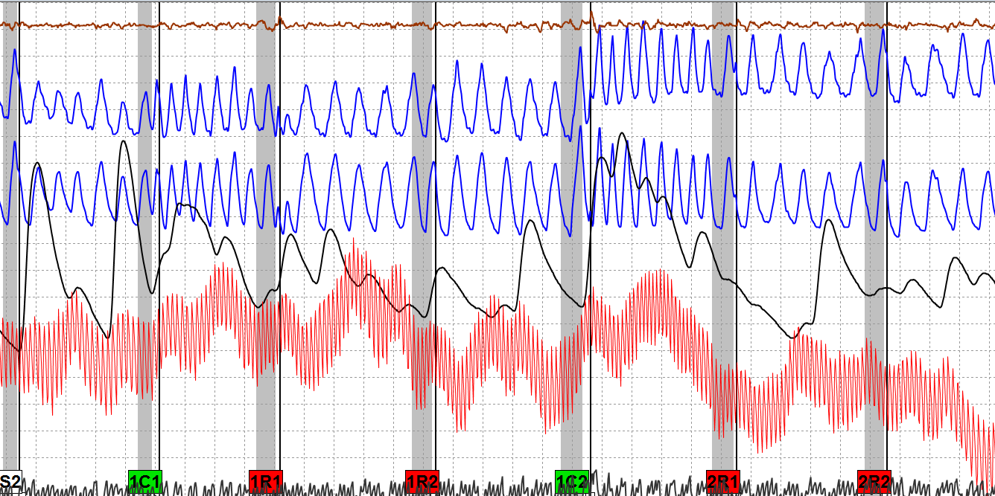
Physiological Features
Cardiograph Channel
Notes:
Do you see any physiology in this slide that appears atypical? (Identify the specific criteria)
Do you think the CV channel is typical of what might be seen in a TES format? Explain.
Do you think that the examinee’s breathing affected the other channels?
Do you think the examiner should have asked an Irrelevant question before asking the R1 question?
__________________________________________________________
This is a CM case. Examinee admitted to rapid breathing at the DLCQs and normal breathing at the relevant questions.

Slide 42
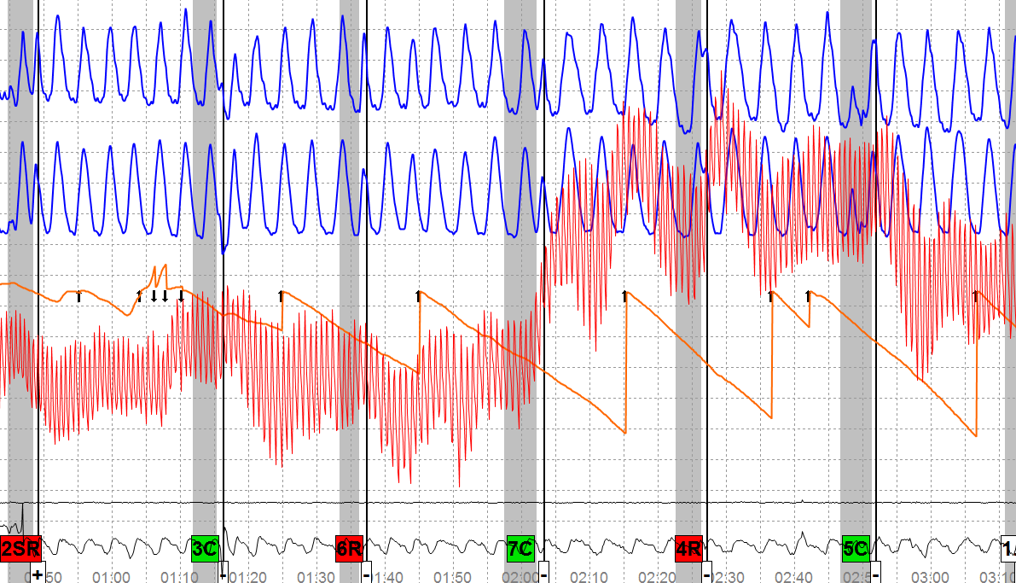
Physiological Features
Cardiograph Channel
Notes:
The slide is a breakdown test:
4R question reads, “Have you intentionally mishandled classified information?”
7C question reads, “Did you cheat in an academic environment more than what you told me about?
Do you think the test data is atypical?
Would you consider the CV channel response to be atypical if it appeared at a different comparison question on each chart?
Would you consider the CV channel to be atypical if the response appeared at 7C on every chart? Explain.
Do you see anything that might indicate CM activity?
________________________________________________________
(DIA#09 2012 02-28) Examinee admitted to mental CM activity

Slide 43
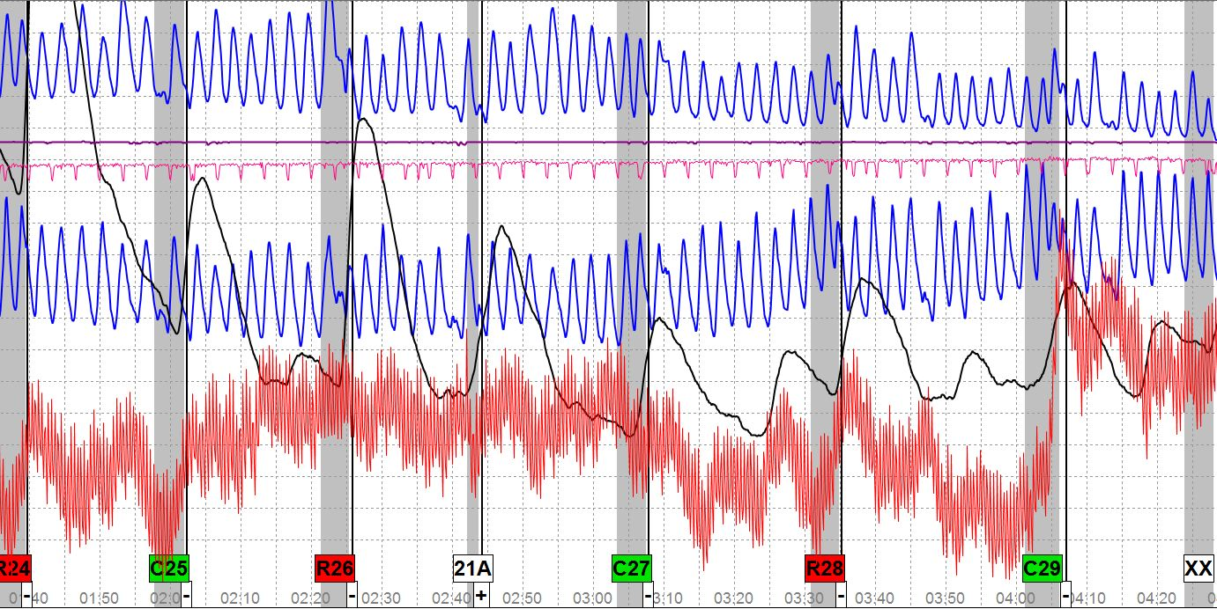
Physiological Features
Cardiograph Channel
Notes:
Do you see anything in the test data that you would consider atypical physiology?
What stands out in the CV channel?
What might cause a pulse rate of around 120 BPM? Discuss.
The examinee admitted to pressing his toe to the floor very hard, and performing the anal sphincter during this examination.
The foot and seat pad have been placed between the PN channels. Do you see anything to indicate CM in those channels?
Do you have any comments to make about the two channels?
Either the pads or the channels at the box are not working.
Examiner should always check the MV sensors before the exam.

Slide 44
Physiological Features Cardiograph Channel
Notes:
How did the anal sphincter movement at the two comparison questions affect the other channels?
The EDA channel and the CV channel at C6 began their rise at the answer, however the rise time at C4 is different – what are some causes for such physiology?
Do you think that the PN channel breathing caused the difference? Why?

Slide 45
Physiological Features Messy Test Data
Do you think there is a typical messy and an atypical messy?
In screening tests if one series is clean but the next series is messy, what does that mean?
What does it mean if only certain questions are messy?

Slide 46
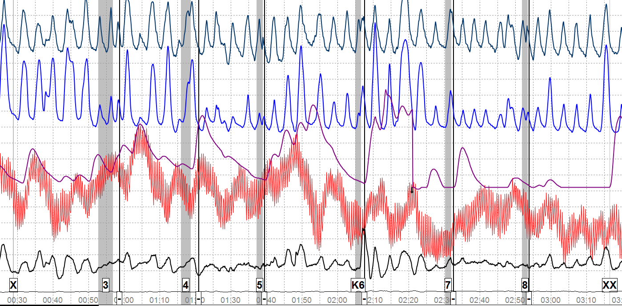
Physiological Features
Messy Test Data
Notes:
Slide is an ACQT of a screening which is part of an applicant screening process using using DLCQ.
Note the breathing change after the key. Do you think that was a righteous peak or examinee attacking the peak with CM?
Do you think the MV in the seat cushion is the result of breathing or physical MV of lower body? (The bottom line is the foot sensor).
The examiner provided a CM warning after the ACQT. Do you think it was warranted?
What do you see in the physiology that warranted a CM warning?
The next chart is chart 1 of the exam………

Slide 47
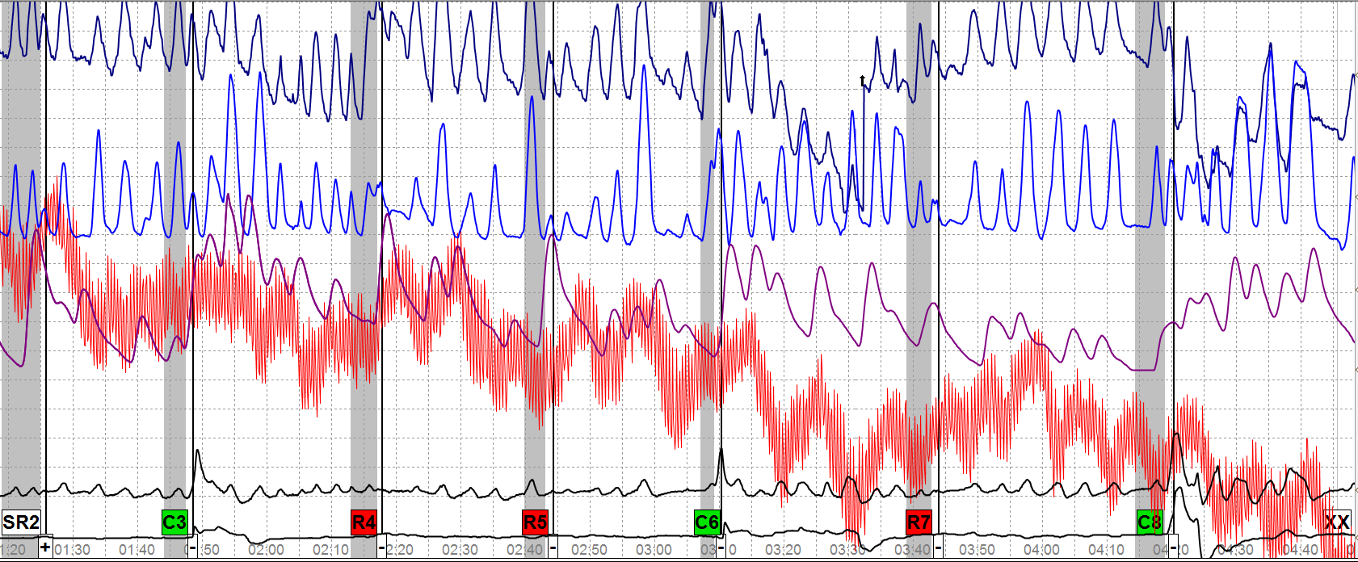
Physiological Features
Messy Test Data
Notes:
Would you consider this messy test data?
What makes it messy?
Do you see any atypical physiology on the chart?
There is MV in both sensor pads. Do you think the MV is the result of examinee’s breathing or do you think examinee is moving?
If there is atypical physiology taking place at the DLCQs do you think it also influences the relevant questions since Irrelevant questions were not asked?
R4 – Serious crime; R5 – Drug activity; R7 – Falsifying forms
________________________________________________________
Examinee admitted to curling toes, tensing his body & changing his breathing at the DLCQs to hide the fact he was cheating on his wife.
A global review of the test data suggests Serious crime & Drugs.

Slide 48
Physiological Features Messy Test Data
Stable tracing
Notes:
What do you see?
Test data is stable although there is inadequate sensitivity in all the components.

Slide 49
Physiological Features Messy Test Data
Notes:
Now what do you see?
In this case the significant change takes place only at a particular comparison question.
If we eliminated the sensor pad would you still suspect CM? Why? Why not?

Slide 50
Physiological Features Messy Test Data
PN channels and EDA stable – Cardio somewhat erratic
Notes:
Dramatic Tonic Change in Rate or Morphology
Question: What do you see?
Test data is not real pretty
PN channels are slowly dropping off the base line (Actually a decrease in amplitude)
EDA is stable
Cardio tracing is not stable – may not be firmly attached, might not have sufficient pressure, might be pressed against the body or the chair arm.

Slide 51
Physiological Features Messy Test Data
Notes:
Another example – In this case it was a mental CM not a physical CM.

Slide 52
Physiological Features Summary
It is possible to differentiate between typical and atypical physiology
We provided a nomenclature for various atypical physiological features
We explained how to identify when atypical physiology is present
Notes:
We live in an information society today – the Internet revolutionized our culture in the mid 1990’s and is a global phenomena today.
In the mid 1980’s those that performed CM were usually unsophisticated and got most of their material from reading “Tremor in the Blood” by David T. Lykken.
Today we have many performing high level CM. The average person can go on-line and find not only the test technique that will be used in their polygraph but the questions asked.
If that were not enough we have those in the polygraph profession willing to teach these individuals how to perform CM in a way that makes it difficult to catch.
For those doing overseas vetting it will become even more complex because the USG provides virtually everything dealing with polygraph to foreign governments.

