Slide 1
Anti-Countermeasures & Counter-Countermeasures
National Center for Credibility Assessment
Notes:
The anti-polygraph sites have one of two possible roles in life.
End all polygraph – because they (the one’s pushing these issues) cannot pass a polygraph.
Or, they are doing it for money. Apparently, a lot of folks that know they cannot pass a polygraph are willing to pay someone to teach them how to defeat the polygraph.
Research reveals that close to 50% of innocent and 80% of the guilty will perform some form of spontaneous CM. These CM do not effect the results of the exam taken by guilty.
In some cases spontaneous CM can effect the result of innocent (they may appear deceptive).
I suspect that if irrelevant questions are placed between the PLC/DLC & relevant questions this will not be a factor.
Objective: Explain reason for anti & counter CM instruction.

Slide 2
Anti-Countermeasures & Counter-Countermeasures
Anti-CM: Any proactive action routinely taken to preclude or deter employment of countermeasures
Counter-CM: Any reactive action taken to verify or negate a suspected countermeasure
Notes:
Anti-CM – The word proactive can be attributed to Lynn Marcy in his 1995 paper on Countermeasures presented at the 30th Annual Seminar of the American Polygraph Association at Las Vegas, NV
These are steps taken to deter CM efforts: Pretest instruction against CM and using the motion sensor pad are examples.
Counter-CM – The word reactive can be attributed to Marcy, et.al.
These reactive steps become an added part of the examiner’s mission – they are techniques used to investigate whether a CM is being used.
Examples would be the use of the “Yes” test or “Time barring” an Irrelevant question.
We will discover that there are instances where a anti-CM can be reactive and become a counter-CM (e.g., Time Barring an IRQ)

Slide 3
Anti-Countermeasures
The Lie Behind The Lie Detector found on antipolygraph.org comments that if polygraph examiner’s can identify CM why would they feel it necessary to tell examinee’s not to use them
The booklet goes on to suggest that if examiners had a reliable method of detecting CM they would be mum so they could catch people performing CM (page 162)
Notes:
The writer’s of TLBTLD do not understand that polygraph examiner’s are looking for conclusive results…not CMs.
An anti-CM instruction provides the innocent examinee an opportunity to not use CM.
In any screening examination the polygraph examiner is unbiased and wants to provide every opportunity for a successful exam.
Polygraph examiner’s do not want good employees and good applicants to cause themselves trouble by performing CM.
Anti-polygraph sites want to deliberately muck up the system in their effort to squelch polygraph.
The guilty will most likely attempt CM –

Slide 4
Anti-Countermeasures
Designed to behaviorally differentiate between the guilty and innocent examinee
Preclude innocent from using CM
Inform guilty that they will not be successful if or when they use CM
No reason to beat around the bush – everyone has open access to the internet and are actively reading the anti-polygraph sites
Notes:
We know from research that approximately 80% of guilty examinee’s will perform some form of CM.
Anti-CM instruction will let these folks know that they should not perform CM, but if they do they will be caught
We know from research that about 50% of innocent will perform some form of spontaneous CM – usually a relaxing technique such as dissociation or controlled breathing
Anti-CM instruction is designed to stop this behavior – if it does not – it is the examinee’s fault for the long day – not the examiner’s
Particularly for an applicant – they may lose their chance for a job – because they chose to listen to an anti-polygraph site
CM instruction needs to be straight forward – no beating around the bush.

Slide 5
Anti-Countermeasures Statement
All anti-countermeasures statements should include the following:
Be direct
Provide a clear warning
Identify the consequences
Obtain a commitment from the examinee
Notes:
Be direct – Do not beat around the bush – assume that everyone has Googled the words “polygraph countermeasures”
Provide a clear warning – Tell the examinee what will happen if they are caught doing CM – emphasize that it does not make any difference if they follow the web sites recommendations and refuse to admit to the CM – that approach will only make the consequences worse
Identify the consequences – Varies depending on the mission.
Applicant screening the examinee may not get the job. Best qualified do not perform CM.
Internal employees – report will be forwarded to the customer explaining non-cooperation.
Criminal suspects – CM proof of guilt.
Obtain a commitment – Verbal commitment increases jeopardy

Slide 6
Anti-Countermeasures Statement
Some are written and some are verbal – for a few agencies it is both
“John, almost everyone that comes in for a polygraph exam have ‘Googled’ the word ‘polygraph’ and ended up on a site suggesting they perform CM. Please do not attempt CM. If you are innocent of any wrongdoing research suggests you will look guilty. If you are guilty of wrongdoing, you will be caught by your own physiology, and CM will do you no good. John, can I count on you not to attempt CM during the test?”
Notes:
Most examiner’s have a CM statement to fit their personality.
We are not dictating how to approach the statement other than:
Being direct
Clearly giving the warning
If in writing – clearly identifying the consequences
Make examinee commit
At some point you need to establish commitment
This means adding the statement, (First or last name), can I count on you not to attempt CM during this test?
Obtain either a verbal affirmative or a positive nod of the head indicating they will not attempt CM

Slide 7
Anti-Countermeasures Statement
The following can be an added comment for the anti-CM statement:
“The motion sensors you see on the polygraph chair seat, arms and floor are designed to pick up physical CM and movements. If you perform any other CM suggested on the various web sites, your physiology will betray you. So, please listen to my instructions today and you will have a successful test”
Notes:
This statement is adding jeopardy to the CM statement for the deceptive individual.
If this is added then add the commitment piece here.
Once again:
Be direct
Provide a clear warning
Identify the consequences
Obtain a commitment from the examinee

Slide 8
Anti-Countermeasures
TLBTLD calls the following counter-CM, but we consider them anti-CM if used proactively
Calling IRQ ‘control’ questions
Placing a time bar on one IRQ
These techniques may work for the naïve guilty and the naïve innocent who disregard your warnings
Notes:
Some agencies may not allow a time barred IRQ on an initial series, but will allow calling IRQs “control” questions.
If they are used in the initial polygraph series they are proactive and are considered anti-CM.
If these two are used on a second series after CM suspected then they are reactive and are considered a count-CM.
Even if the examinee has read all of TLBTLD that does not mean they will remember what you are doing.
Most examinee’s that plan to perform CM will have a CM or CMs picked out will have practiced the techniques.

Slide 9
Anti-Countermeasures
If a IRQ is called a ‘control’ question and is time barred
Where do you place the IRQ with the time bar?
What do you do with the comparison questions?
Use category comparison questions
Yes – they work great in specific issue exams
Need to think about what you are doing when using category comparison questions
Notes:
A time barred IRQ should be introduced in the middle of the exam.
If it is attacked – provide time for homeostasis
Consider placing a non-time barred IRQ next to it
Stagger the time between questions (pattern avoidance)
(e.g., Before moving to SC, did you ever possess an Alabama driver’s license? Prior to this year, did you ever live in Illinois? Before your 30th birthday, did you ever join the USAF?)
Category comparison questions make it more difficult for the examinee – they now have to try and determine what is a ‘control’, what is ‘relevant’, and what is a ‘category’ comparison.
Category comparison questions can be called issue questions .
(e.g., in a child abuse case a category comparisons might be, “Did you deliberately hurt a small animal?”; “Did you intentionally try and injure a player during a football game?”; “Did you harm your best friend by talking behind his back?”)

Slide 10
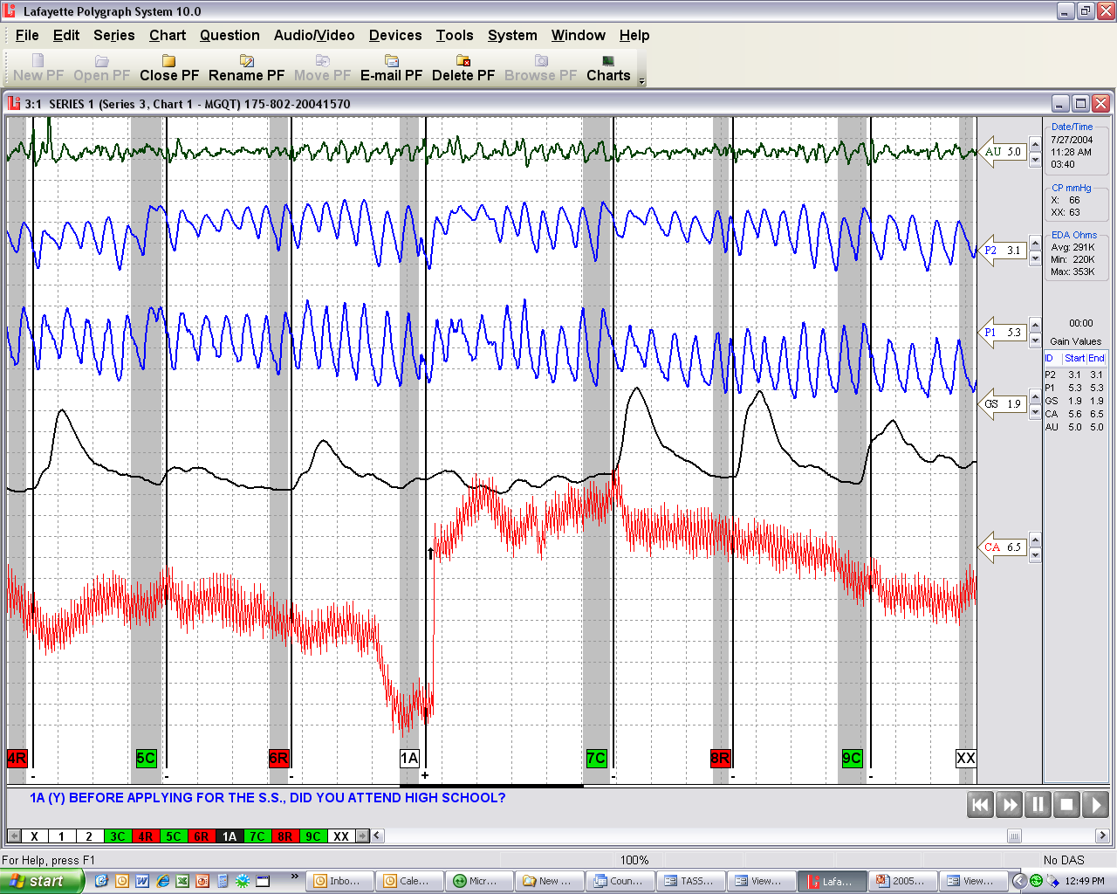
.
Notes:
The IRQ here is: Before applying ___________, do you attend high school?
What do you see that appears abnormal?

Slide 11
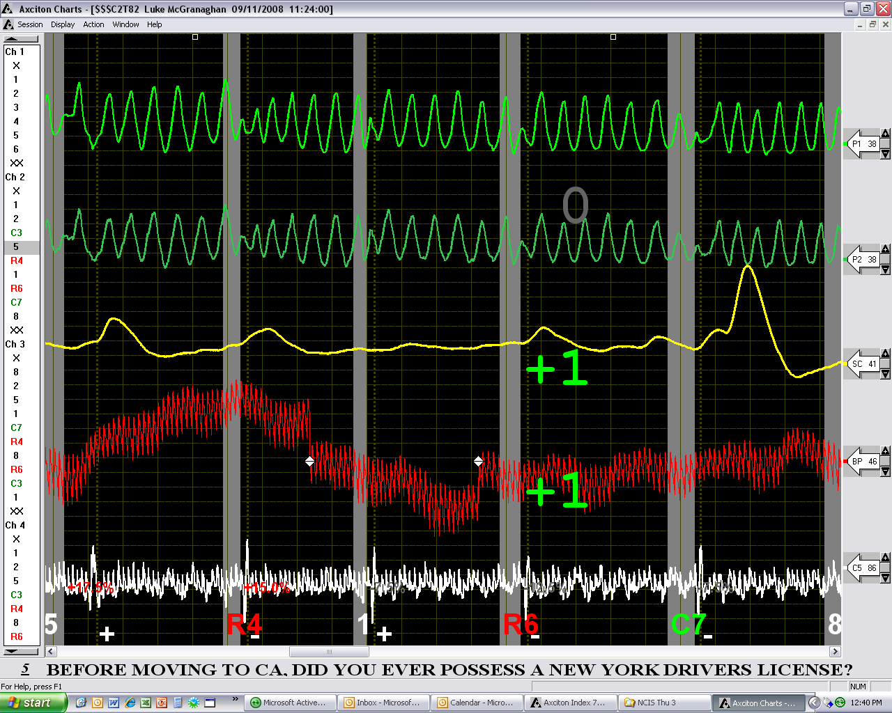
Notes:
The first question (Q5) is: Before moving to California, did you ever possess a New York drivers licence?
What do you see that is abnormal?

Slide 12
Anti-Countermeasures Counter-Countermeasures
Remind examinee to follow instructions
Tell examinee to move a toe or finger very slightly so you can adjust the movement sensor
Observe face, abdomen, fingers, arms, feet
Watch examinee during question onset and after they answer
Make sure examinee knows you are watching
How can we do that?
Notes:
Examinee’s know the purpose of the sensor pad – make it clear that you can pick up movements
If they are going to do CM this will often push the CM to mental CM, tongue bites, or both – GREAT!
Most CM will take place during the question onset or right after the answer
Look at examinee’s body, jaw line, arms, legs, and feet
If you see movement give a MI followed by an IRQ
The type of exam may determine the approach to take
Approaches will be discussed in the classified CM course

Slide 13
Counter-Countermeasures
ACQT
Direction and Control
IRQ – Pattern avoidance
Strategically place time barred IRQ
Repeat IRQs
Repeat CQs
Notes:
ACQT – 2 approaches when key is attacked – (1) “I see very little response at the question you lied about, but I now have everything balanced to your physiology, we should have no problems today”, (2) “You made a commitment to me that you would not perform CM, yet you did during this test – If you continue to perform CM it is going to be a very long and unpleasant day for the both of us – stop the manipulations now!” [Obviously other comments can be made]
Direction and Control – Remind examinee to follow your instructions; adjust the CM cushion as outlined earlier; Give MI if observed; if examinee’s eyes close during the test tell examinee to open eyes then follow with a time barred IRQ
IRQ – Pattern Avoidance – Ask an IRQ after a CQ or RQ then 10 or 15 seconds later follow with the next CQ or RQ.
Strategically place time barred IRQ – If CMs are suspected
Repeat IRQ or CQ – after last question on test if CMs suspected

Slide 14
Counter-Countermeasures
Specialized techniques:
Repeat last word test
Yes test
Silent answer test
CM test (separate series)
Notes:
Specialized techniques – Some agencies may prohibit certain tests, so check with your agency before attempting some of these techniques.
Repeat last word test – If CM are suspected this is an exam that will increase cognitive load making CM more difficult [Explain]
Yes test – Identified in TLBTLD – still a method to consider to validate CM activity [Explain]
Silent answer test – A test that is often abused. Used for one chart to see if erratic physiology is normal or abnormal; also used when examinee SN or DB before answering every question. [Explain]
CM test – Explain when and why this might be considered. Give examples.

Slide 15
Countermeasures question to consider?
If I see CM at the CQ or the IRQ but no or very little response at the RQ, can I make an NSR/NDI decision? Why? Why not?
Notes:
No – If the examinee’s total focus is on the CM, and the examiner does not use proper operations a RQ can appear to have very little response.
See the next slide as an example:

Slide 16
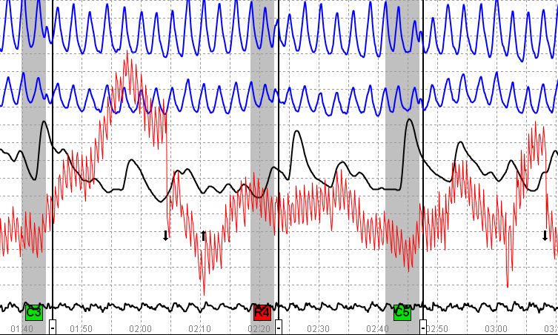
Notes:
Examinee is continuing to respond at C3 after 30 seconds – an IRQ should have been asked to bring examinee back to homeostasis.
If the examiner had done so, R4 would have had a significant response.
Examinee admitted to controlling his breathing and flexing muscles. He did so to hide both unreported criminal activity and drug use.
What do you see in the tracings that appear abnormal for the second series of a screening exam?

Slide 17
Counter-Countermeasures Maintaining Control
Be confident:
Be direct
Provide a clear warning
Identify the consequences
Obtain a commitment from the examinee
Be observant
Be critical
Be conservative
Be an expert
Notes:
Be confident – When discussing CM activity during the pretest
Be observant - If you see CM activity – take action
Be critical - If you choose to continue testing after CM attempts question every anomaly
Be conservative - This is in both global and numeric evaluations
Be an expert - If the examinee performs CM hard enough to affect the test data – the CM activity will leave a marker – learn what the markers are and trust what you see

