Slide 1
Countermeasures
“Suspicion is healthy but paranoia is crippling”

Slide 2
CAUTION!
Do not…repeat…not put anything that you learn today into the public domain.
Do not…repeat…NOT tell the examinee how you detected his CMs.
Do NOT…repeat…NOT put anything about CMs onto the Internet, directly or indirectly.

Slide 3
CM Definition
Any action taken to affect a polygraph examination by using behavioral, physical, mental and/or pharmacological measures, regardless of the examinee’s honesty to the tested issue(s).

Slide 5
The first big Internet CM case Peter S. London
February - June 1997
Case Study #1
London, Peter S. & Krapohl, Donald J. (1999). Polygraph, 28 (2), 143-148.

Slide 6
Initial Case Facts
Applied for position with a sensitive Govt. agency.
Highly desired because of his education & scientific/technical experience.
Nothing from his background investigation prepared the examiners to expect CMs, which were:
  Sophisticated, multi-layered, and involved outside coaching.
After confessing to other issues, he laid out his CM methodology, providing an educational opportunity for the polygraph profession.
Notes:
6
5
4
4
4

Slide 7
First Session
Pretest interview
42 year old male
Very likable
Intelligent
Well educated: Ph.D.
Global knowledge
Confident
Cooperative
Good verbal & nonverbal behavior
The pretest interview took longer than usual because the subject talked so much about his background in defense technology and counterintelligence matters.
The examiner was kept busy making notes and asking questions, as the subject went from topic to topic.
The subject later confessed that this had been a CM strategy on his part. Overload the examiner with so much detailed info that he managed control the direction of the pretest and to avoid areas he wished to conceal.
Notes:
7
6
5
5
5

Slide 8
End of First Session
Information obtained
  Weapons technology
  Attempting to sell technology to two foreign intelligence services
There were unresolved reactions on the charts
Notes:
8
7
6
6
6

Slide 9
Second Session the next day
Re-examined by the same examiner.
Much of the same information discussed.
Conducted a breakdown on concealing contact with a foreign intelligence service.
There continued to be unexplained reactions on the charts
Notes:
9
8
7
7
7

Slide 10
Third Session - 4 Months Later
Objectives
A different examiner conducted test: Peter London
Resolve foreign intelligence contacts
Explore potential penetration of U.S. Intelligence
Explore selling of weapons technology
Notes:
10
9
8
8
8

Slide 11
Pretest
As a military officer, he had served as a General’s aide.
  At meetings, he assessed participants’ verbal, nonverbal behavior, and briefed the general on whom he believed to be truthful or not.
  London and John sized each other up, decided each knew a lot.
John admitted his PhD was honorary, not earned; and awarded by an organization, not a university. He has since been deliberately misrepresenting his academic background.
John also admitted manipulating the previous examiner by information overflow.
London attached the sensors and ran the first chart.
Notes:
11
10
9
9
9

Slide 12
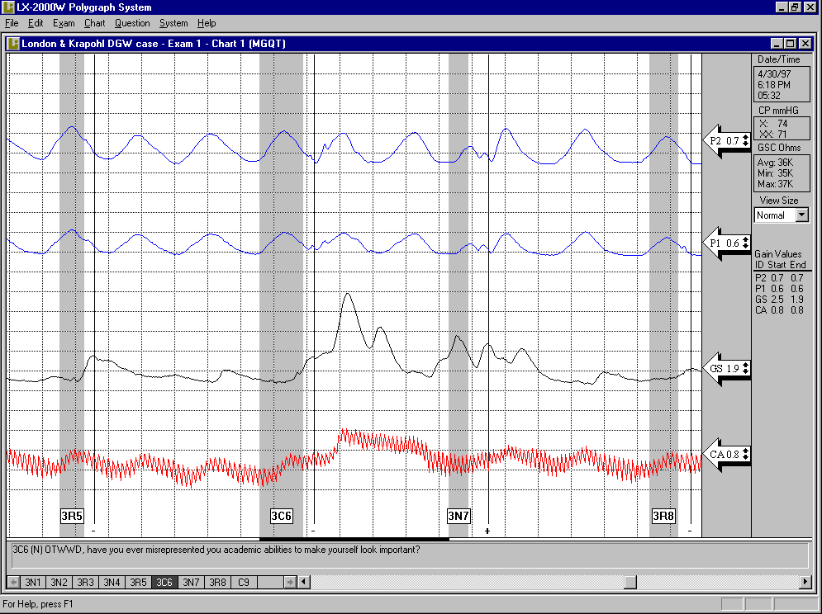

Slide 13
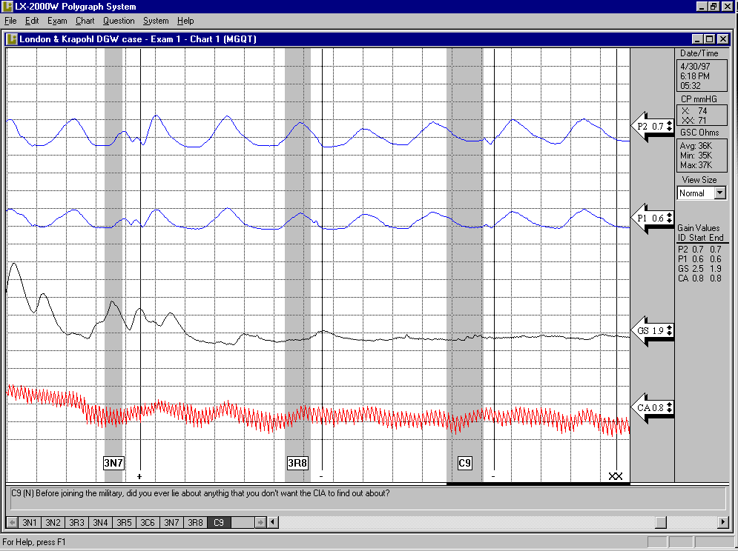

Slide 14
Data Collection
London suspects possible CMs.
  Observed slow breathing
  not always a CM
Why a big response on 3C6, but nothing on C9?
London then ran the 2nd chart.
Watched Subject very closely between questions.
  No movements
  No visual indicators of manipulation
Notes:
12
11
10
10
10

Slide 15
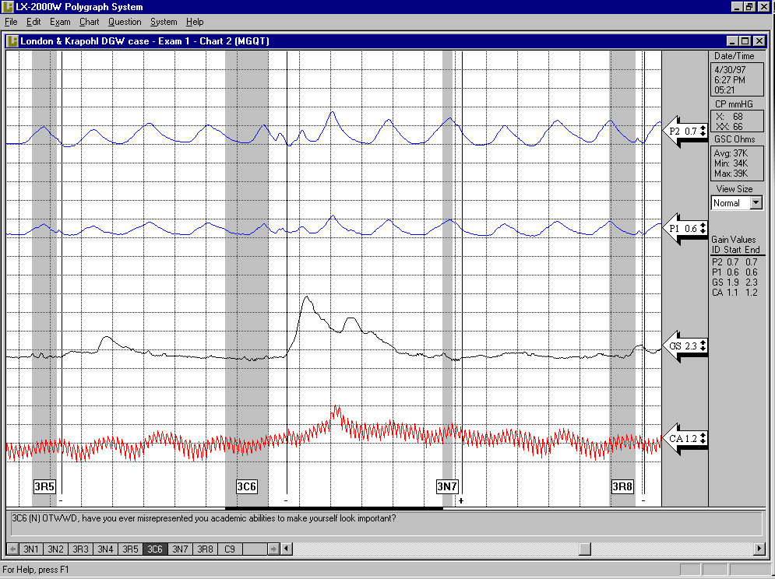

Slide 16
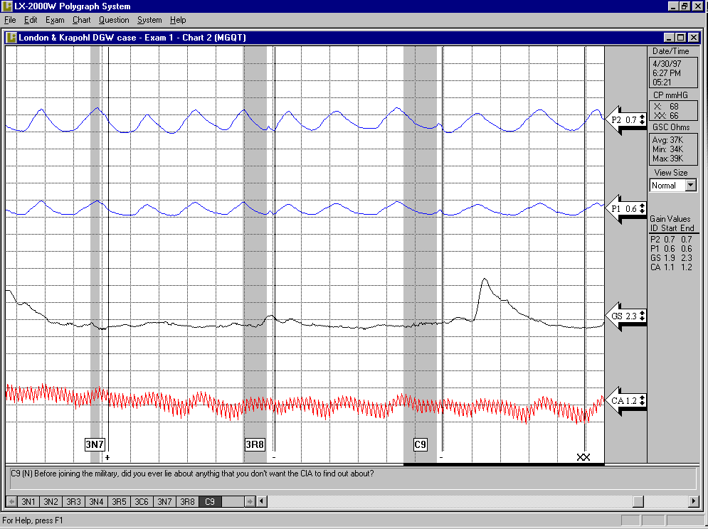

Slide 17
Increased Suspicion
Slow breathing - too consistent.
Controls - too much response.
Controls - similar responses; like from a cookie cutter.
Never looked at examiner between charts.
Unable to determine exactly what John was doing to create the reactions, London decided to run a 3rd chart to verify that the reactions were deliberate.
  Watched more intensely
  Repeated controls back-to-back to collect evidence that supported Subject using CMs
Notes:
13
12
11
11
11

Slide 18
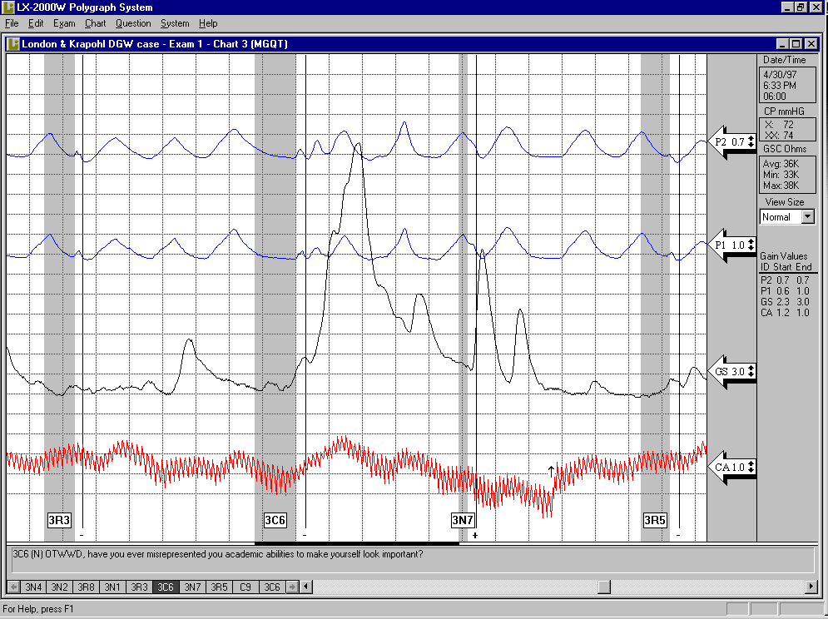

Slide 19
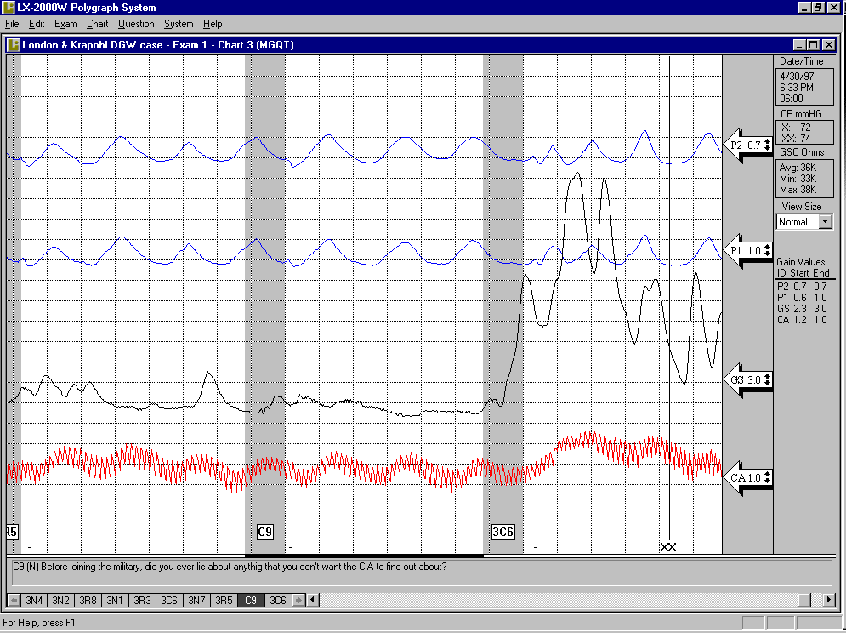

Slide 20
Posttest on CMs
Interrogated re manipulating the test. London didn’t mention the C word.
At first - who me?
Themes
  it was obvious what he was doing
  credibility diminishing
  too smart to throw everything away
  conducting an experiment
Notes:
15
13
12
12
12

Slide 21
Subject’s Confession re: Preparation
When he was called back for a third exam, he decided to apply countermeasures.
Accessed Internet and library resources
Bought and studied “How to Sting the Polygraph”
Called Doug Williams to discuss CM strategy.
Tried buying polygraph
Bought cardio cuff to practice sphincter & tongue bite.
Practiced controlling his breathing.
Thought out and rehearsed a detailed CM strategy involving behavioral and physical CMs.
Notes:
17
14
13
13
13

Slide 22
Subject’s Confession
Regarding CMs
Biting tongue on charts 1& 2
Anal sphincter contracted on chart 3
Would not look at examiner
He did not recognize C9 as a CQ, hence did nothing on that question.

Slide 23
Tongue bite

Slide 24
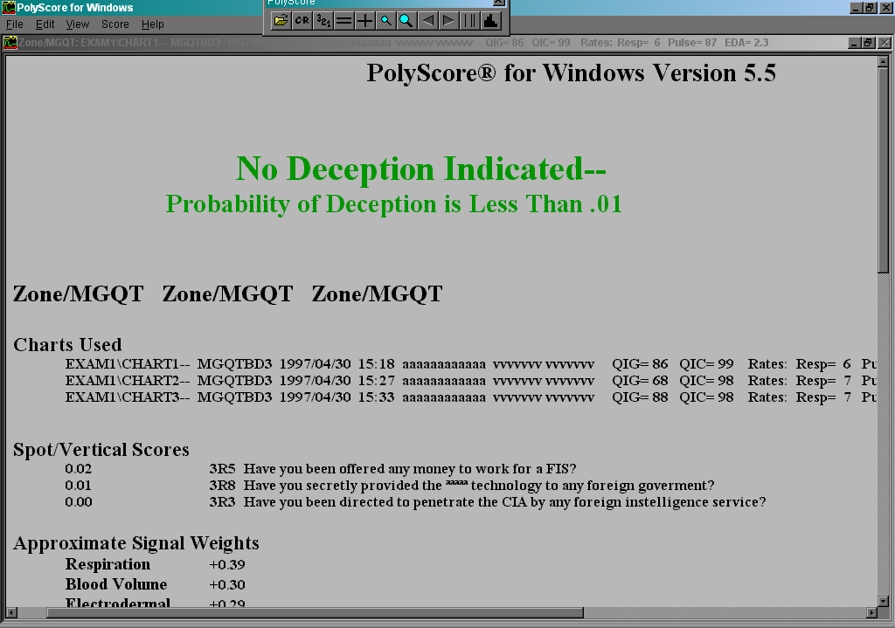
PolyScore results: NDI

Slide 25
How & why he was caught
Peter London was alert for countermeasures.
Once his suspicions were aroused, he devised a plan for confirming their use.
He interrogated. He persisted.
  He didn’t accuse him of using countermeasures.
  He provided plausible rationalizations.
  He provided advantages for coming clean about them.

Slide 26
Types of CMs
MENTAL
Spontaneous Countermeasures
Specific Point Countermeasures
General State Countermeasures
PHYSICAL
Spontaneous Countermeasures
Specific Point Countermeasures
PHARMACEUTICAL
General State Countermeasures
BEHAVIORAL (Krapohl 1996)
General State Countermeasures

Slide 27
Sophistication Levels
Low Level
Instinctive, not taught. No authoritative
information.
Pre-internet (before 90’s)
Mid Level
Self taught. Knows about polygraphs, CQTs, CMs
Primary threat today because of internet
High Level
Trained. Coached by an examiner.
Practice tests.

Slide 28
General State CMs
Include anything that a subject might do to affect him or herself throughout the test. They include:
  Pharmaceutical
  Fatigue
  Anti-perspirant applied to the fingers
Used to inhibit reactions. Mainly drugs, some mental, but seldom physical in nature.
NONE of these are likely to be effective against the CQT, although they might be effective against the GKT…..don’t know for sure.

Slide 29
Spontaneous CMs
Spontaneous CMs are attempts at influencing the examination outcome and are conducted without apparent forethought or planning.
Usually movement or mental CMs
Limited field data on spontaneous CMs.

Slide 30
Examples of Spontaneous CMs
Honts, Raskin, Kircher & Hodes, 1988 reported the following spontaneous countermeasures:
Mental Countermeasures
Relaxation
Disassociation
Self-deception
Imagery
Rationalization
Physical Countermeasures
Attempts to Control Breathing
Biting Tongue
Attempts to Control Heart Rate
Attempts to Control Physiology
Pressing the Toes to the Floor

Slide 31
Specific Point CMs
Specific Point CMs attempt to alter a polygraph test outcome by changing a subjects physiological reactivity at specific places in the test.
Turned off and on at specific points
Movement CMs, biting tongue, pressing toes against floor

Slide 32
Specific Point CMs
Almost always used to create reactions, not inhibit them.
Always mental and physical, never chemical/drug.
Effective against CQT. Probably effective against GKTs, though less so, because use is suspicious.
Presumed largely ineffective against R&I tests.

Slide 33
Mental CMs
Hypnosis
Attempts to create amnesia
Rationalization
Self justification to reduce responses
Mental Exercises
Math, Exciting thoughts, counting and other thinking exercises
Dissociation
Mentally isolated from consciousness

Slide 34
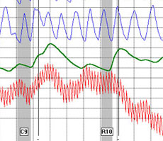
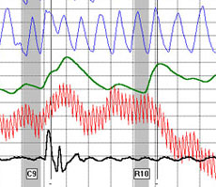
Use a Motion Sensor!
Without CM Sensor Detection
With CM Sensor Detection

Slide 35
Rules
Look at the chart.
Decide whether the examinee is attempting to manipulate the tracings.
After each chart I will show the same chart with the motion sensor turned on.
All, none, or some of them are manipulated.
Ready?

Slide 36
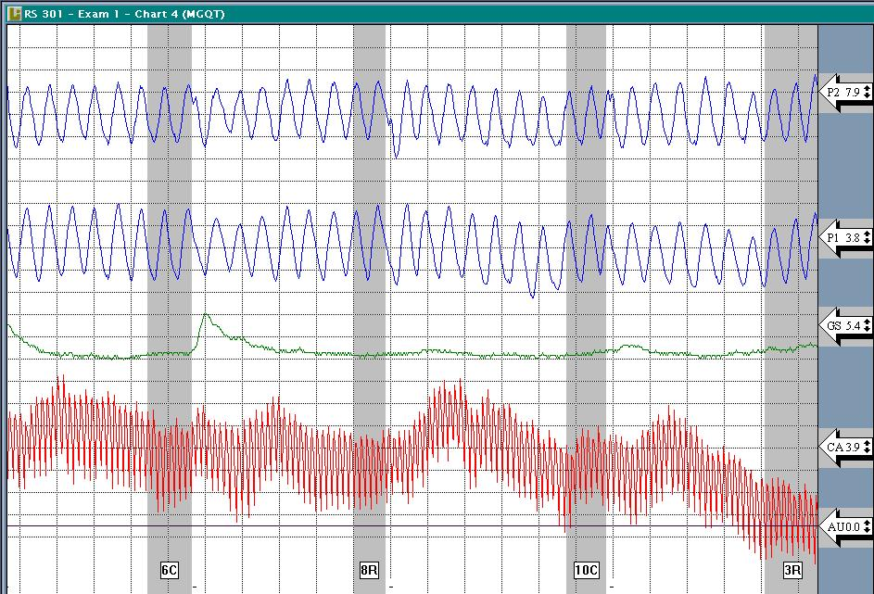

Slide 37
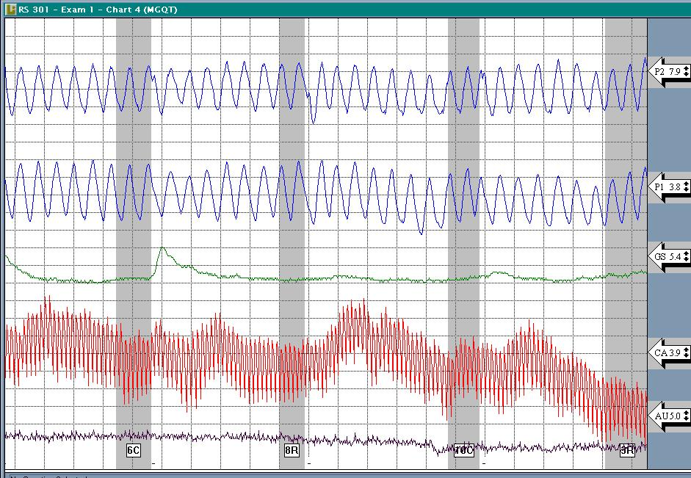
NO

Slide 38
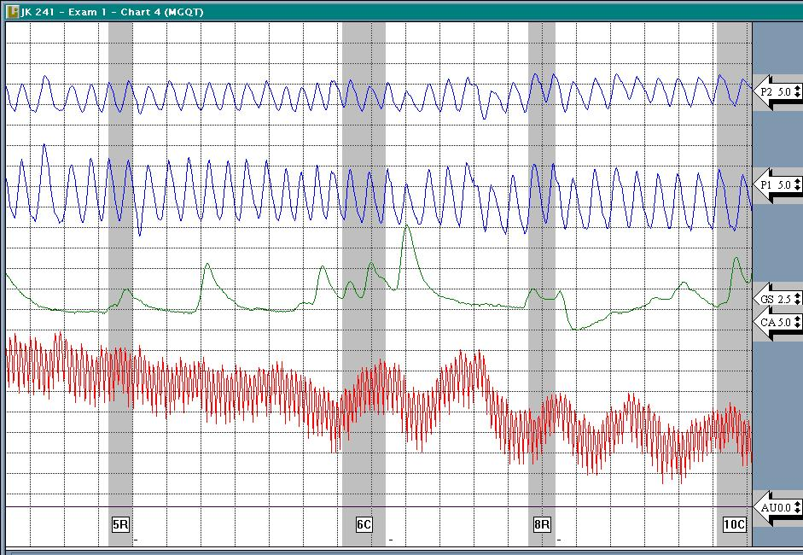

Slide 39
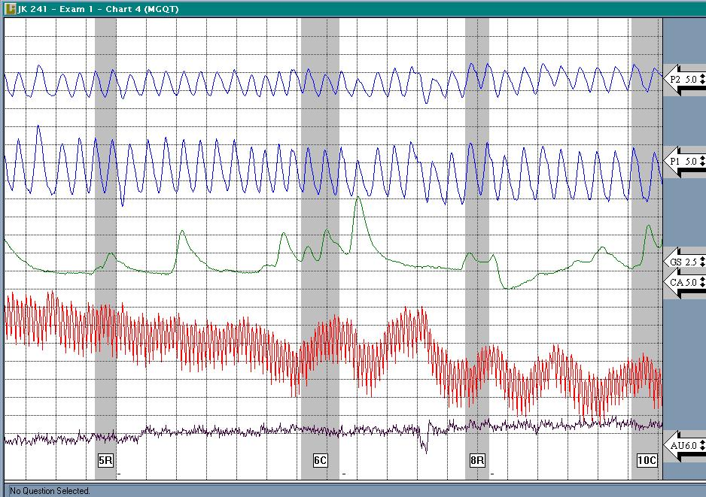
Yes

Slide 40
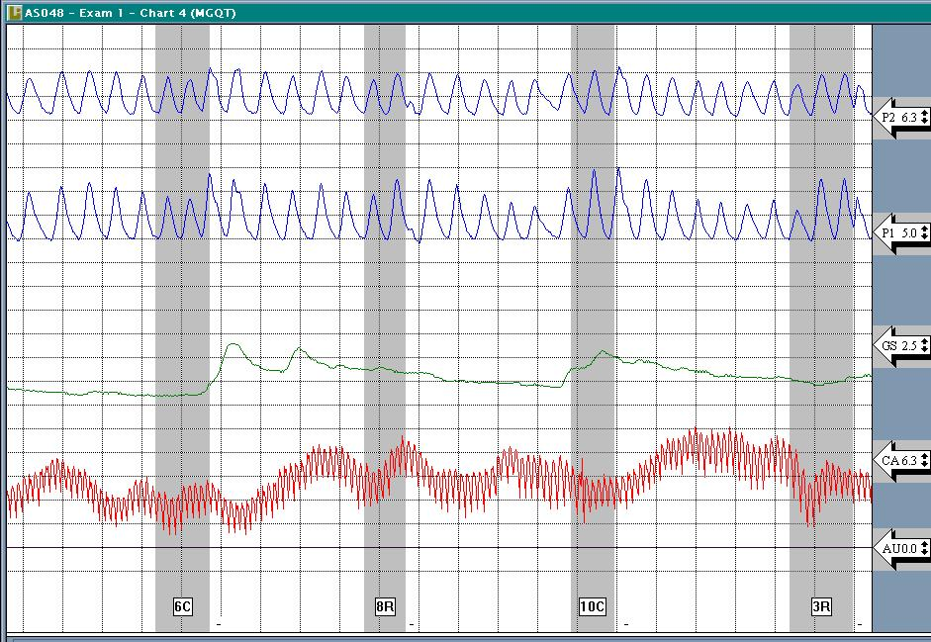

Slide 41
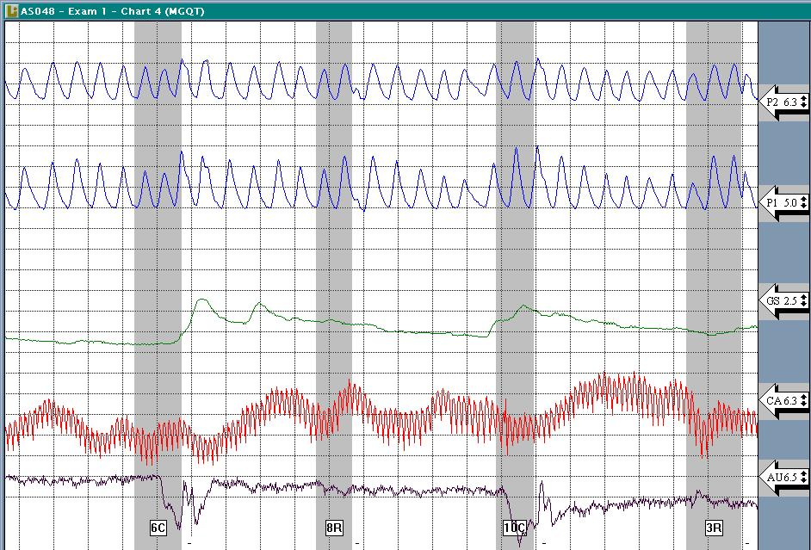
YES

Slide 42
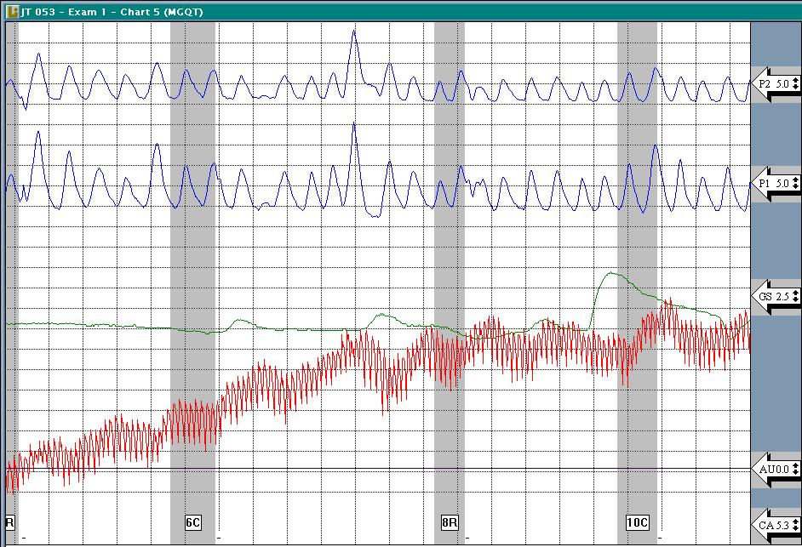

Slide 43
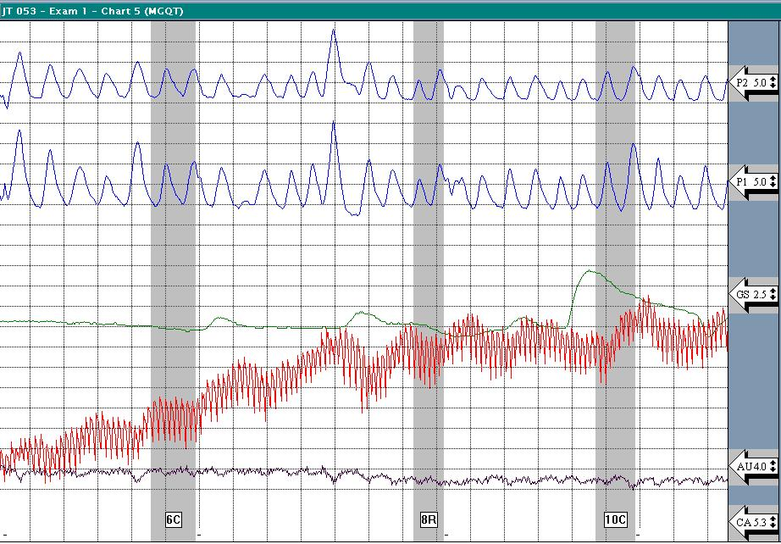
NO

Slide 44
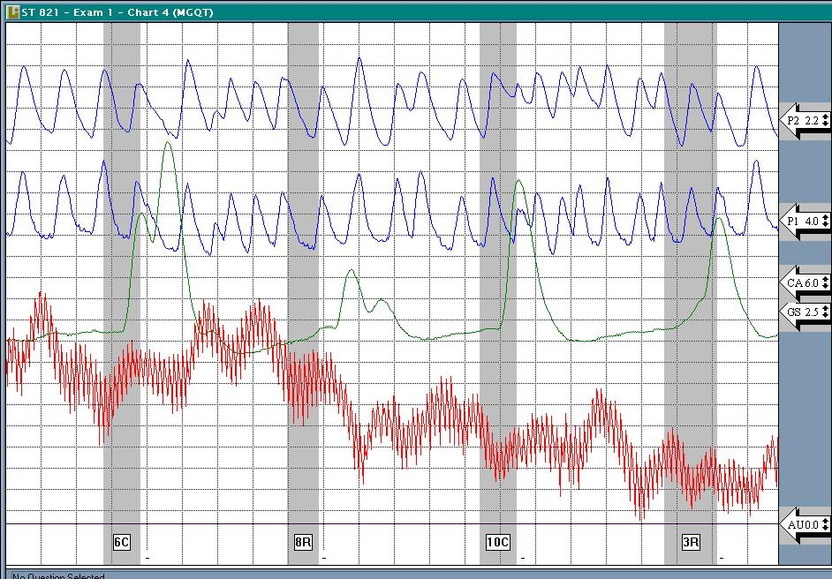

Slide 45
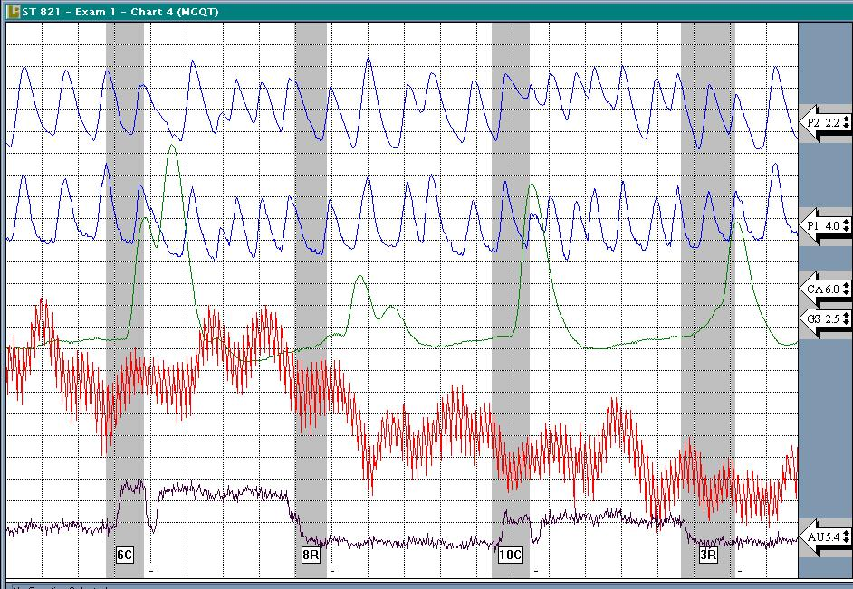
YES

Slide 46
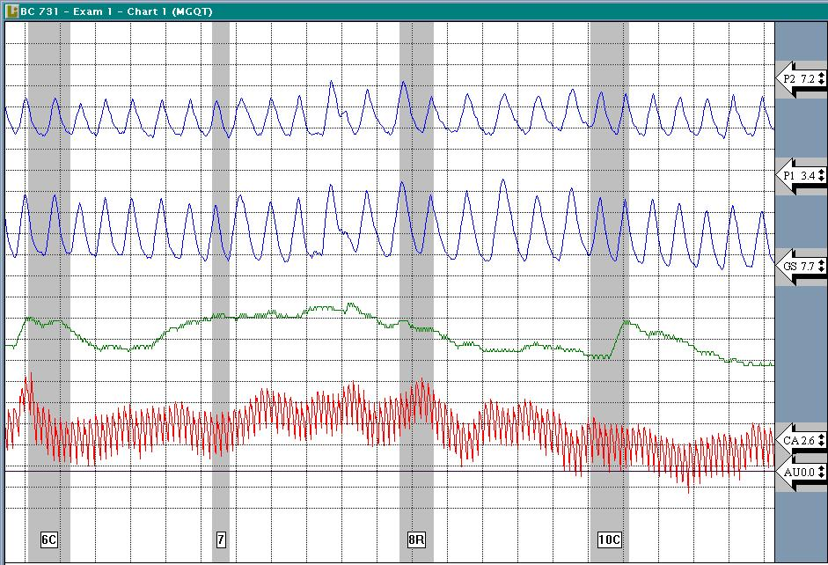

Slide 47
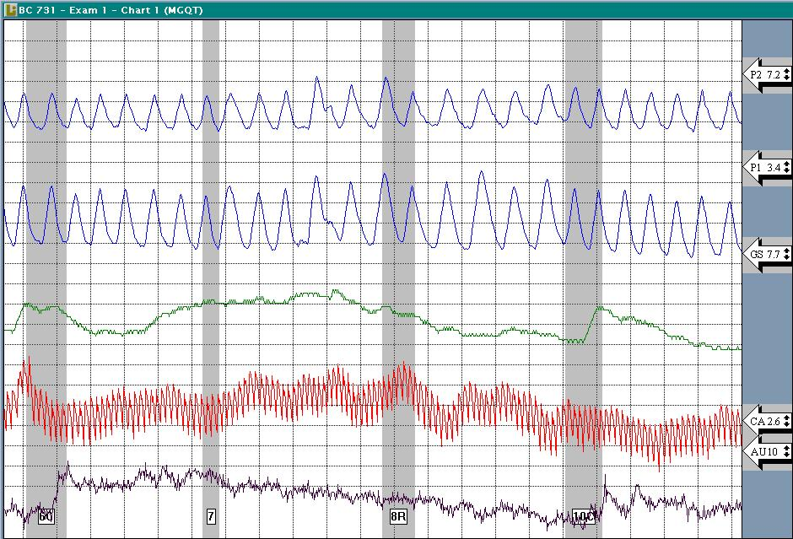
YES

Slide 48
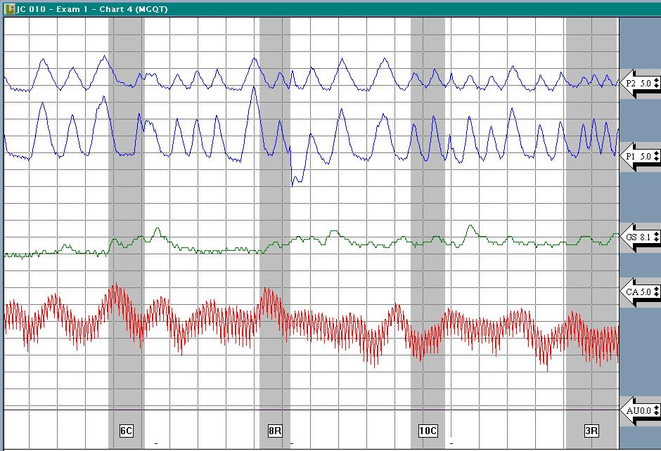

Slide 49
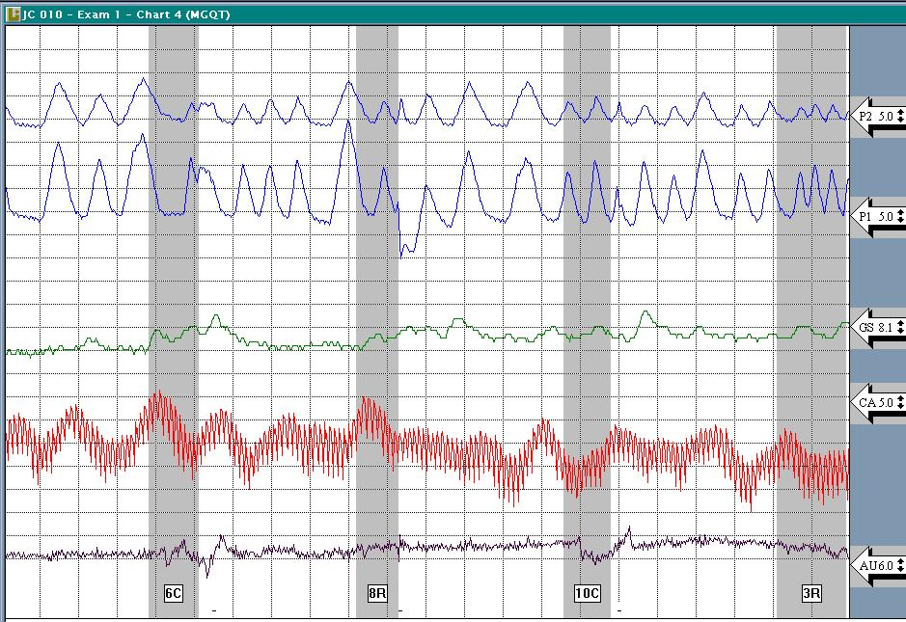
YES

Slide 50
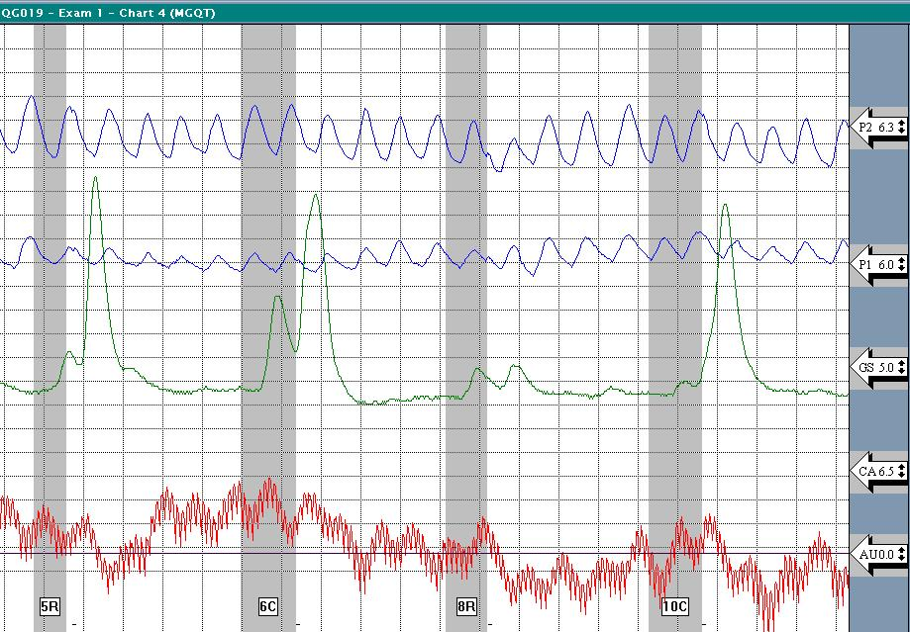

Slide 51
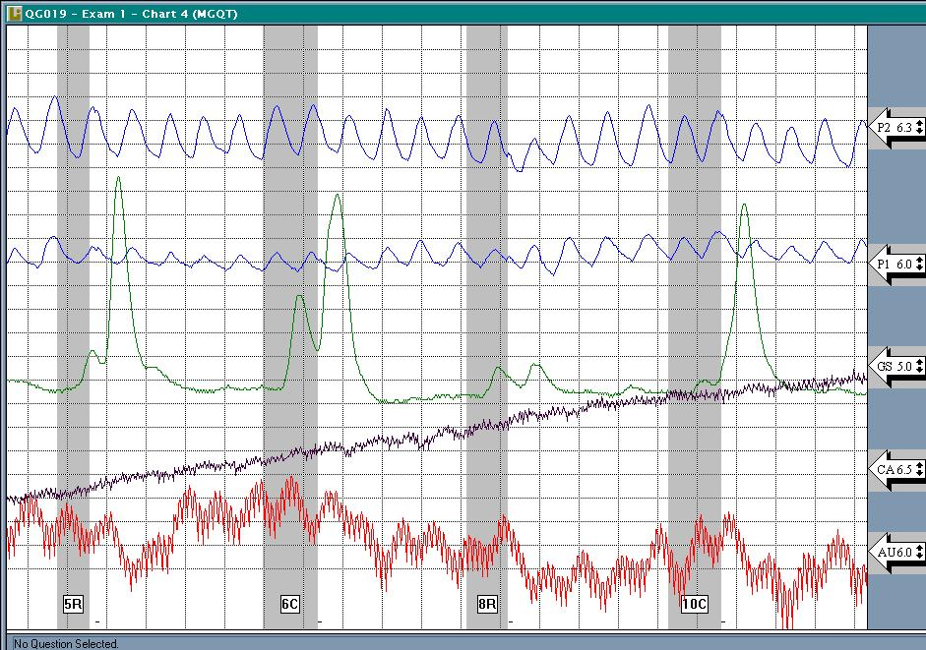
NO

Slide 52
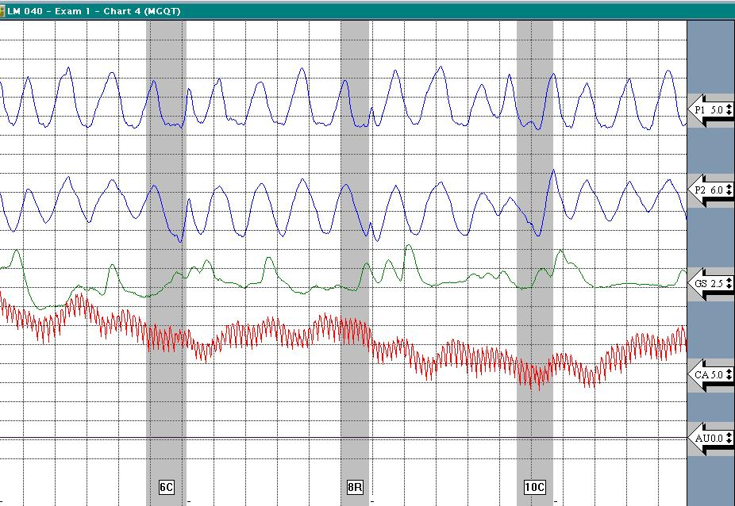

Slide 53
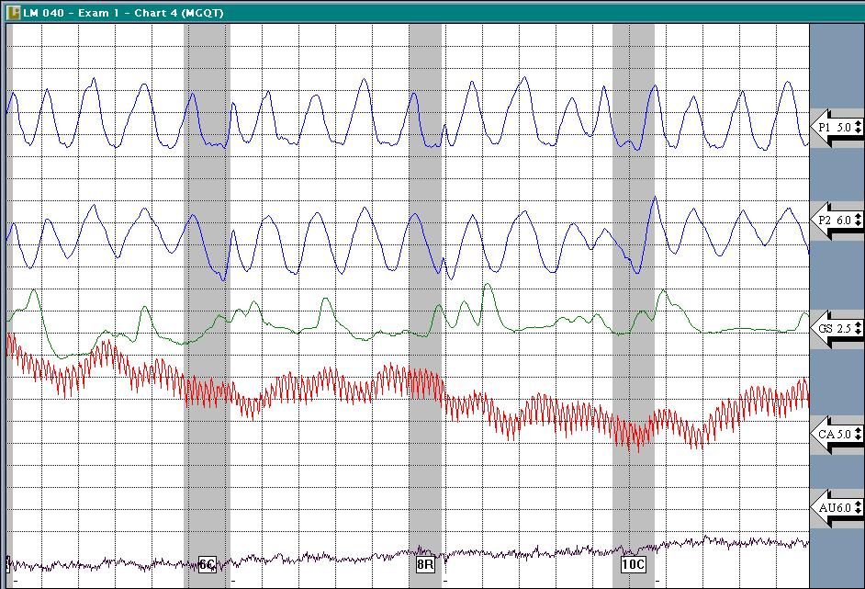
NO

Slide 54
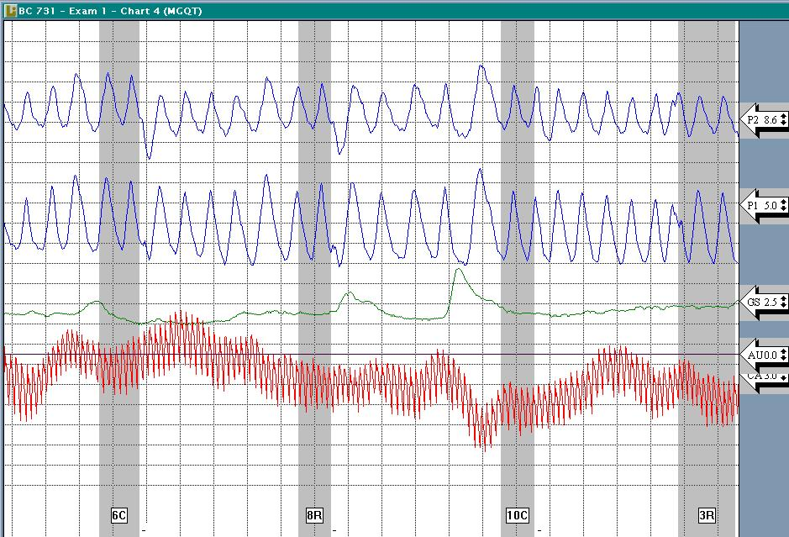

Slide 55
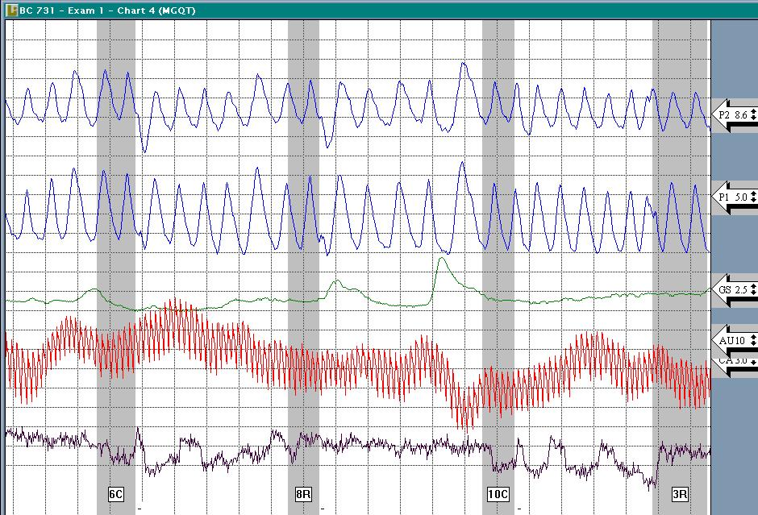
YES

Slide 56
Grading Scale
10 Correct = A
Less than 10 correct = buy a motion sensor

Slide 57
Physical CMs
Controlled breathing rate
Movement
Muscle tensing
Anal Sphincter muscle contraction
Pressing toes against floor
Pressing thighs against the chair
Crossing eyes
Squinting eyes
Gritting teeth (watch for jaw movement)
Pressing tongue against roof of mouth
Pain
Biting tongue (watch for jaw movement)
tack in shoe
Press tongue against sharp object in mouth (watch for jaw movement)
Fatigue

Slide 59
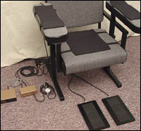

Slide 60
Pharmaceutical CMs
Prescribed drugs taken in excess such an anti-depressants or narcotics.
Non-prescription drugs such as sleep aids and cold preparations.
Illegal drugs taken prior to an examination.

Slide 61
Behavioral CMs
Include an examinee’s attempt to affect the interpretation of the data or manipulation of the examiner or the examination process (Eddie Haskall)
Communication CM’s – sending false verbal and non-verbal signals to the examiner
▪ A deliberate overflow of information given to the examiner

Slide 62
Insert Video of Eddie Haskall like behavior

Slide 63
Impact of CMs on Innocent Examinees
Innocent subjects who used countermeasures produced more negative scores (M = -3.91) than did Innocent subjects who did not attempt countermeasures (M = 4.55).

Slide 64
Law of Inequalities
Whenever you see a reaction on a comparison question that’s “too good to be true,” it’s probably artificial.
Whenever you see a reaction on a relevant question that’s “too good to be true,” it’s probably genuine.
Therefore, whenever you see a reaction that’s “too good to be true,” probe!
  Never tell them it’s “too good to be true.”
  Don’t show them the charts (don’t give any biofeedback)
  Never explain what aroused your suspicions.

Slide 65
Keys to Identifying CMs
Atypical Physiology
Specificity
Frequency
Clusters

Slide 66
What must be done to work?
A CQT: The CM must reverse the differential reactivity between relevant and comparison questions so the comparison questions evoke stronger responses than the relevant questions.
A GKT: The CM must alter the subject’s physiological responding so that the Keys consistently produce smaller responses than at least one of the Foils.
For both tests, the CM must be applied in a way that is not detectable by the examiner, through an observation of the subject or the physiological data.

Slide 67
Pneumo Channel
False Apnea
Exaggerated Exhalation
Hyperventilation
Answer-like Distortions
Loss of Parallelism
New Permanent Baseline
Bradypnea

Slide 68
Hyperventilation
Two types
  More rapid breathing rate than is normal for the individual (usually more than 23 cycles per minute)
  Significant amplitude increase

Slide 69
False Apnea– Holding

Slide 70
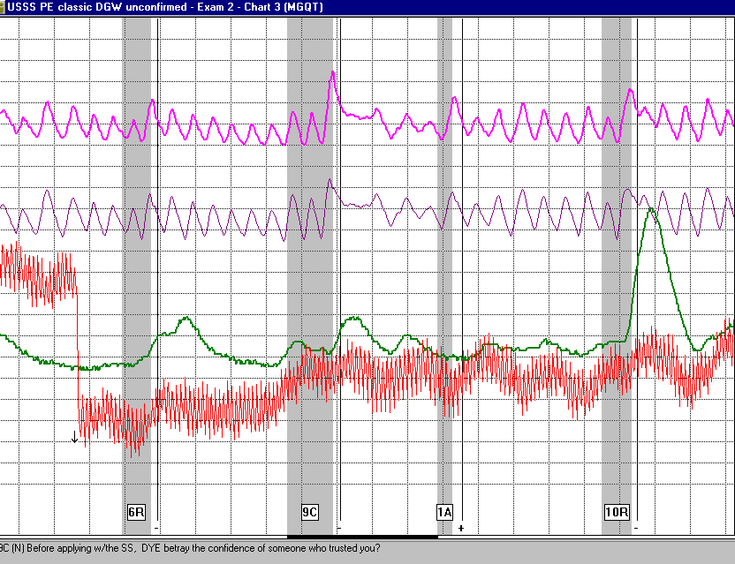
False Apnea - Holding

Slide 71
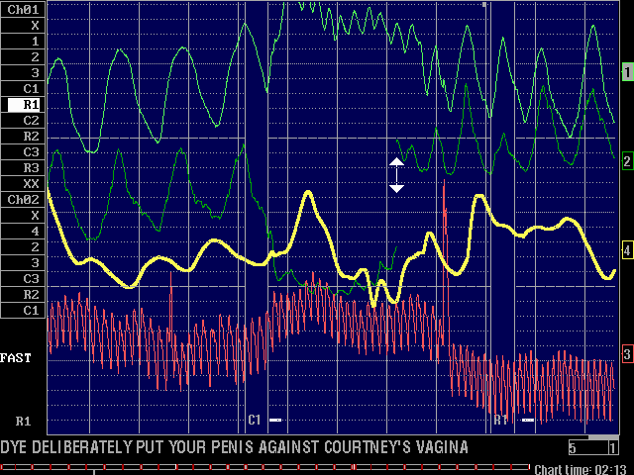

Slide 72
SDB (1/6 secs = 10/min)
DGW #4
Baselines diverge
Suspicious activity
Movements
Massive, prolonged response
Sexual molestation Simmons: Aug 1998

Slide 73
Insert examples of each Pneumo

Slide 74
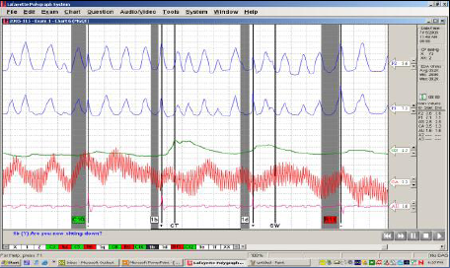
Answer-like Distortions
Lip Biting on Neutral Question

Slide 75
EDA Channel
Labile EDR
Inconsistent Latency
Exaggerated
Downward Spike

Slide 76
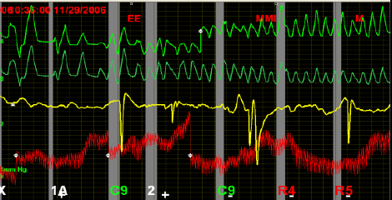
Downward Spike

Slide 77
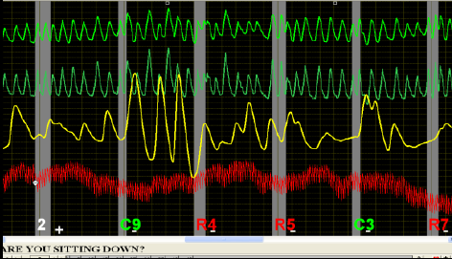
Labile EDA

Slide 78
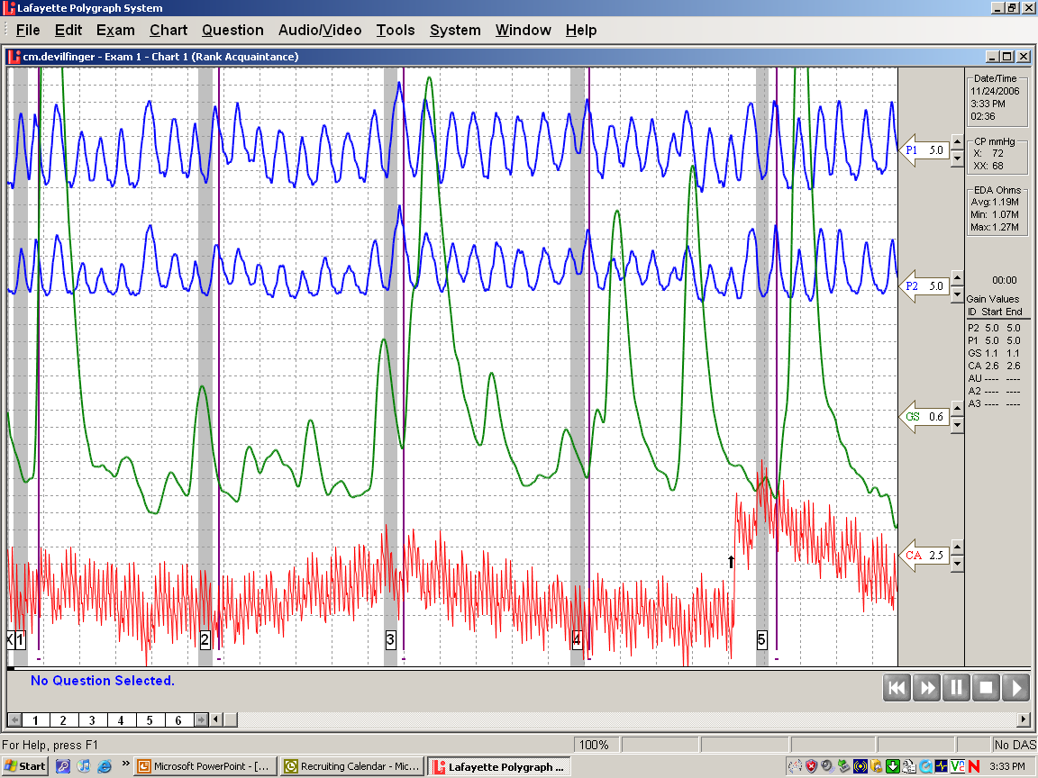
Labile EDA

Slide 79
Insert Inconsistent Latency and Exaggerated EDA

Slide 80
Cardio Channel
Exaggerated Blood Pressure Increase
Compound Blood Pressure Response
Heart Rate (<60 or >100 bpm)
Inconsistent Response Latency

Slide 81
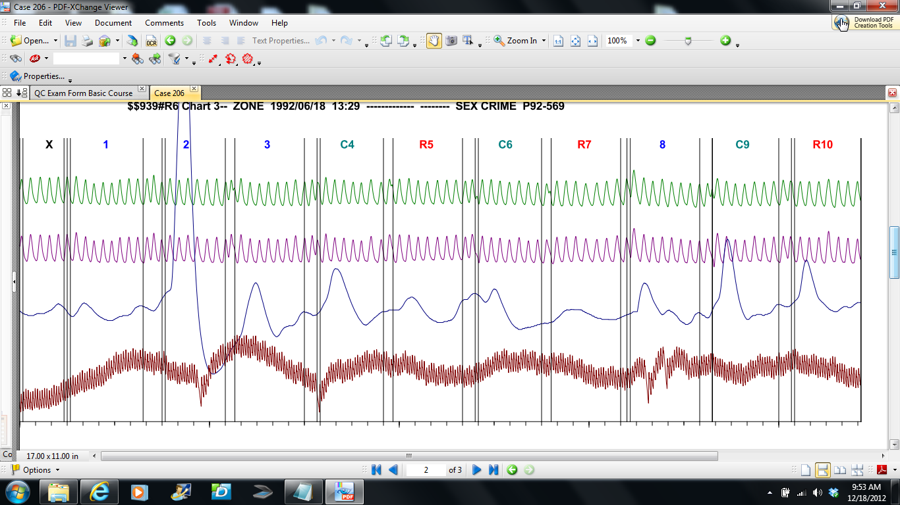
PVC’s not CM’s

Slide 82
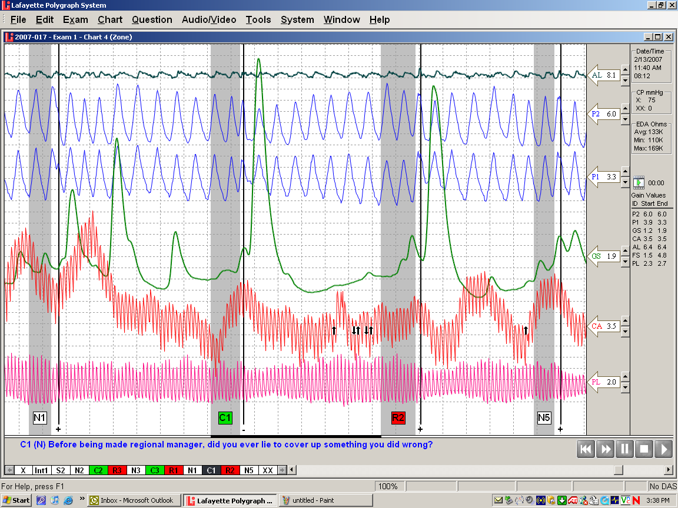
Rapid Rise Cardio

Slide 83

Same shot with Foot Sensor

Slide 84
Movement- cardio

Slide 85
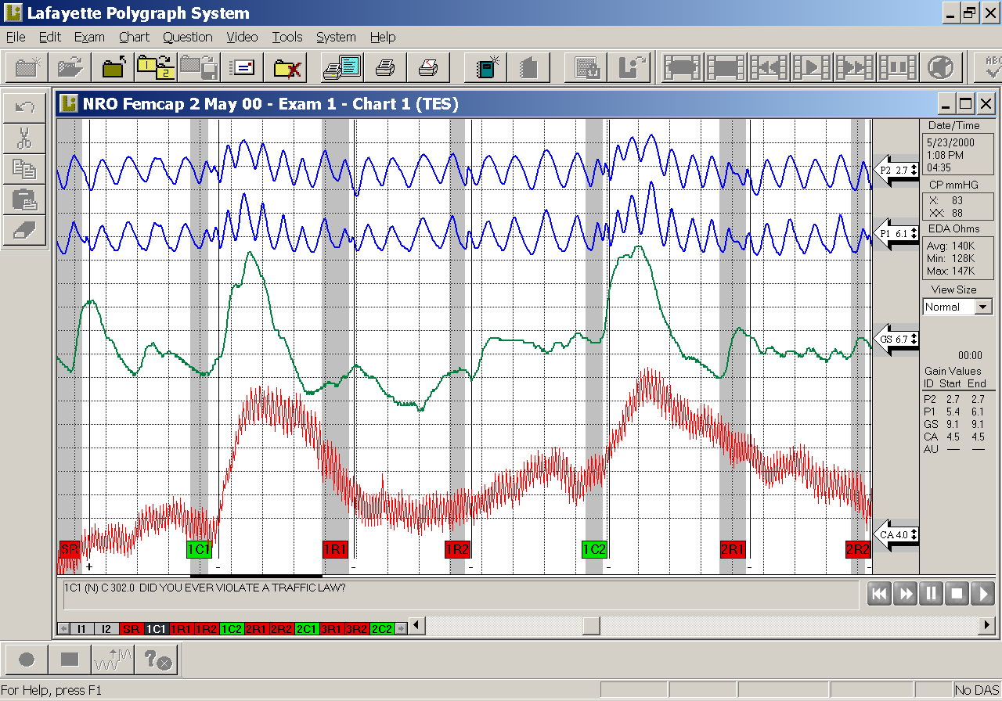
Exaggerated Cardio Response

Slide 86
Insert Cardio examples

Slide 87
Other CM Considerations
Messy data (erratic tracing or over 100 bpm)
Cookie Cutter responses
Dramatic change in rate or morphology within or between charts
Answer delays (late answers to CQs)

Slide 88
Examples of other CM considerations

Slide 89
False Apnea
True Apnea (Blocking) is rare and occurs more often at RQs than at CQs
High frequency of blocking at CQs may indicate CMs
False Apnea (Holding) occurs at other than the bottom of the tracing.
False Apnea often has immediate recovery.

Slide 90
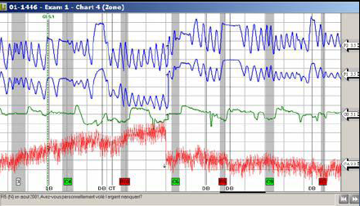
False Apnea - Holding

Slide 91
True Apnea
True Apnea is infrequent.
More often at RQs than at CQs
High frequency at CQs may indicate CMs

Slide 92
Exaggerated Exhalation Cycle
Similar to false apnea
One cycle of drawn-out exhalation
Often falling below baseline
Immediately followed by a single deep breath

Slide 93
Hyperventilation
90% breathe at 10 – 23 bpm
20% faster is an indication
Significant amplitude increase indicative of hyperventilation

Slide 94
Misplaced or Multiple
Answer-like Distortions
On what side of the respiratory cycle do we typically see answers?
How long does it take to say “yes” or “no”
Accurate markings are critical
Look for answer delays
Look for sharp increases in the cardio

Slide 95
Loss of Parallelism
Diverging or converging
Slight or exaggerated
Usually accompanied by other signatures

Slide 96
New Permanent Baseline
The baseline can be up or down
Normally at comparison question
Can be dramatic or subtle

Slide 97
Bradypnea
Resting respiration seldom below 10 bpm
Rare exceptions

Slide 98
Labile EDR
Excessive electrodermal activity
Often in constant motion
Responses frequently found well after points of answer

Slide 99
Inconsistent EDR Latency
Stimulus onset to response onset
What is atypical?

Slide 100
Exaggerated EDR
Globally out of proportion
Frequency

Slide 101
Downward Spike of EDR
EDR does not have parasympathetic innervations
Look for patterns

Slide 102
Exaggerated Blood Pressure Increase
Rapid rise and/or prolonged response duration
Common at RQs for DI examinees
Not common at CQs
Virtually non-existent at Neutral Questions

Slide 103
Secondary Blood Pressure Response
Sharp rise in cardio followed by a secondary rise
“Compound cardio”

Slide 104
Tachycardia & Bradycardia
Tonic pulse rate in excess of 100 bpm strong likelihood of either deception or CMs
Less than 60 bpm

Slide 105
Inconsistent Cardio Response Latency
Consistent with EDR latency
Contrast latencies of CQs with other questions

Slide 106
What’s #1 in a Google Search?
Wikipedia
Antipolygraph.org
HowStuffWorks.com
Police-Test.net
SkepDic.com
Polygraph.com
WikiHow.com
PassaPolygraph.com

Slide 107
Pre-test Statements
“ Lots of info out there regarding polygraph. I always like to address
Any concerns or misinformation. Many people try to prepare
For their exam. What research have you done?
“If you do anything to intentionally manipulate the results
of this examination, then it may negatively affect your process.”
“If someone tries to manipulate the data, it will make me
think they have something to hide.”
“Doing things to distort test, can cause inconclusive results. Promise
me you won’t do anything to distort the test.”

Slide 108
Your Agency’s CM Policy
Know what your agency will do to both suspected and confirmed CMs.

Slide 109
Anti-countermeasure and
Counter-Countermeasures
ACM = done prior to the intest to deter CMs
CCM = what is done to negate the effects of CMs already being done.

Slide 110
Pretest ACM
“Doing things to distort the test can cause inconclusive results. Promise me you won’t do anything to distort the test.”
Designed to behaviorally differentiate between the guilty and innocent subjects
  Preclude innocent from using

Slide 111
ACM Pretest
Introduce neutral questions as CQs
Use event or category bars, or use time bar at end of CQs.
  Prior to working at XYZ Company, have you ever lied to a co-worker?
  Have you lied to a family member before this year?
Time-bar some (not all) neutral questions
  Before moving to Florida, did you possess a drivers license?
  Prior to 2010, did you ever drink water?
Use movement sensor and sell its use

Slide 112
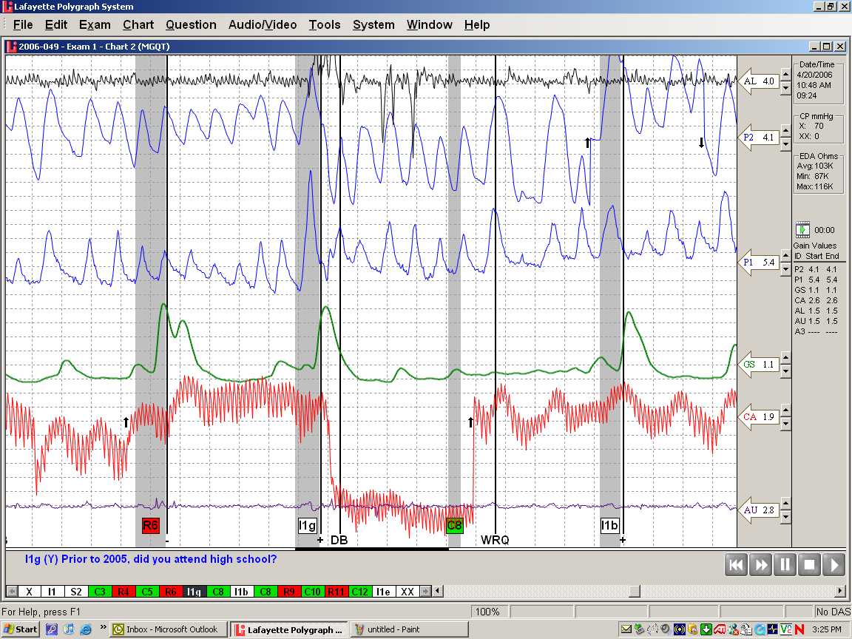
I1g-Prior to 2005, did you attend high school?

Slide 113
Who attempts CMs?
According to a 2001 study on CMs (Honts, Amato and Gordon)
89.6% of Deceptive subjects
45.8% of Non-deceptive subjects

Slide 114
ACM/CCM
Watch the subject!
  Arrange room so you can observe the chin, fingers, abdomen, maybe even toes
  Focus on Subject, especially during question onset
  Ensure Subject knows you are watching

Slide 115
CCMs
Only use this if you are 100% sure they did CMs on the Key in the ACQT.
  If you see Subject using CMs on Key in ACQT, tell them after ACQT that the Key didn’t respond as strongly as you expected, but it will work.

Slide 116
CCMs
Intersperse Neutral Questions
  Repeat Neutral Questions
  Hint: Utah Zone Question Sequence is not mentioned in Maschke’s manual!
Provide direction and control to Subject
  “Look up”
  “Don’t move around”

Slide 117
More CCMs
Run a separate series with CM questions
  Ex. Did you do anything to manipulate the test today?
  Do NOT just throw in CM questions in a regular format! Make it a separate series! Why? Because then you are introducing another issue being tested! More issues = less accuracy.
Silent Answer Test (answer distortions)
Yes Test
Repeat Last Word

Slide 118
Silent Answer Test
“John, I’m going to conduct another test…
  “It is a little different”
  “Instead of answering aloud, listen, answer truthfully…but silently.
  You can instruct them to slightly (nose moves no more than a ¼”) nod to make sure they are paying attention.

Slide 119
Yes Test
Helpful in cases wherein Subject has tried to evade detection by distorting tracings
Instruct Subject to answer all questions “yes”
With CQT, advisable to drop CQs
No DI/NDI decision from this data!

Slide 120
Repeat Last Word
Used when CMs are suspected
Examinee is instructed to repeat the last word of the question and then answer with “yes” or “no”

Slide 121
Honts, et al (2009)
In a study using both probable-lie and directed-lie examinations, Honts et al (2009) debriefed participants about their spontaneous use of countermeasures.

Slide 122
Honts et al (2009)
Overall 48% reported attempting a countermeasure.
Probable-lie 50% attempted
Directed-lie 46% attempted
Of the Guilty 78% attempted
Probable-lie 83% attempted
Directed-lie 72% attempted (p = .095)
Of the Innocent 18% attempted (p > .001)
Probable-lie 15% attempted
Directed-lie 20% attempted

Slide 123
Sequence
  Listen for “buzz words”
  “control question,” “comparison question,” “LEPET”
  Refer to it in post-test
  2. Obtain admission to a conduct
  “I can see that you were doing some things during the test that you weren’t supposed to do.“
  Ask what else?

Slide 124
Sequence
3. Acquire Subject’s understanding as to why he did it.
4. Have Subject relate where and when the activity was employed (on which questions).
5. Ask when he decided to employ the tactic.
6. Get the why

Slide 125
Post-test CM Actions
When you know CMs were used
  Interrogate
When you only suspect CMs
  Proceed with caution
  Provide non-threatening reminder
  Collect more data
  Seek a second opinion
  Probe

Slide 126
Questions to Cover
Who did you get it from?
  Doug Williams
  Instructor at the academy
  Friend
What did you do exactly?
What did you think was going to happen as a result of doing this?
Where did you learn about it?
When did you decide to use it?
When during the exam did you do this?
How did you do it?
Why did you do it?

Slide 127
CM Themes
“You just got bad information!”
“You were afraid of a false positive”
“You were only trying to be helpful”
“You like to experiment with things”
“You are curious about what would happen”

Slide 128
Apnea
Is this diagnostic Apnea? No!
Is this diagnostic Apnea? No!
Is this diagnostic Apnea? Normally, yes!

Slide 129
Insert Confirmed CM charts
With and without motion sensor tracing showing

Slide 130
How to Report CM Results
When a person used CMs, even if on only one chart, never call that person NDI.
DON’T use the word “Countermeasures”
How to report Suspected CMs
“The polygraph tracings are not what are typically seen in polygraph examinations. The tracings are consistent with what I have normally seen in confirmed cases where intentional manipulation has occurred.”

Slide 131
Suggestions
Avoid using time-barred CQs
If you decide to run consecutive comparison questions (to confirm suspected CMs), do so after running your protocol number of charts. In other words, run an extra chart once you have already run the total number of charts you need for a conclusive examination.
If you are not comfortable with the chart data (i.e. suspect CMs), it is permissible to interrogate on NDI, DI, or NO conclusions.

Slide 132
Suggestions
Run a minimum of 15 seconds of data before the X on each chart.
“Don’t try to make anything happen, don’t try to prevent anything from happening, just be still during the examination.”
If you suspect CMs, run a “Repeat the last word, and then answer” chart.
Look for delayed answers!
Time-bar ONE Irrelevant Question. Do NOT time-bar all Irrelevant Questions! Place it right before a middle or later CQ in the sequence!

Slide 133
Suggestions
Keep an eye on your Subject
Get more than 2 cycles of homeostasis before beginning your next question.

Slide 134
Exercise
Create the following question template:
X
Are the lights on?
Bite your tongue
Squeeze your sphincter
Scream in your head
Clinch your teeth
Curl your toes
Cross your eyes
Think exciting thoughts
Flex a muscle
Control your breathing
Are you now sitting down?
XX

